Slide 1
Fetele si femeile se conecteaza pentru mobilitate

Slide 2
De ce este important să privim schimbările climatice dintr-o perspectivă de gen?
Notes:
Schimbările climatice nu sunt neutre din punct de vedere al genului, iar pe parcursul acestui document vom pune în context de ce.

Slide 3
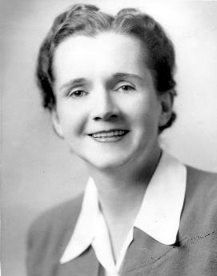
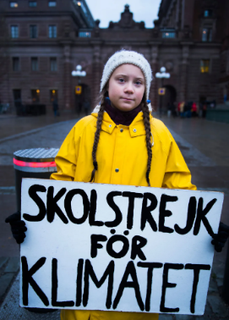
Rachel Carson
Greta Thunberg
Autoare a publicației de referință "Silent Spring" din 1962, care denunță impactul asupra mediului al utilizării pesticidelor, denunțând practicile incorecte ale industriei chimice. I se atribuie meritul de a fi dat startul mișcării ecologiste din anii '60.
Tânără activistă care a inițiat mișcarea "Vineri pentru viitor" în urma promisiunii sale de a face grevă la școală în zilele de vineri pentru a determina guvernul suedez să acționeze în privința schimbărilor climatice. Pe 15 martie 2019, peste un milion de elevi din întreaga lume s-au mobilizat pentru greva școlară pentru climă și au mărșăluit în orașe din întreaga lume.
Notes:
Dacă ne gândim la mișcarea pentru mediu și climă, este posibil să ne vină în minte figuri feminine. De la Rachel Carson, care în anii 1950 a publicat "Primăvara tăcută", lucrarea sa de referință care se consideră că a dat startul mișcării de mediu și a deschis calea pentru reprezentarea femeilor în domeniile științifice de mediu dominate de bărbați, până la Greta Thunberg, cea mai proeminentă activistă climatică din zilele noastre, care s-a făcut cunoscută pentru că a fost în grevă la școală în zilele de vineri și a dat startul mișcării internaționale "Vinerea pentru viitor". Femeile au fost în mod clar în prima linie a mobilizării în favoarea problemelor de mediu și climatice. Dar realitatea este că femeile sunt considerate astăzi unul dintre cele mai vulnerabile grupuri la impactul schimbărilor climatice.

Slide 4
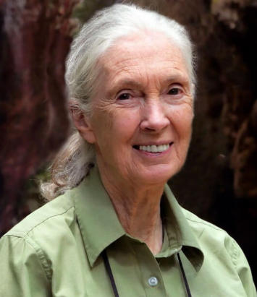
Jane Goodall
Sylvia Earle
Biolog marin și oceanograf, unul dintre cele mai apreciate și mai importante nume din domeniul conservării oceanelor. Exploratoare pentru National Geographic Society. A susținut acest domeniu și a lansat mai multe inițiative pentru a contribui la protejarea zonelor marine.
În domeniul cercetării cimpanzeilor, Jane Goodall este considerată un deschizător de drumuri. De la începutul studiilor sale revoluționare în 1960 în Africa, unde a stabilit inițiative noi de conservare și dezvoltare, Institutul Jane Goodall a devenit un institut respectat pe scară largă.
Notes:
În secolul trecut, mișcarea de mediu a fost marcată de femei remarcabile, atât în domeniul conservării pe uscat, prin activitatea lui Jane Goodall, renumită la nivel mondial, cât și în domeniul marin, prin Sylvia Earle, unul dintre cele mai cunoscute nume din domeniul conservării oceanelor.

Slide 5
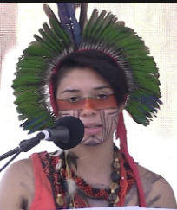
Vanessa Nakate
Artemisa Xakriabá
Tânără activistă indigenă braziliană. Ea a fost foarte activă în apărarea comunității sale împotriva devastării provocate de industria minieră din Minas Gerais și a protestat împotriva încălcării drepturilor omului.
Activist pentru justiție climatică din Uganda. Ea a inițiat o mișcare pentru climă inspirată de Greta Thunberg, după ce a devenit conștientă de consecințele creșterii temperaturilor în țara sa. Este una dintre cele mai proeminente voci de pe continentul african care luptă pentru dreptate climatică.
Notes:
Nu numai în nordul global, ci și femeile din sudul global au fost voci foarte vocale și importante în mobilizarea pentru acțiune. Vanessa Nakate este în prezent una dintre cele mai proeminente voci care luptă pentru justiție climatică pe continentul african. În Brazilia, Artemisa este activă în lupta pentru drepturile comunităților indigene împotriva industriei miniere și forestiere. Aceste exemple și multe altele din Sudul Global sunt deosebit de inspirate, având în vedere contextul social și politic al acestor regiuni, în locuri în care a fi un activist vocal poate pune aceste persoane în situații periculoase și implică un mare număr de riscuri.

Slide 6
FEMEILE ȘI SCHIMBĂRILE CLIMATICE
De ce este important să privim schimbările climatice dintr-o perspectivă de gen?
Schimbările climatice agravează inegalitățile: segmentele cele mai vulnerabile ale populației vor resimți cele mai grave efecte economice și de mediu, în special în sudul lumii;
Experiența femeilor din Sudul Global este diferită de cea din Nordul Global. În Sudul Global, femeile sunt percepute ca fiind liderii comunităților locale și administratorii resurselor;
Femeile sunt încă foarte puțin reprezentate în posturile de decizie, în special în domeniul științei și al acțiunii climatice - cercetările arată că acțiunea climatică beneficiază de pe urma prezenței mai multor femei în aceste posturi.
Femeile fac parte din cele mai vulnerabile segmente ale populației;
schimbările climatice pot perpetua violența de gen, în special în comunitățile în care femeile sunt administratoarele resurselor;
Notes:
Femeile au fost în mod clar în prima linie a mobilizării în ceea ce privește problemele legate de mediu și climă. Dar realitatea este că femeile sunt considerate astăzi unul dintre cele mai vulnerabile grupuri la impactul schimbărilor climatice.Potrivit Convenției Națiunilor Unite asupra schimbărilor climatice (UNFCC), impactul climatic, în special fenomenele meteorologice extreme, afectează rolurile femeilor și bărbaților din întreaga lume, în special în zonele rurale. De asemenea, a recunoscut că femeile sunt agenți ai schimbării. S-a demonstrat că guvernanța favorabilă incluziunii, promovată de organismele internaționale și de guvernele naționale, poate avea ca rezultat politici de lungă durată și eficiente, rezistente la schimbările climatice, care duc la o mai bună echitate socială în general și la egalitatea de gen în special, prin integrarea mai multor femei și grupuri marginalizate în procesul de luare a deciziilor.De asemenea, este necesar să se recunoască diferențele de experiență dintre Nordul și Sudul global. Există o diferență destul de mare de experiență în rândul femeilor din aceste realități. În timp ce femeile din sud au un rol mai preponderent în gestionarea resurselor și în conducerea comunității și, prin urmare, vor suferi mai mult de pe urma impactului evenimentelor meteorologice extreme agravate de schimbările climatice, în nordul global există o lipsă de reprezentare în organismele care guvernează și decid asupra problemelor climatice, precum și în rolurile științifice. Acest lucru nu înseamnă nicidecum că femeile din sudul global nu suferă de acest lucru, ci există o lipsă de reprezentare prevalentă din partea realităților din sudul global. Cu toate acestea, recunoașterea acestor experiențe diferite este esențială pentru a cultiva solidaritatea între aceste două părți ale globului și pentru a coordona o acțiune și un sprijin holistic pentru aceste probleme interconectate.
Surse: https://www.un.org/womenwatch/feature/climate_change/downloads/Women_and_Climate_Change_Factsheet.pdfhttps://unfccc.int/sites/default/files/resource/sbi2022_07.pdf

Slide 7
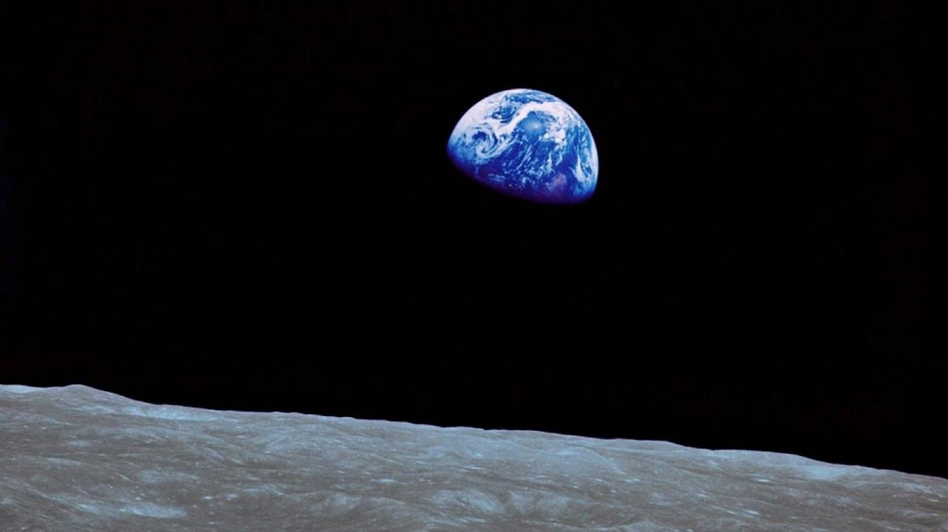
O INTRODUCERE ÎN CONTEXTUL SCHIMBĂRILOR CLIMATICE

Slide 8
Notes:
Această fotografie a fost realizată de astronauții misiunii Apollo, în timp ce orbitau în jurul Pământului. Este o imagine destul de simbolică, deoarece a dat o idee despre cât de unic este Pământul, planeta albastră.

Slide 9
Vreme și climă
Starea zilnică a atmosferei și variația sa pe termen scurt, care variază de la câteva minute la câteva săptămâni.
Vremea medie pe o perioadă lungă de timp (de obicei o perioadă de cel puțin 30 de ani), într-o anumită regiune și perioadă a anului.
Notes:
În primul rând, trebuie să înțelegem ce anume se schimbă atunci când vorbim de schimbări climatice. Nu există o modalitate mai bună de a face acest lucru decât să știm mai întâi ce anume este clima. Un bun mod de a exemplifica este de a face diferența între vreme și climă. Vremea este starea zilnică a atmosferei și variația sa pe termen scurt, care variază de la câteva minute la câteva săptămâni. Pur și simplu, este vorba de informațiile pe care ni le furnizează oamenii de la meteo în fiecare dimineață - umiditate, vânt, temperatură și așa mai departe... Clima, însă, este o descriere pe termen lung a tiparelor meteorologice, de obicei pe o perioadă mai lungă, de minimum 30 de ani. Cu alte cuvinte, informațiile despre modelele meteo sunt cele care vă permit să știți la ce să vă așteptați de la vremea sezonieră pe parcursul anului și să știți ce tip de haine să păstrați în dulap pentru a face față vremii din fiecare anotimp.Acum, să ne concentrăm atenția asupra locului în care au loc toate acestea: atmosfera. Atmosfera este un spațiu complex și stratificat care se învârte în jurul planetei Pământ, compus din mai multe gaze care sunt fundamentale pentru a garanta o planetă locuibilă și unde, printre altele, au loc fenomene meteorologice.

Slide 10
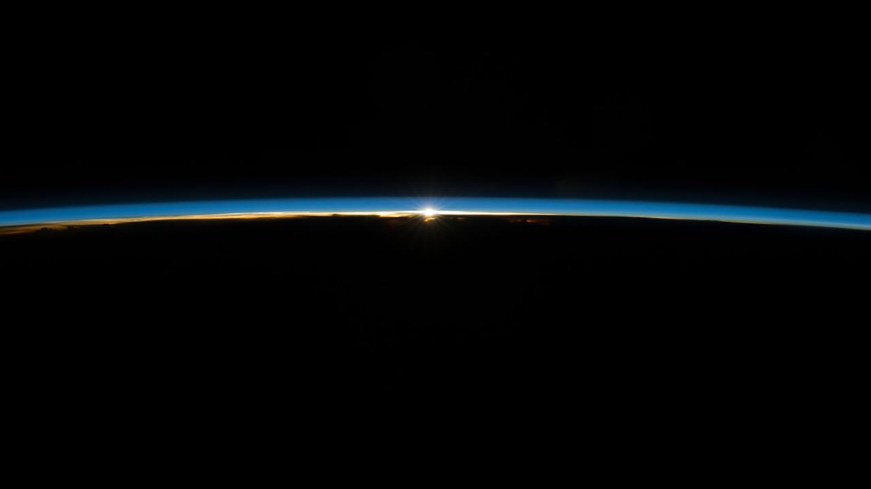
Notes:
Acum, să ne concentrăm atenția asupra locului în care au loc toate acestea: atmosfera. Atmosfera este un spațiu complex și stratificat care se învârte în jurul planetei Pământ, compus din mai multe gaze care sunt fundamentale pentru a garanta o planetă locuibilă și unde, printre altele, au loc fenomene meteorologice.

Slide 11
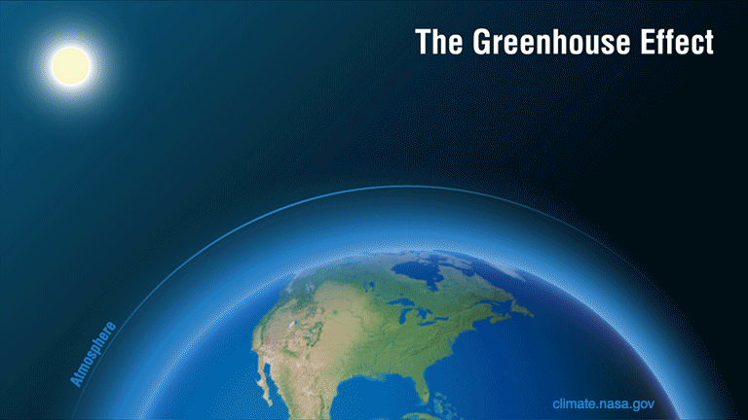
Notes:
În atmosferă se întâmplă multe lucruri, iar cel mai important în ceea ce privește schimbările climatice este efectul de seră. Efectul de seră este un proces natural care ne împiedică să înghețăm aici, pe planetă. Fără el, temperatura la suprafața Pământului ar fi de -18Cº. Acest efect seamănă cu funcționarea unei sere, de unde și numele. Radiația solară trece prin atmosferă și este absorbită de suprafața Pământului, care reemite radiația la o lungime de undă mai mică, sub formă de radiație infraroșie (IR). Această radiație IR este o radiație termică, adică determină o creștere a temperaturii. Această radiație este emisă de suprafața Pământului în spațiu, dar este captată de anumite gaze prezente în atmosferă, care au capacitatea de a o absorbi și de a o reemite în toate direcțiile, inclusiv înapoi pe Pământ. Astfel, se formează un strat cu radiație termică constantă, care nu iese imediat de pe Pământ, încălzind atmosfera acestuia. Este exact ceea ce se întâmplă într-o seră, unde lumina trece prin sticlă, atinge solul, care se încălzește și radiază înapoi radiația IR, care este reținută de sticlă, încălzind interiorul serei.

Slide 12
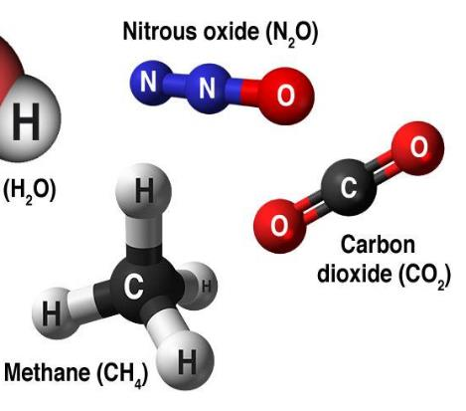
Greenhouse gases (GHG)
CO₂ - carbon dioxide
CH₄ - methane
N₂O - nitrous oxide
HFCs - hydrofluorocarbons
PFCs - perfluorocarbons
SF₆ - Sulfur hexafluoride
Natural
Synthetic
(Fluorinated Gases)
Notes:
Gazele cu efect de seră (GES) sunt responsabile de încălzirea atmosferei și a suprafeței Pământului. Dioxidul de carbon (CO2) este probabil cel mai familiar, deoarece este cel mai bine cunoscut, însă nu este singurul GES. Protocolul de la Kyoto grupează următoarele gaze în categoria GES:Naturale - și prin naturale înțelegem că acestea există în mod natural în atmosferă și provin din medii naturale/antropogene: Dioxidul de carbon (CO2), Metanul (CH4), Oxidul de azot (NH2); Sintetice - create de noi: HFCS - Hidrofluorocarburi, PFCS - Perfluorocarburi, SF6 - Hexafluorură de sulf.

Slide 13
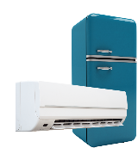
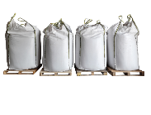
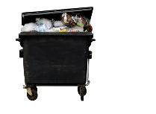
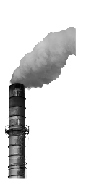
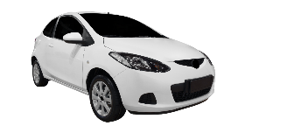
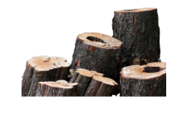
Greenhouse Gases (GHG)
Global Greenhouse Gas Emissions by Gas
Fluorinated
Gases 2%
Nitrous
Oxide
6%
Methane
16%
Carbon Dioxide
(Forestry and other land uses)
11%
Carbon Dioxide
(Fossil fuels and industrial processes)
65%
Source: Intergovernmental Panel on Climate Change, Fifth Assessment Report (2014)
Notes:
GES provin dintr-o gamă largă de surse. Dioxidul de carbon este cel mai răspândit în atmosferă și provine în principal din arderea combustibililor fosili în transporturi și în procesele industriale, precum și din păduri și alte utilizări ale terenurilor (cum ar fi agricultura, de exemplu). Metanul este generat de deșeuri, dar mai ales din activități agricole și zootehnice, așa cum este cazul protoxidului de azot, care provine mai ales din utilizarea îngrășămintelor. Gazele fluorurate sunt generate mai ales în procesele industriale și în refrigerare, de exemplu, aparatele noastre de aer condiționat și frigiderele.

Slide 14
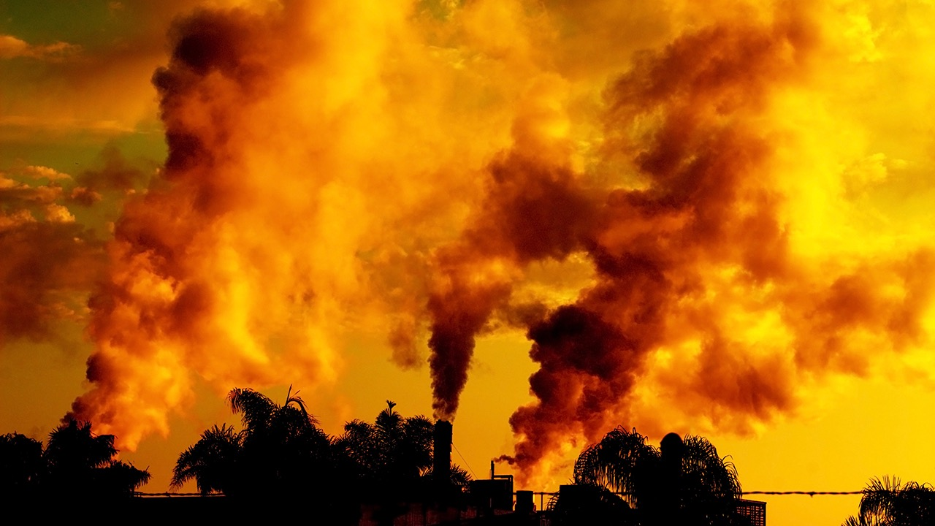
Notes:
Acum am aflat cum se menține temperatura Pământului la o medie globală de 18ºC, care ne împiedică să înghețăm. Și ce legătură are acest lucru cu schimbările climatice? Poate fi prea mult dintr-un lucru bun. Iar acest lucru este valabil pentru concentrația de GES din atmosferă.

Slide 15
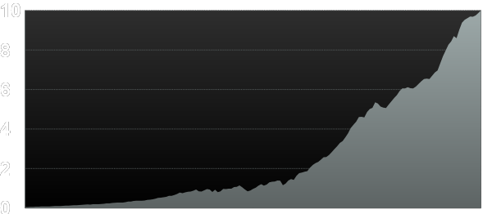
Global Carbon Emissions from Fossil Fuels
Billions Tons. of Carbon
2018
Data: U.S. Department of Energy/CDIAC
Notes:
De la revoluția industrială din secolul al XIX-lea și pe măsură ce economiile globale au progresat și s-au dezvoltat, au crescut și emisiile de gaze cu efect de seră, iar astăzi CO2 este eliberat în atmosferă mai repede ca niciodată, cel puțin în ultimii 66 de milioane de ani.

Slide 16
CO2 este eliberat în atmosferă mai repede ca niciodată, cel puțin în ultimii 66 de milioane de ani.
Source: RE Zeebe, et al., Nature Geoscience, March 2016

Slide 17
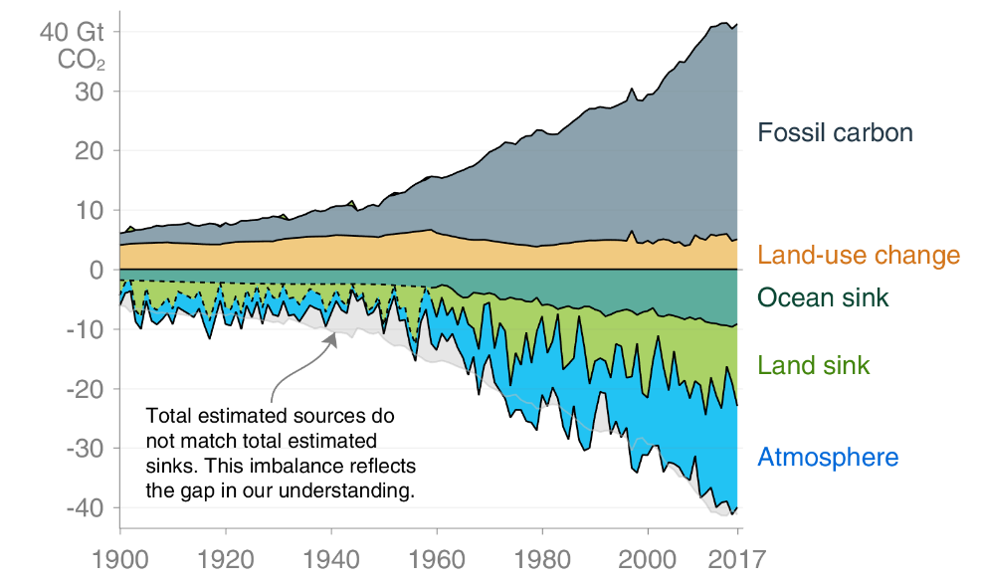
Bilanțul global de carbon
22%
29%
Source: Global Carbon Project
Notes:
Dioxidul de carbon emis în atmosferă nu rămâne în întregime acolo. Există un echilibru între absorbția și emisia de dioxid de carbon... Acest echilibru este menținut de ceea ce se numește "rezervoare naturale". În cazul Pământului, rezervoarele naturale sunt pădurile și oceanele, care absoarbe CO2 din atmosferă prin fotosinteză. Cu toate acestea, am depășit capacitatea de absorbție a acestor rezervoare, astfel încât o mare parte din CO2 emis se acumulează în atmosferă, ceea ce agravează efectul de seră.

Slide 18
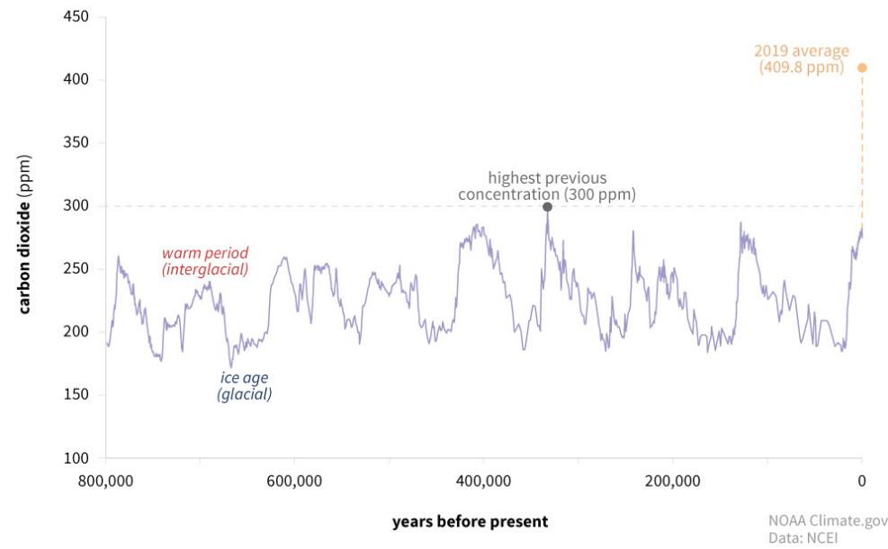
Concentratia de CO2
Concentratia curenta
417.47 ppm
(last measurement
Jun 2021)
Source: National Oceanic and Atmospheric Administration (NOAA)
Notes:
Variațiile concentrației de CO2 din atmosferă sunt ciclice și sunt de așteptat, așa cum s-a întâmplat de-a lungul mileniilor. Aceste variații coincid cu perioadele glaciare și cu perioadele mai calde ale Pământului. Dar ceea ce am înregistrat astăzi este o concentrație record de CO2 în atmosferă, fără precedent.

Slide 19
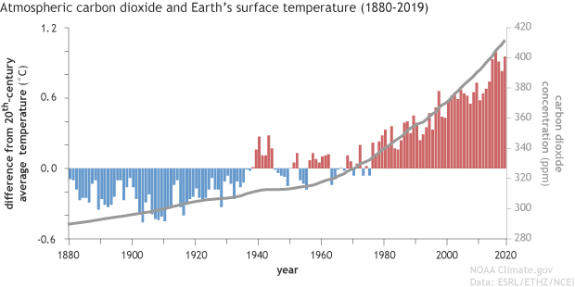
Concentrația de CO2 și creșterea temperaturii
Diferențele anuale de temperatură la suprafața Pământului în raport cu media secolului XX și concentrația de CO2
source: National Oceanic and Atmospheric Administration (NOAA)
Notes:
Poate că 417 părți pe milion nu pare mult, dar dacă luăm în considerare diferențele de temperatură medie din secolul trecut, putem vedea o corelație între acestea și creșterea CO2 în atmosferă.

Slide 20
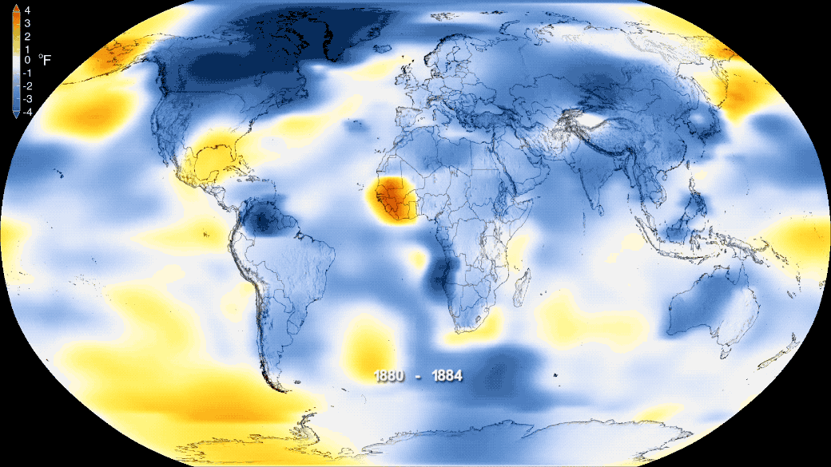
Fonte: NASA
Notes:
Dacă luăm în considerare întregul glob, așa cum au ilustrat unele grafice NASA în prezentare, putem vedea clar o tendință de creștere a temperaturii începând cu secolul al XIX-lea.

Slide 21
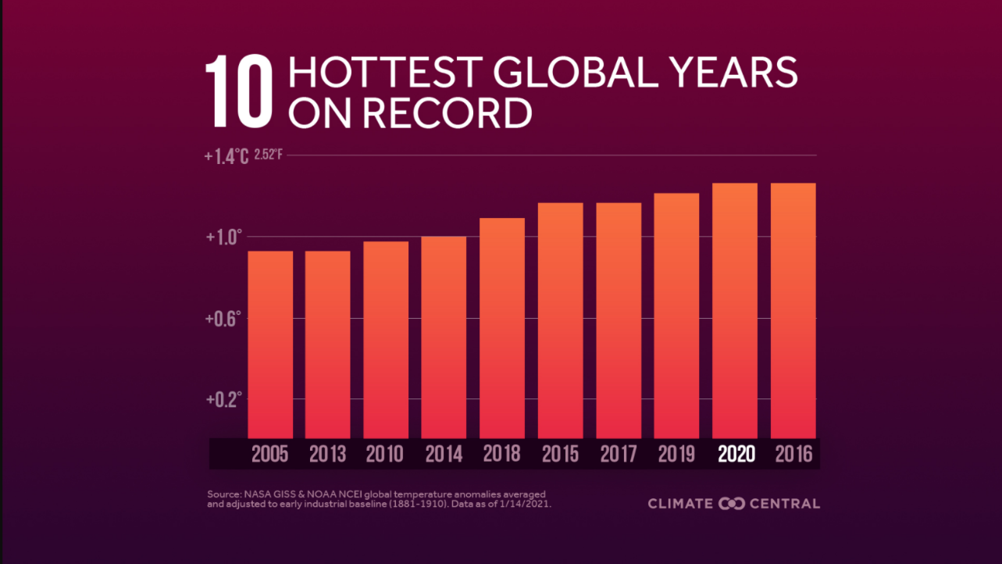
Temperature increase
Fonte: NASA GISS & NOAA
Notes:
Astăzi, în secolul XXI, atingem temperaturi record, toate aceste recorduri fiind înregistrate numai în acest secol, ceea ce susține această tendință de creștere a temperaturii.

Slide 22
TOP CLIMATE EXPERTS IN THE WORLD!
Notes:
Când a început să apară problema schimbărilor climatice, au apărut unele îndoieli. În primul rând asupra certitudinii acestui lucru, deoarece, așa cum am văzut anterior, este obișnuit să existe cicluri de perioade mai calde și mai reci. Iar al doilea, asupra influenței umane asupra respectivei încălziri a globului. Acestea au fost exprimate în principal de către marile grupuri economice care au interesul de a menține lucrurile așa cum sunt, cunoscută și sub numele de abordarea "business-as-usual". Dar există un consens unanim în rândul oamenilor de știință cu privire la aceste două întrebări ridicate anterior. IPCC - Grupul interguvernamental de experți în domeniul schimbărilor climatice este format din experți de top în știința climei care publică la fiecare 4-5 ani rapoarte considerate cele mai importante documente în domeniu, iar acestea sunt unanime în ceea ce privește influența umană asupra schimbărilor climatice și necesitatea de a acționa în fața crizei climatice. António Guterres, Secretarul General al Organizației Națiunilor Unite, a clasificat ultimul raport al IPCC ca fiind un "cod roșu pentru omenire".

Slide 23
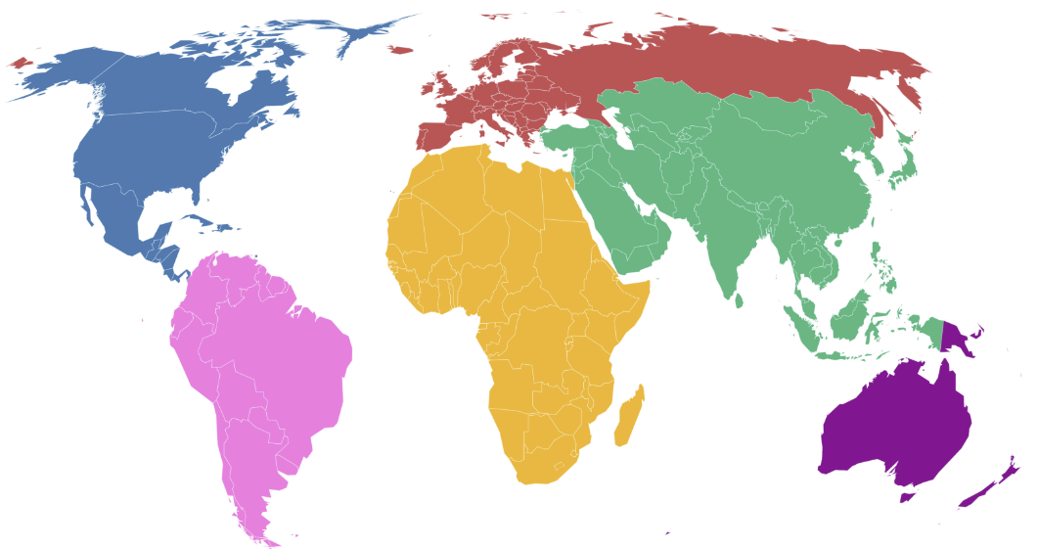
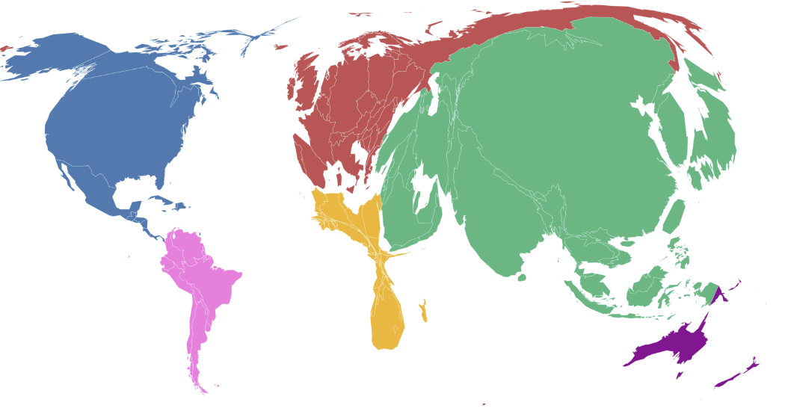
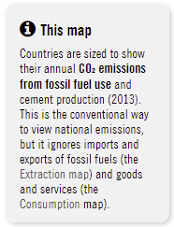
Emisii pe țară
Source: carbonmap.org
Notes:
Nu toate emisiile sunt distribuite în mod egal între țări. De fapt, în prezent, mai mult de 60% din emisiile globale provin din numai 10 țări. Disparitățile economice dintre țări se reflectă asupra emisiilor individuale ale țărilor, deoarece emisiile sunt legate în mod intrinsec de dezvoltarea economică. Panorama actuală a emisiilor cuprinde cele mai bogate țări și țările cu economii emergente, cum ar fi China și India, ca fiind cele mai mari contribuitoare la emisiile globale de carbon.[ Acest grafic exacerbează dezechilibrul emisiilor globale, între țări].

Slide 24
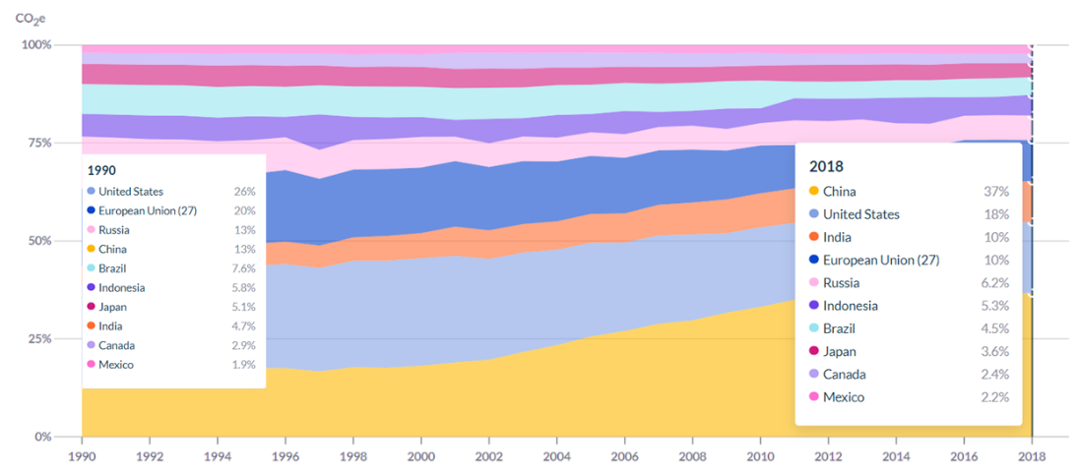
Emisiile istorice pe țară
Source: Climate Watch
Notes:
Cu toate acestea, în cadrul dezbaterii privind reducerea emisiilor, se pune întrebarea cum să se distribuie reducerea într-un mod echitabil și corect - din moment ce țările dezvoltate au avut șansa de a-și dezvolta economiile, nu ar trebui ca și țările în curs de dezvoltare să aibă aceeași oportunitate? Acest lucru este valabil deoarece, dacă ne uităm la panorama istorică a emisiilor cumulate, clasamentul celor mai mari emițători se schimbă.

Slide 25
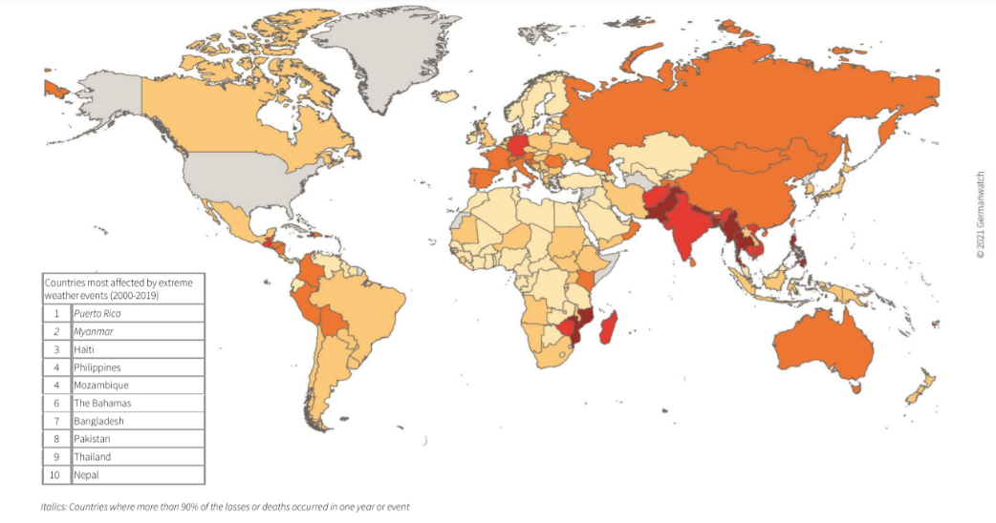
Most vulnerable countries to climate change
Source: Germanwatch
Notes:
Deși cea mai mare parte a emisiilor globale de gaze cu efect de seră aparține doar la 10 țări, vulnerabilitatea și riscul la schimbările climatice nu sunt distribuite proporțional între cei mai mari contribuabili la emisii. Ne putem uita la cazul Mozambicului sau al țărilor din America Centrală, care au o contribuție reziduală la emisiile de carbon, dar care sunt unele dintre cele mai vulnerabile la schimbările climatice. Scoate în evidență disparitățile și inegalitățile dintre cei mai importanți factori care provoacă criza climatică și cei care au contribuit cel mai puțin, dar care, cu toate acestea, suferă consecințele și au adesea o capacitate economică mai redusă de a reacționa la fenomenele meteorologice extreme.

Slide 26
Reflecție
Care sunt principalele surse de emisii de gaze cu efect de seră și în ce ordine de importanță?
Notes:
Să restrângem domeniul de aplicare și să analizăm emisiile în funcție de sursă. [Puteți cere publicului să reflecteze asupra principalelor surse și să creeze o hartă a cuvintelor folosind www.mentiminter.com]

Slide 27
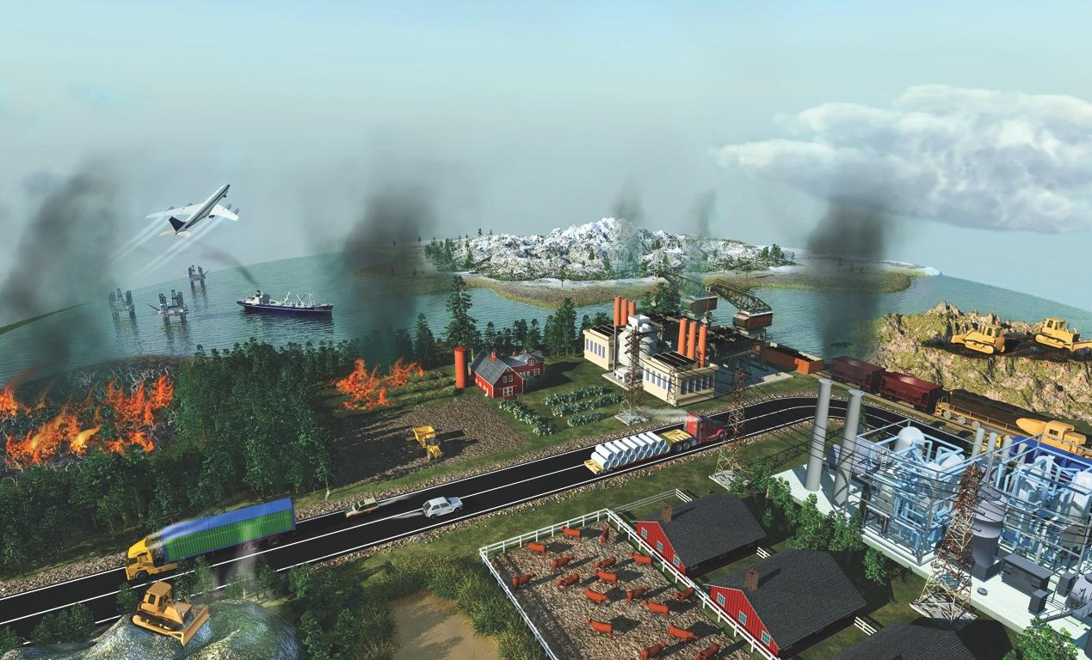
The Biggest Sources of Greenhouse Gases
MELTING PERMAFROST
AIR TRANSPORT
COAL MINING
COAL-FIRED POWER STATIONS
OIL PRODUCTION
INDUSTRIAL PROCESSES
CROP BURNING
FERTILIZERS
FOREST BURNING
INDUSTRIAL AGRICULTURE
ROAD TRANSPORT
LANDFILLS
Melcher
Notes:
ID #3622.B - Can be used in noncommercial online and TV broadcasts of your presentation, but not modified.
DESCRIPTION: Graphic representation of major sources of greenhouse gas emissions
ADDITIONAL TALKING POINTS: Most of the global warming we’re seeing today is caused by carbon pollution from fossil fuels.* Other important contributors include deforestation, transportation, agriculture (crops and livestock), and industrial processes.**
REFERENCES:
* Union of Concerned Scientists, “Why does CO2 get most of the attention when there are so many other heat-trapping gases (greenhouse gases)?," last accessed February, 2017. http://www.ucsusa.org/global_warming/science_and_impacts/science/CO2-and-global-warming-faq.html
** United States Environmental Protection Agency, “Global Greenhouse Gas Emissions Data," last updated August 9, 2016. http://www.epa.gov/climatechange/ghgemissions/global.html
Generally speaking, emissions come from a variety of sources, that are illustrated here in this picture.

Slide 28
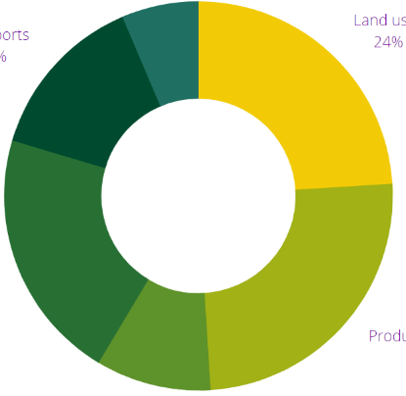
Global sources of emissions
24%
Land uses
6,4%
Buildings
Production of electricity and heat
25%
Transports
14%
Transports
14%
21%
Industry
Energy (other)
Energy (other)
9,6%
9,6%
source: Intergovernmental Panel on Climate Change, Fifth Assessment Report (2014)
Notes:
Let’s narrow the scope and look at the emissions by source. [You can ask the audience to reflect on the main sources, and even ask someone to share their thoughts.]
One thing to be aware of is that the source data may vary. Some analyses focus on different categorizations of the sources – for instance in the case of energy, which can be considered a broader category that includes electricity production, buildings, and transportation. The characterization of emission sources in the chart was devised by the Fifth assessment report produced by the IPCC in 2014. It may be subjected to change when the 5th report is released during this year and throughout 2022.

Slide 29
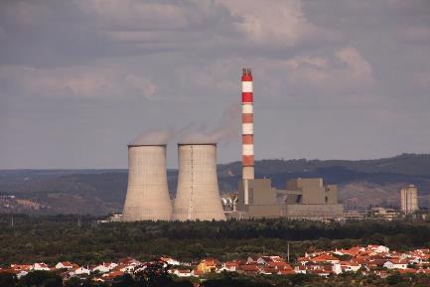
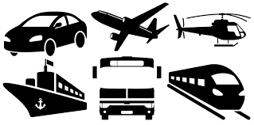
Global sources of emissions
ELECTRICITY AND FUEL PRODUCTION
TRANSPORTS
Hydrocarbons + Oxygen (O₂) -> Carbon dioxide (CO₂) + Water (H₂0)
Notes:
Energy powers not only our houses and buildingins, but it also is fundamental the transportation system, which is heavily dependent on fossil fuels, or to use the scientific term, hydrocarbons. Hydrocarbons are essentially the responsible for the carbon emissions for these two activities.

Slide 30
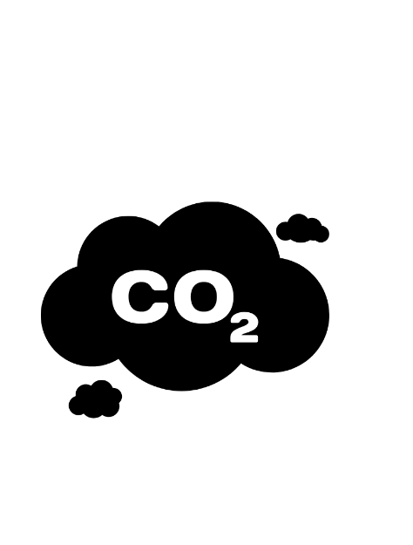
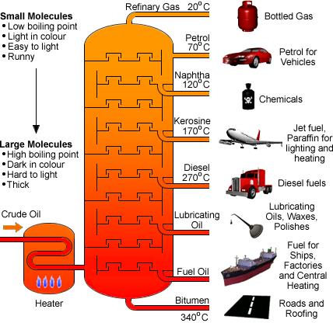
Global sources of emissions - Transports
Notes:
Oil is the fossil fuel most used in the energy and transportation. It goes through a refining process to produce several fuel sources that power cars, planes, and ships. It is the backbone of the mobility system

Slide 31
CONSEQUENCES
Notes:
Now that we understand a bit better what climate change is, and what it is driving it, you should be wondering what are the practical effects of all of this in our daily lives. Let us focus on the consequences of climate change.

Slide 32
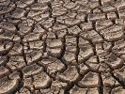
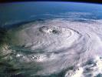
Extreme weather events
More heat waves
Precipitation changes
More droughts, fires
More intense tornados and hurricanes
Notes:
As the global climate patterns are disrupted it contributes to the increase of extreme weather events such as heatwaves, changes in precipitation, floods, droughts, wildfires, and more intense storms and hurricanes.

Slide 33
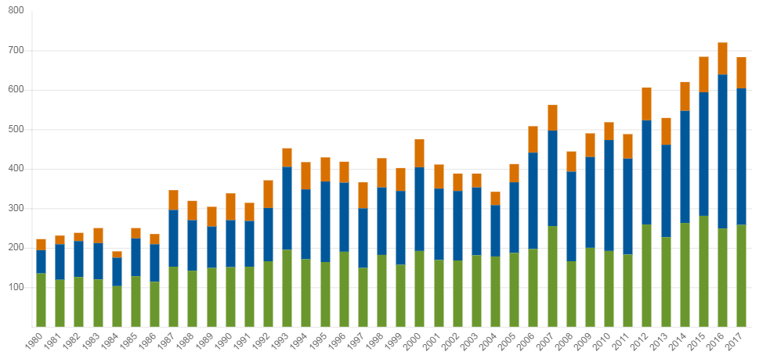
Extreme events
Climate events on a global scale 1980-2017
Number of events
Storms
Floods, landslides
Extreme temperatures, drought, fires
Source:: Munich Re, Geo Risks Research, NatCatSERVICE, Fev 2019.
Notes:
As the global climate patterns are disrupted it contributes to the increase of extreme weather events such as heatwaves, changes in precipitation, floods, droughts, wildfires, and more intense storms and hurricanes. There is a tendency for an increasing number of extreme events, which will worsen in number and intensity in the future.

Slide 34
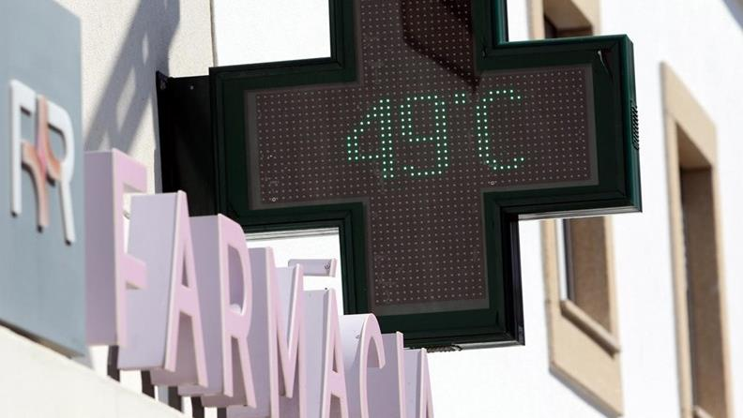
Castelo Branco, Portugal
4 August, 2018
In Portugal, of the 96 IPMA stations, 16 exceeded the 45ºC maximum temperature. The city of Lisbon recorded a new maximum, 44 º C.

Slide 35
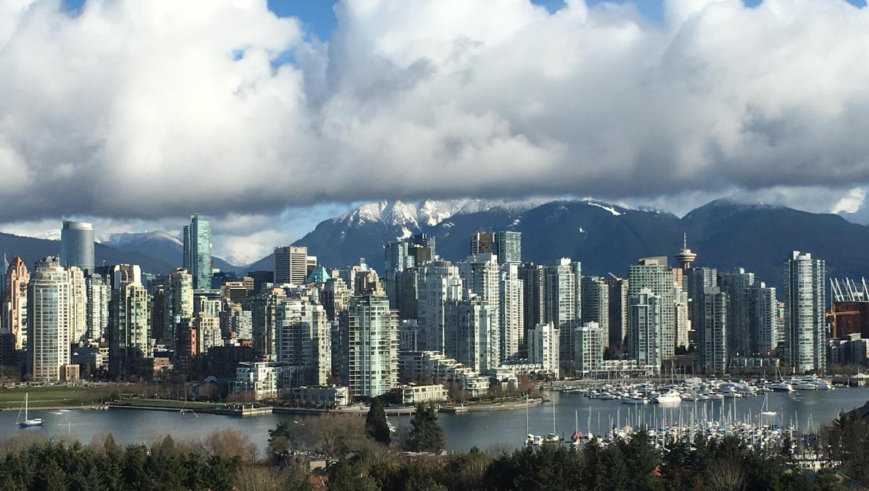
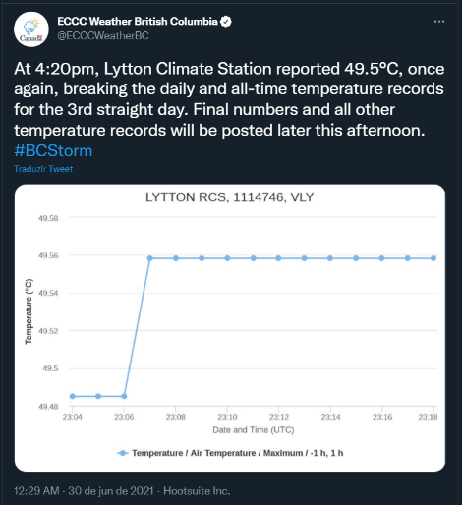
British Columbia, Canada
June, 2021
More than 600 people died in the deadliest heatwave in Canada history.

Slide 36
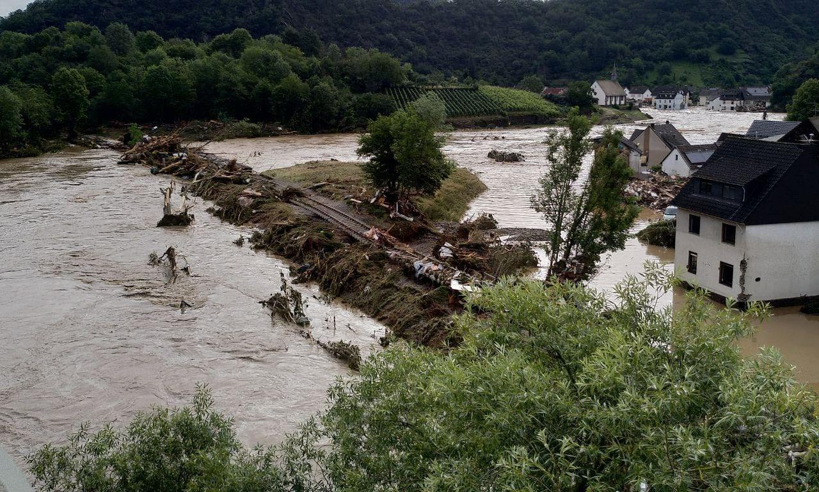
European floods
July 2021
Severe floods affected Europe, in countries such as the UK, Austria, Belgium, Czech Republic, Italy , France, Germany, Luxembourg, The Netherlands, Romania and Switzerland. It killed 296 people and caused > 10 Billion euros in property damages

Slide 37
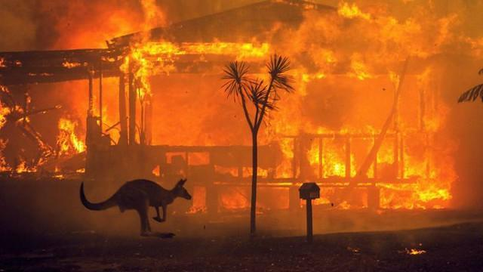
Australian Wildfires
July 2020
Up to 19 million hectares were burnt, and nearly 33 million animals were impacted. 33 people lost their lives, and more than 3000 homes were destroyed
Notes:
Source: https://www.wwf.org.au/what-we-do/bushfires#gs.d3dmvh

Slide 38
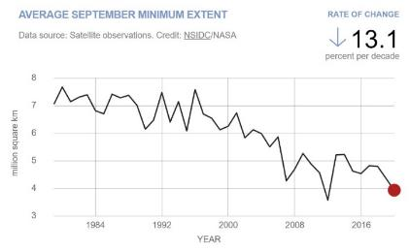
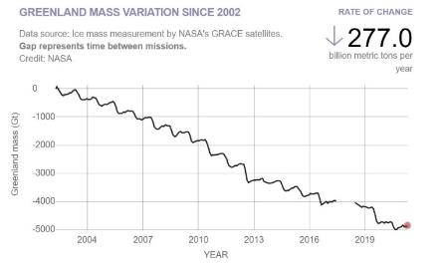
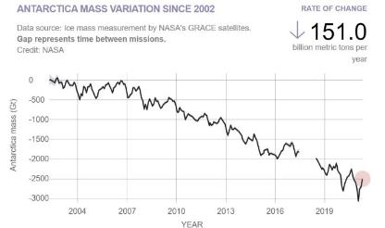
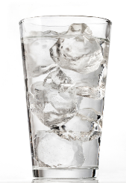
Defrost
Arctic (Iceberg)
Greenland and Antarctica (Glaciers)
The melting of icebergs and glaciers do not have the same consequences on rising sea levels.
Source: National Aeronautics and Space Administration/Goddard Institute for Space Studies (NASA/GISS)
Notes:
An increase in the temperature causes ice to melt, both glaciers (ice over land) , like Greenland and Antarctica and on the mountains all over the world, and icebergs (ice floating in the sea) such as the big ones in the Arctic Ocean. These graphs show a clear tendency of ice cover decrease in both glaciers and icebergs. Loss of glaciers causes sea level rise and affects coastal populations. Loss of ice on mountain glaciers causes a decrease in water resources for populations living in those areas. Iceberg melt doesn’t cause sea level rise, think of an ice cube on a glass of water, however, it can cause changes on ocean currents, and furthermore, it decreases reflection from sunlight, which in turn increases the temperature.

Slide 39
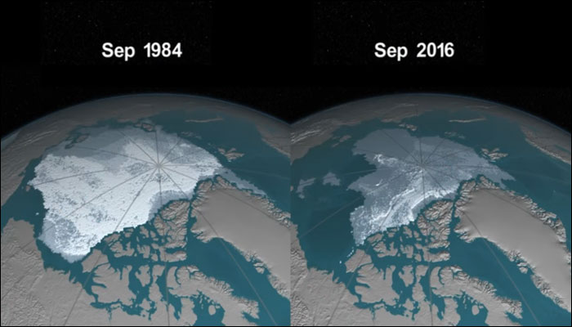
Defrost - Iceberg
Satellite images of the Arctic at the annual minimum ice point (September)
Source: National Aeronautics and Space Administration/Goddard Institute for Space Studies (NASA/GISS)
Notes:
An increase in the temperature causes ice to melt, both glaciers (ice over land) , like Greenland and Antarctica and on the mountains all over the world, and icebergs (ice floating in the sea) such as the big ones in the Arctic Ocean. There is a clear tendency of ice cover decrease in both glaciers and icebergs. Loss of glaciers causes sea level rise and affects coastal and island populations. Loss of ice on mountain glaciers causes a decrease in water resources for populations living in those areas. Iceberg melt, however, doesn’t cause sea level rise. Think of an ice cube on a glass of water, however, it can cause changes in ocean currents, and furthermore, it decreases reflection from sunlight, which in turn increases the temperature.

Slide 40
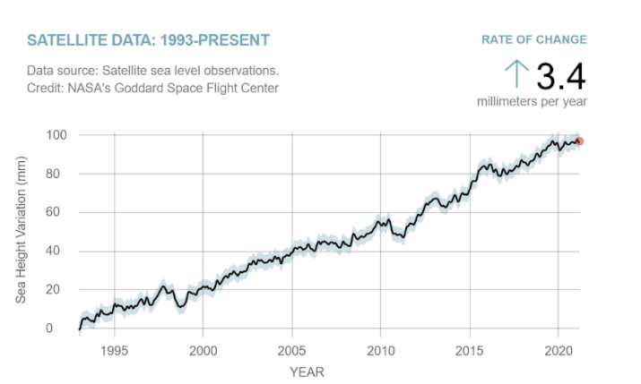
Sea level
2 factors: thermal expansion of the ocean and melting glaciers
Source: National Aeronautics and Space Administration/Goddard Institute for Space Studies (NASA/GISS)
Notes:
There are two main drivers for sea-level rise: the melting of the glaciers and thermal expansion which is caused when seawater expands because of the higher temperature of the water. Since the oceans absorb heat from the atmosphere, when the atmosphere becomes warmer so will the oceans. ... The increased volume will cause the level of the water in the oceans to rise.

Slide 41
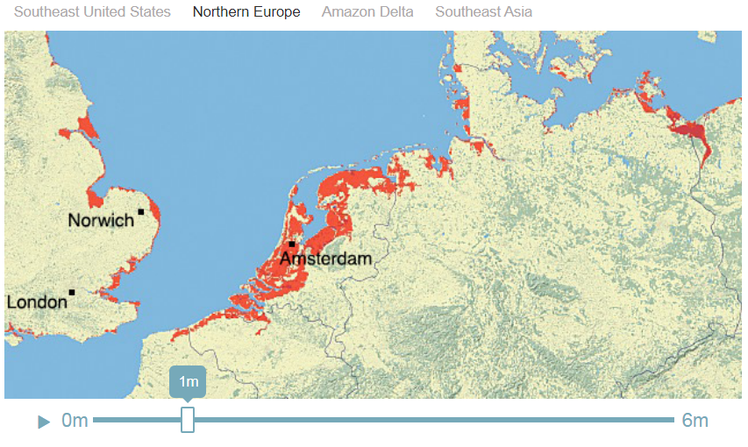
Sea level
NASA coastal zone simulator
Source: National Aeronautics and Space Administration/Goddard Institute for Space Studies (NASA/GISS)
Notes:
Currently, there is a tendency of rising sea level, in 2020 that variation was about 1 cm. Coastal areas are the most vulnerable to sea-level rise, which threatens the coastal communities. Amsterdam is one of the particular areas that are threatened by this since the city is 4 meters below sea level.

Slide 42
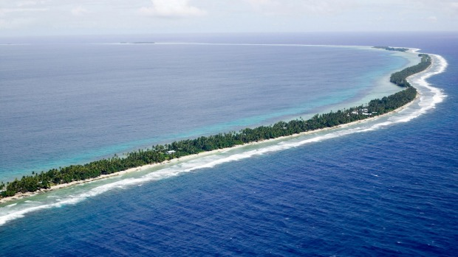
Tuvalu Island faces the risk of completely disappearing due to sea level rise
Notes:
Tuvalu Island, located in the Pacific Ocean is facing the risk of being submerged if the sea level continues to rise. Island states and coastal areas are the most vulnerable places that face the threat of sea levels rising

Slide 43
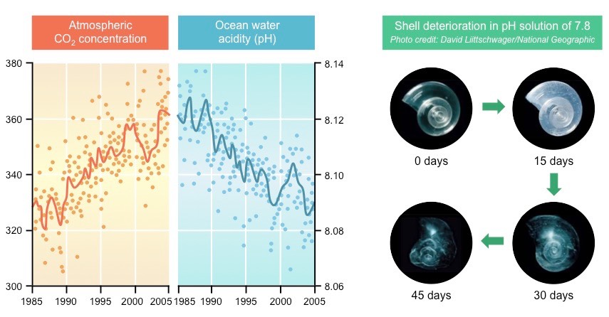
Ocean acidification
Notes:
The oceans are also a natural sink of absorption of CO2. As the CO2 concentration in the atmosphere increases, so does the absorption in the ocean, and the consequential acidification of the water. This has dire consequences on marine life, which are particularly sensitive to these types of variations. As an example, more acidic waters deteriorates the shells of marine organisms that are made of calcium carbonate – caused by chemical reactions between carbon and the chemicals of the shells

Slide 44
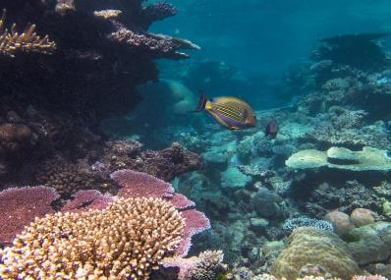
Effects on ecosystems
Coral reefs are home to about 25% of marine life, the terrestrial equivalent of rainforests!
In 2016, during the 4th episode of mass bleaching, 50% of the large barrier coral died.
Notes:
Rising temperatures have catastrophic consequences on ecosystems. One example is coral reefs, which are fundamental to entire marine ecosystems, and are considered biodiversity hotspots. They are also incredibly sensitive to temperature and pH variations. Temperature increase and acidification of the oceans contribute to the phenomena called coral bleaching that results in the death of the reef – entire organisms perish in these conditions, which means that the marine life that coexists in this ecosystem vanishes completely.

Slide 45
Effects on human health
Distribution of the Malaria pathogen:
Today
Possible in 2050
Climate Change and Malaria
Source: De Souza et. al. (2012), Impact of Climate Change on the Geographic Scope of Diseases
Notes:
Warmer temperatures, and changing climate patterns in countries, creates conditions for pathogens and diseases common to warmer weather to emerge in regions of the world that have never seen them before. This is the case of Malaria, which is transmitted by a mosquito that is common in warmer/tropical climates, but it is predicted to emerge in norther regions of the world.

Slide 46
Notes:
Madagascar, one of the region’s most vulnerable and at risk of climate change, is already facing the consequences of it, where 1 million people are currently facing famine linked to climate change. Climate change is changing weather patterns in the country, which deeply depends on agriculture, disrupting seasonal weather that allows for this economic and subsistence activity to persist in the area. Again, the countries that least contributed to climate change are the ones that are already facing the consequences.

Slide 47
Climate change "will likely lead to
shortages of food, water, and pandemic diseases,
refugee and resource conflicts, and destruction from natural disasters in many regions of the globe."
US Department of Defense
2014 Climate Change Adaptation Roadmap
October 2014
Notes:
More and more populations in the world will face grave consequences caused by climate change in their regions. Today, many people in developing countries are suffering from droughts and windstorms on a scale never seen before, depriving them of daily food and basic needs. It is still fresh in our memories that last November many people from the Central American countries of Honduras, Guatemala, and El Salvador, which were hit by two massive hurricanes, poured across the border into Mexico and headed toward the US border.
The term “climate refugee” was first coined to describe the increasing large-scale migration and cross-border mass movements of people that were partly caused by such weather-related disasters. As the weather events worsen, so dies the need for these populations to migrate to other countries to seek refuge.

Slide 48
Tipping points
Notes:
Think about tipping point as a game of jenga, you remove pieces one by one, and then comes a point where the tower comes down and there is no stopping gravity. This is an analogy for the climate tipping points, which once surpassed will lead to irreversible changes. A specific example, melting of the glaciers and icebergs is a dangerous positive feedback loop on the climate, which means that the effect of temperature increase, ice melt, increases its cause, the temperature itself, keeping a circle of ever increasing temperature which can lead to the disappearance of the glacier.

Slide 49
WHAT CAN BE DONE TO REDUCE EMISSIONS?
Notes:
Moving on from the doom and gloom of the climate crisis, what can then we do to try and resolve this pressing issue?

Slide 50
On a large scale
Save the trees!
Change our energy system
Notes:
On a global large scale level, we need to focus on reducing our global carbon emissions, plain and simple. There are two main ways to seek to balance our emissions and absorption, which is through preserving and restoring our natural sinks and to fundamentally change our energy system

Slide 51
Forests
Global balance between carbon sources and sinks
Source: Global Carbon Project
Notes:
As we have seen previously, natural sinks are essential to maintaining a balance of carbon dioxide in the atmosphere, and we have long surpassed the absorption capacity. Carbon dioxide concentrations have been increasing, for one, because of the ever-increasing emission rate, but also because we are tearing down one of our natural sinks: Forests.

Slide 52
Deforestation in the Amazon Rainforest
Notes:
Increasing pressure of human activity - population rise, economic and technological development, and other pressures and driving deforestation. Brazil has one of the worst rates of deforestation in the world, and it shows no signs of slowing down. The countries in the Indian-pacific also experience a high rate of deforestation, mainly driven by industry exploration. Brazil is an alarming case for example, a country that hosts one of the largest areas of forest cover, including the Amazon Rainforest, commonly named the “lung of earth”.

Slide 53
Preserving vs restoring our forests
Notes:
Does this mean that we can just plant more trees and solve the issue? Not quite. Research shows that preserving our current natural sinks brings more benefits than restoring, in terms of “emissions gains”, because as we mentioned before, cutting down forests not only generates emissions but also reflects in CO2 absorption losses. As trees regrow, the absorption capacity also rises, but it always starts at a smaller level, so it may take up years to actually start to have a meaningful impact on balancing emissions. The time that we currently do not have to address the climate crisis. Research shows that preserving our current natural sinks brings more benefits than restoring, in terms of “emissions gains”, because as we mentioned before, cutting down forests not only generates emissions but also reflects in co2 absorption losses. So in terms of reducing our emissions, preserving the standing forest is preferable to restoration and reforestation practices. But this is not to say that regeneration shouldn’t be an option altogether to the damage already done to our forest areas.

Slide 54
Reshaping our energy system
Notes:
Fundamental systemic change on our energy systems

Slide 55
Energy
Greenhouse gas emissions by sector
Notes:
There are several ways we can look at the breakdown of emissions. By sector, by economic activity and so on. If we account energy emissions as a whole, it accounts for a staggering 75% of total global emissions. This means that 75% of total emissions comes from generating energy. Why is this?

Slide 56
Energy production sources
Fossil fuels
Renewable energy
Notes:
There are two main sources from where we produce our energy and electricity. Fossil fuels: Oil, gas and coal. And renewable energy.

Slide 57
Global energy consumption by source
Notes:
Energy production takes up that much of global carbon emissions because it is still mostly reliant on fossil fuels. Almost 85% comes from burning fossil fuels, that are very carbon intensive. Changing the source of energy and transitioning from fossil fuels to renewable energy is fundamental to cutting down emissions.

Slide 58
Renewable energy sources
SOLAR
HYDROELECTRIC
BIOMASS
Solar photovoltaic
Concentrating solar thermal
Reservoirs
Water strands
WIND
OCEANS
GEOTHERMAL
Onshore
Offshore
Waves
Tides
Notes:
Renewable energy sources include:
Solar: Photovoltaic panels, concentrating solar thermal energy through mirrors
Hydroelectric: Water reservoirs, or water strands
Biomass is the burning of wood, agricultural waste, and other organic material, to generate electricity and heat. Although the burning of biomass does release carbon dioxide to the atmosphere, the organic material during its growth phase absorbs a considerable amount of carbon dioxide, so it balances it with emissions.
Wind: located onshore or offshore
Oceans: waves and tides
Geothermal energy uses the heat of the earth to generate electricity

Slide 59
Renewable energy
Renewable energy
Notes:
But there is hope to have our energy system relying on renewable energies!

Slide 60
Renewable energy
Percentage of primary energy from renewable sources, 2019
About 11% of global primary energy consumption is from renewable sources.
This is the percentage of renewables in the energy mix. This energy corresponds to the sum of electricity, transport and heating.
About 11% of global primary energy consumption is from renewable sources.
This is the percentage of renewables in the energy mix. This energy corresponds to the sum of electricity, transport and heating.
Notes:
The distribution of renewable energy sources varies between countries that source them – it depends on various economic and environmental factors ( wind, yearly sunlight) and the infrastructure investment of each country. However, globally speaking, the overall renewable energy consumption remains at about 11%. The energy mix is a group of different primary energy sources from which secondary energy for direct use - such as electricity, transports, and heating - is produced.

Slide 61
The carbon footprint of the internet
An email has an estimated carbon footprint of 4 grams of CO2
The average website produces 1,76 grams of CO2 per page view
www.websitecarbon.com
An email with a large attachment can have 50 grams of CO2
Notes:
All the energy consumed for our technology and internet needs does carry a carbon footprint, in other words, sending an email does produce carbon emissions. And websurfing also has its footprint, because of the servers needed to host most web services. You can check a website’s carbon footprint at www.websitecarbon.com! Data centres and web service providerscan opt for renewable energy to source their power needs.

Slide 62
Reduce energy consumption
Source: NASA Earth Observatory
Notes:
All in all, reducing energy consumption is necessary to address global carbon emissions, not only because our energy system is still dependent of fossil fuels, but also as a means to reduce the pressure and strain we put on the energy system to better control demand and supply of energy

Slide 63
Notes:
Shifting away from the larger scale and systemic changes required to cut down emissions, lets now speak of what we can do to act upon our individual consumption of energy, at a smaller scale.

Slide 64
Reflection
How do you travel to school/ work, and which transport has less emissions?
Notes:
Let’s narrow the scope, and look at the emissions by source. You can ask the audience to reflect on the main sources, and even ask someone to share their thoughts.

Slide 65
Global CO2 emissions from transportation type
Source: European Environmental Agency
Notes:
[You can interact with the audience and ask which type of transport contributes the most to global CO2 emissions]
Let’s have a look at which transports most of the carbon emissions come from. Which mode of transportation do you think has the greatest carbon footprint overall? Road transportation accounts for more than half of total carbon emissions, and in this category cars take the prize for the biggest source of emissions. Which does make sense considering that on earth there are almost 1.5 billion cars!
Cars are the transport that most contribu

Slide 66
CO2 emissions of travel per km (2018)
Notes:
[You can ask the audience which transport has the biggest emissions per km and per passenger. Essentially the most inefficient if you account the distance traveled per person and the emissions released]
And what about emissions per person and per km traveled in each type of transportation? Essentially which is the least efficient way to travel taking into account the distance traveled against the emissions? In that case, aviation wins. Cars also have a significant inefficiency when it comes to emissions per distance traveled, mainly because, usually, we travel alone in our cars.

Slide 67
Aviation
Notes:
Aviation is certainly the least efficient, because of the amount of fuel and the power planes consume to travel. And they are increasing ever than ever in the skies, mainly due to the affordability of plane tickets, which were very expensive several decades ago.

Slide 68
Cars

Slide 69
Emissions from cars
Source: European Environmental Agency
Notes:
Carbon dioxide is not the only problematic gas that is emitted from cars. They are one of the greatest contributors to air pollution and respiratory problems caused by these substances. They emit other gases and small particles that are very dangerous for human health. They are also very inefficient in terms of converting energy from fuels to generate power to move, seeing that only 30% of the energy from burning gasoline and diesel is in fact used - this means that we have to use more gasoline to move around if the energy use was 100%.
There are indeed new technologies to substitute petro vehicles. Eletric cars are at the top of the array of alternatives

Slide 70
Electric vehicles
An electric vehicles is powered by an electric battery.
Does not emit GHG, and other gases or particles.
There are also hybrid options that combine a combustion motor and electric motor.
Notes:
There are indeed new technologies to substitute petro vehicles. Electric cars are at the top of the array of alternatives. Electric vehicles exist for some years now, and the technology is evolving evermore. On the electric modality there are some other vehicles that were popularized earlier: hybrid cars, that run on electricity and petrol.Electric vehicles essentially run on large lithium batteries.

Slide 71
Hydrogen vehicles
Power plants generate electricity to separate hydrogen from water
The hydrogen is stored and transported to charging stations
The hydrogen is stored in vehicles. It reacts with oxygen that generates electricity that moves the car. The only “emission” is water!
Notes:
Another alternative, from an emerging technology is hydrogen powered vehicles. Hydrogen is around for some time now, it is the gas that made Zeppelins fly. Electric vehicles are powered by energy from the grid, but the process to get hydrogen to power vehicles has some extra steps to take. It starts from water( h2o), the hydrogen is separated from the oxygen in a process that requires energy. After that the hydrogen is stored, which does require more energy, and transported to fueling stations. The hydrogen is pumped in the car, similar to fueling a petrol vehicle, and takes about just four minutes to fill!. In the car deposit, the hydrogen reacts with the oxygen of the air that comes in the container and the reaction generates electricity that makes the motor run. The result of this reaction is water, it is so pure you can actually drink it!

Slide 72
Cons: Hydrogen vs Electric
Cons:
Cost;
Hydrogen infrastructure;
Still an inefficient process- the car only has an efficiency of about 15%
Cons:
Charging times can take up from 30 min to 12 hours
Range
Environmental impacts of lithium batteries
Notes:
The biggest pro arguments for these vehicles are in fact the zero emissions in transit for these types of cars. But there are some cons particular for each type.
Hydrogen vehicles biggest con is the lack of infrastructure at the moment. This limits the range a car can travel, and you need to take into account where the infrastructure exists, which is still lacking in most parts of the world. The inefficiency of the hydrogen conversion is also a big con, since the process takes up a lot of energy, and only has a conversion of 15%, because the hydrogen is a gas very volatile. And of course, the cost of these vehicles is still very prohibitive for most people, since it is still a novel technology with limited availability, the cost is very high at the moment.
Electric vehicles take a long time to charge. There are supercharging stations, and leaving them to charge overnight is an option. But this limits, for instacance, people that live in apartments with no garages or do not have charging infrastructure nearby. The range, although it is getting better and better, is still limiting for a long range option, and worsen by the charging times, it can make a long drive take even longer. The environmental impacts to construct an electric car, especially the lithium batteries is significant.

Slide 73
Charging stations availability
Hydrogen vehicles
Electric vehicles
Notes:
Electric vehicle infrastructure is must more developed at this point than Hydrogen vehicles infrastructure, which is noticeable by the number of charging stations available for each, which is considerably less to hydrogen cars.

Slide 74
Renewable energy sources and alternatives to petrol
Notes:
The electric and hydrogen alternatives do not produce emissions in transit. However, they can only be true alternatives if the energy system fundamentally changes, and transitions to renewable energy sources. These vehicles rely on electricity to function, and if the energy system of a country with the best electric vehicle grid still relies mostly in fossil fuels to power it, emissions wise, this is nothing more than a false solution.

Slide 75
CO2 Emissions through the life cycle of vehicles of different fuel types
Source: European Environmental Agency
Notes:
In fact, carbon emissions on the overall life cycle of an electric vehicle that is powered by fossil fuels is greater than a petrol vehicle.

Slide 76
Public transportation
Notes:
Public transportation comes in the form of railroad transport and road transport.

Slide 77
Train, trams and subways
Train
Tram
Subway/ Underground
Notes:
Railway wise, we can count on trains, trams and subways. These locomotives are powered by electricity from the grid. Although there are some trains that move on diesel - following a similar principle as the trains from last century that runned on steam, they are a minority compared to electric trains.

Slide 78
Trains as alternatives to aviation
There is a need to invest in cross-border high speed network to make it a viable alternative to airplane travel.
Notes:
To make “avoiding aviation” a valid option, trains need to become a viable alternative. But there is still a need to invest in high speed infrastructure and services for cross border train travel to be an efficient alternative.

Slide 79
Buses
Source: European Automobile Manufacturers association
Notes:
Buses are one of the best options to travel between small towns and other localities which do not have railroad connections. And they do have a smaller individual carbon footprint than an individual car. However, they are still mostly reliant on fossil fuels. Not all run on diesel or gasoline, there are some fuel alternatives such as natural gas, Liquified petroleum gas, biofuels and ethanol vehicles, but they too have considerable emissions.

Slide 80
Bicycle and other two-wheel modes of transportation
Riding a bicycle is one of the best ways to move around emissions free
Not all cities and locations can be as flat and bicycle oriented such as the Netherlands, but there is a large variety of electric options that can help with steep ascends
Electric scooters
Notes:
Apart from walking, bicycles are the best option to travel emission free. The benefits reflect economic, health, and environmental gains. Of course not all places have the best infrastructure to accommodate a cycling lifestyle, or have flat surfaces to make it easier to ride a bicycle, such as the Netherlands. But there are some interesting electric options emerging to help fight the steep climbs!

Slide 81
Bicycle and other two-wheel modes of transportation
Sharing services!
Notes:
All throughout cities, two-wheel sharing options are starting to emerge. The equipment can be expensive for an individual to bear the cost of investing, if the travels do not justify that. These grids of scooters and bicycles are a great option to move around the city with low emissions. Usually you pay for the kms you use, and there are stations spread out in the cities that you can leave the equipment for another person to use.

Slide 82
Space taken by 60 people on bicycle, cars and a bus
Source: Brodowicz, Pospiesnzy & Grzymala (2015)
Notes:
The discussion around using cars is not only about emissions, but also for the space they take, and how cities accommodate this vehicle. Options for collective transports or other individual types of transportation free up roads from cities, making way for people to reclaim the space.

Slide 83
Bicycle infrastructure
At www.opencyclemap.org you can check for bike lane routes

Slide 84
Citizen initiatives for cycling
A “bycicle train”, Ciclo expresso is a group of children that gather with monitors to ride their bicycles to school, in Lisbon and Aveiro
CiclAveiro is an association that promotes the use of bicycles for the well being of people and the planet, in Aveiro, Portugal.
Notes:
There are a lot of civic movements and associations that focus on this type of transport. These groups of citizens usually gather to route by bicycle to their works or to leave their kids at school - this is particularly significant in places where bicycle infrastructure is lacking. Traveling in groups significantly increases the security of traveling by bike and makes drivers aware of their presence. These associations also offer repair workshops and other logistic support to make sure you have your gear ready to cycle. These groups can start anywhere, you just need to gather interesting people to make this idea happen.
Two examples of these initiatives in portugal are:
Ciclo espresso - Known as a “Bicycle train”, this initiative is comprised by a groups of children that gather with monitors to ride their bicycles to school in Lisbon and Aveiro. They travel together to ensure safety for all, and parents can join as monitors if they want!
CiclAveiro - is an association that promotes the use of bicycles for the well being of people and the planet, in Aveiro, Portugal. They offer an array of workshops and services for members.

Slide 85
Integrated services
MobiCascais
Notes:
Integrated systems are the future for interconnect smart cities. MobiCascais is an example of that, in just one app it gathers together a network of transportation that is free for people who live, study or work in Cascais, a municipality in Lisbon. It also offers reduced prices for everyone else to use any of the services available. For instance, you can buy a day ticket for 1,5 euro and make use of any type of transport in the network for the whole day - bicycles, electric scooters, trains or buses in Cascais. It also shows where to park your car, and where to locate nearby charging stations if you have an electric vehicle.

Slide 86
15 minute cities
Notes:
Urban planning plays a significant role on how mobility is planed in devised. It is also a major challenge to fundamentally change the fabric of already existing cities, but that does not mean it is not possible. The 15 minute city is a concept which imagines a place where everyone living in a city should have access to essential urban services within a 15 minute walk or bike. This would significantly reduce the need to move around using cars, and would free up the space of cities for communities to better enjoy the space, would significantly reduce air pollution and increase the quality of life in these places.

Slide 87
Reduction in emissions in 2020 relative to 2019 levels due to Covid-19 lockdowns
What could this mean for the future of cities?
Notes:
It is interesting to analyse the impact that the global lockdowns caused by the 2020 pandemic had on emissions. The most significant reduction was precisely on ground transportation emissions, which has the biggest contribution by individual cars. This provides an overview of the reduction potential on emissions if we leave our cars at our homes, and to support alternative means to move around the cities. What could this mean for the future? It is an interesting reflection to have, now that discussions around the future of work vs telework are also on the table.

Slide 88
Summing up, what can you do?
Avoid air travel
Opt for public transportation
Ride your Bicycle
Walk
Share rides
Notes:
To sum up all this information, what big small actions can you make to reduce your transportation emissions footprint? For starters, avoid air travel! Opt for taking your vacations in your home country, also known as staycations - it will also support local economies if you opt to stay in. If you live far away from the place you study or work, opting for public transportation, riding your bicycle or walking are the best options. But of course, this depends if you are able to use these options. If you have no other option than riding your car, make sure to share your rides!

Slide 89
THANK YOU !
Find more resources at:
http://we4change.eu/educational-resources/
Notes:
merci

