Slide 1
Translate it!
Create a voice translation app
with MIT App Inventor

Slide 2
About mobile applications
A mobile application - or simply, an app - is a software application developed specifically to run on a mobile device, which can be a smartphone or tablet computer.
Notes:
Mobile apps are designed with consideration for the demands and constraints of the devices and also to take advantage of any specialized capabilities they have. A gaming app, for example, might take advantage of the phone's accelerometer. Even if apps usually have limited function, they still manage to provide users with quality services and experiences. What kind of apps do you use most often? (Productivity apps, lifestyle apps, entertainment apps, , social media apps, educational apps etc)

Slide 3
How do we use mobile apps? And looking into the future
There were more than 250 million daily app downloads between 2019–2020
Social media mobile apps are the most used app category.
2% of app users open an app over 100 times per day.
65% of females over the age of 18 use mobile devices
The demand for the number of developers is expected to increase from 17% to 24% by the year 2026
Notes:
The popularity of mobile application has continued to increase. Mobile apps are not only a source of entertainment; they’re also a source of numerous conveniences, and they can be a lucrative business for those with the right idea. Whether they’re smartphones or tablets, mobile devices have become items most of us can’t imagine living without. The goal behind this list of app usage statistics is to point out how useful these devices can be, how prominent they’ve become, and how much time we can sometimes waste on them.
In the future, we would see an exponential increase in mobile and internet users. Hence there would be growing demand for mobile applications to support those consumption requests for various purposes. Therefore, the demand for the number of developers is expected to increase from 17% to 24% by the year 2026.
Today, we will give it a try and build our first mobile app to understand how mobile apps work beyond the buttons we see on our mobile devices.

Slide 4
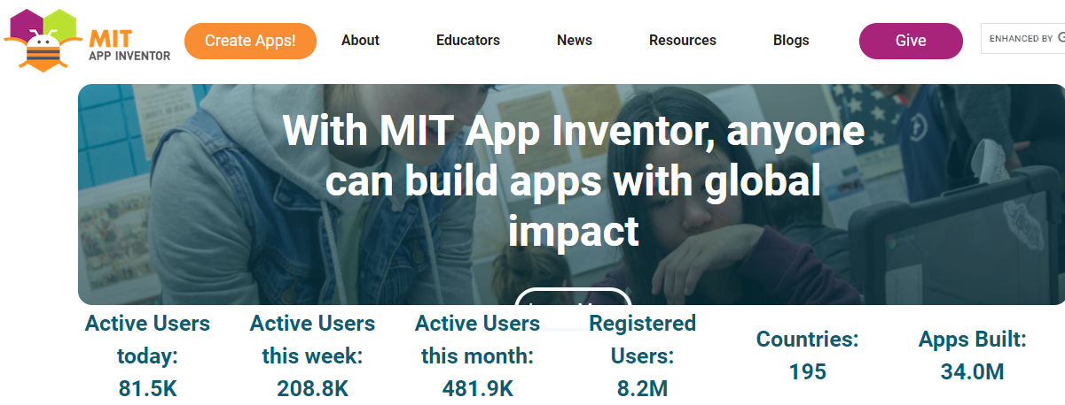
Translate it! Build your first voice translation app with MIT App Inventor
Resources:
MIT App Inventor: http://appinventor.mit.edu/explore
Coding: http://hourofcode.org
GOOGLE!!!!
Why MIT App Inventor?
Open Source
Computational thinking, powerful, REAL coding in Android
Notes:
MIT App Inventor is a web application integrated development environment originally provided by Google, and now maintained by the Massachusetts Institute of Technology (MIT). It allows newcomers to computer programming to create application software(apps) for two operating systems (OS): Android, and iOS, which, as of 8 July 2019, is in final beta testing. It is free and open-source software.
It uses a graphical user interface (GUI) very similar to a puzzle which allows users to drag and drop visual objects to create an application that can run on android devices. It also uses an App-Inventor Companion, which is the program that allows the app to run and debug on in real time that is installed on a testing mobile device.

Slide 5
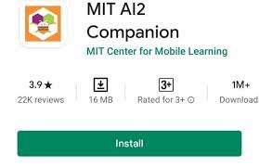
Let’s get started!
Basic Necessities
Computer
Device – phone or tablet - with "MIT App
Inventor Companion App” from Google Play Store!
Same WiFi for Both Devices!!!
Login: http://ai2.appinventor.mit.edu/
Gmail Account
Create apps!

Slide 6
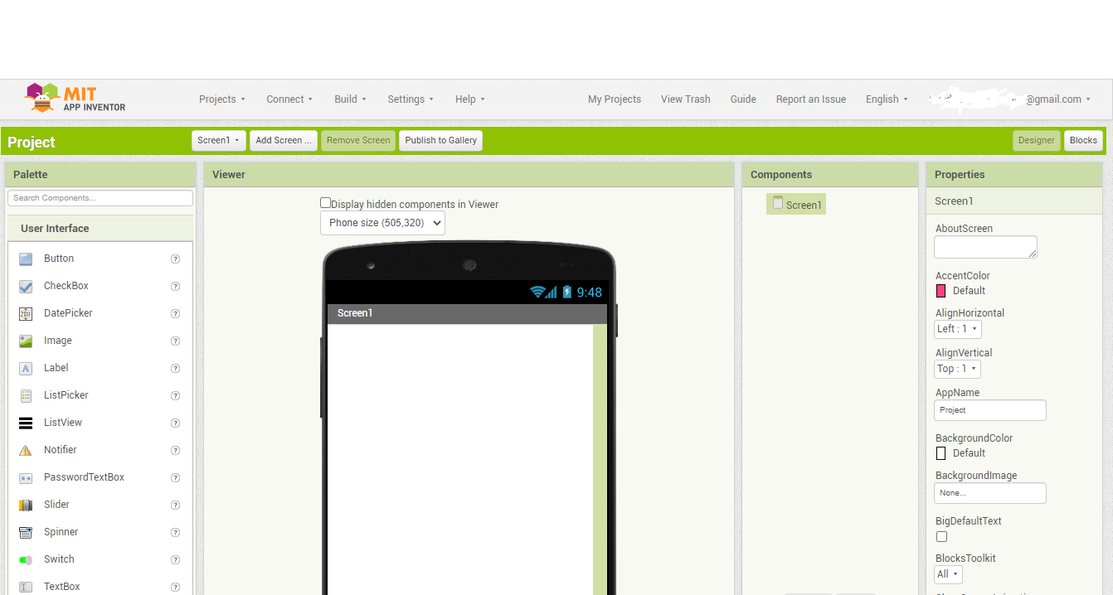
Navigating the MIT App inventor
Start New Project: Give it a name using CamelBackCase: "TranslateIt"
Designer: to create the User Interface: Elements, Properties, etc.
Blocks: includes the code that gives the behavior of our app
Notes:
In the menu on top of the page, select Projects and then New Project
Give it a name using CamelBackCase: "TranslateIt » (Camel case is the practice of writing phrases without spaces or punctuation, indicating the separation of words with a single capitalized letter, and is often used as a naming convention in computer programming (more info: https://en.wikipedia.org/wiki/Camel_case)
The Designer part of the App Inventor contains the elements that help us create the User Interface (how the app will look on the user’s device) and their different settings, and the screen shows:
on the left hand side is the Pallete: is where you add all the elements that make the app perform any number of tasks. The components are grouped by functionality, making it easy to find the right component: user interface components, media, sensors etc. There are two main types of components: visible and non-visible. Visible components such as Button, TextBox, Label, etc. are part of the User Interface. Non-visible components such as Accelerometer, Sound, OrientationSensor are not seen and thus are not a part of the UI screen, but they provide access to built-in functions of the Android device. Take a minute to explore the different components. If you click on the question mark next to each component it will give you more information on it.
In the center left there is the Viewer: is where you drag out the different components that will make our app function. It looks like a phone screen and it mirrors how your app looks on the user’s phone.
In the center right side of the screen there is the Components list: it lists of all components that you have selected (by dragging and dropping in the Viewer) for your app, both visible and non visible.
In the right side there is the Properties list: clicking on one of the components, in this panel you will see what properties they have and it allows for a certain degree of customization for that specific component of your app.
Let’s start by designing how our app will look. Afterwards we will see how the Blocks editor works.

Slide 7
First prototype of our translation app
1. Once the Translate It button is activated
2. It recognizes the words you speak
3.Translates them
4. Into the language you selected
5. And speaks back the translated text
About
Translate It
Notes:
Before we start developing our app, we first need to plan the development process. Let’s do a simple drawing that would represent the first prototype of our translation app.
In terms of User Interface, to make the use of the app simple for the user, we will only add two buttons that will show on the screen: About – that will show a short text explaining what the app is about - , and another button that will activate the translation function, which we will call Translate It.
Regarding the app’s functioning, these are the steps and the order in which the app will do the translation, starting from the text you speak into the phone in English and finishing with the translation of that text in the selected language, spoken back by the phone.
(Read the steps from the slide).

Slide 8
Step 1 Select the app components
User Interface: Button
Rename Button to “AboutButton“
Properties - Text: “About"
User Interface: Button
Rename to “TranslateButton”
Properties - Text: Translation
User Interface: Notifier
Nonvisible Component
Displays Alerts
Media: SpeechRecognizer
Nonvisible Component
Component for using Voice Recognition to convert from speech to text
Media: TextToSpeech
Nonvisible Component
Component speaks a given text aloud.
Media: YandexTranslate
Nonvisible Component
Component to translate words and sentences between different languages
Notes:
Following the logic of our prototype, it’s time to select the different components of our app, from the Pallete.
1. Add the two buttons to be displayed on the app screen:
From the User Interface we drag & drop a Button component (it already shows on the Viewer, it is a visible component). In the Components panel, click on Button1 and rename it to AboutButton, using camel back case (this will be the button name that will show in the Blocks editor). In the Properties panel, go to Text and write About (that will be the button name that will show on the app screen).
Do the same to add the Translate It button.
Play with the colors, fonts and size of the text to customize your app!
2. From the User Interface add a Notifier component: it will display the text of the About button in a message box. It is a non visible component, so it will not show on the app screen.
3. From Media add a SpeechRecognizer component: it is using Voice Recognition to convert from speech to text in the background when we will speak the words to be translated into our phone. It is a non visible component, so it will no show on the app screen.
4. From Media add a TextToSpeech component: this component speaks a given text aloud. You can set a language of pronunciation by supplying a language code. This changes the pronunciation of words, not the actual language spoken. For example, setting the language to French and speaking English text will sound like someone speaking English (en) with a French accent. We will keep the default pronunciation.
5. Finally, the component that will automatically do the translation is Yandex.Translate, from Media. This component needs Internet access, as it will request translations to the Yandex.Translate service.

Slide 9
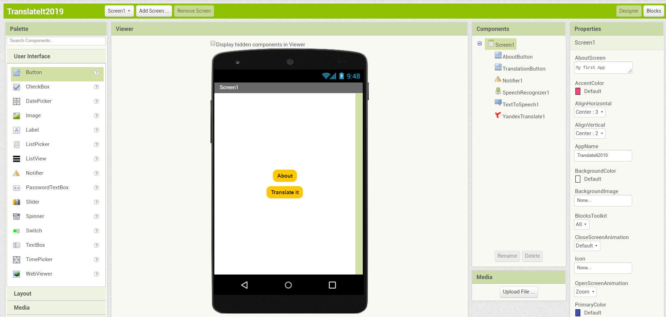
Step 1 Select the app components
Notes:
This is how the components should look like on your screen.

Slide 10
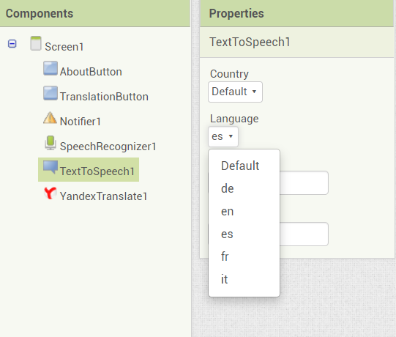
Step 2 Specify Language
TextToSpeech component
Properties: Language (Select)
Notes:
To choose the language in which the app will translate, you need to specify the target language using two letter language codes. For example, "es" will translate to Spanish. Other examples are: de - German, fr – French, it – Italian.

Slide 11
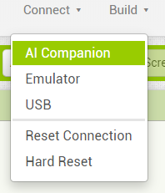
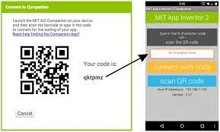
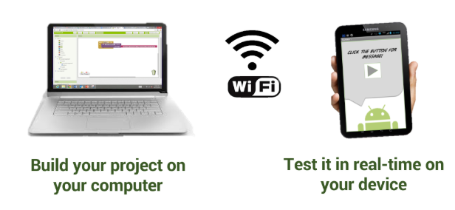
Setup Companion
Download and install the MIT AI2 Companion App on your phone from Google Playstore!
Try it out already:
Connect: AI Companion
Use Companion to Scan QR Code
Should bring you to your App!!!
Notes:
It’s time to see how our app looks on a mobile device!
To see your app on a device while you build it (also called “Live Testing”), you’ll need to follow the steps below:
Download and install the MIT AI2 Companion App on your phone from Google Playstore!
On the menu bar on your computer select Connect -> AI Companion
Scan the QR code appearing on your computer screen with the companion on the mobile device
Now it should bring you to your App!
*Tip: if the connection between the two devices fails from time to time, use the option Reset Connection to reconnect.
Remember that we haven’t yet given a behavior to our components. We will do this in the next steps.

Slide 12
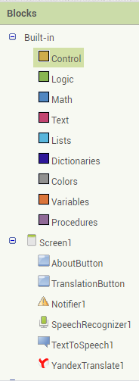
Blocks editor
Give all your components a behavior!
Built-in blocks are available regardless of which components are in your project.
In addition to these language blocks, each component in your project has its own set of blocks specific to its own events, methods, and properties. This is an overview of all the Built-In Blocks available in the Blocks Editor.
Hover over elements to see what you can do with them.
Screen1: Everything you’ve made! :)
Notes:
The blocks editor is an environment in which app inventors can visually lay out the logic of their apps using color-coded blocks that snap together like puzzle pieces to give your app a behavior. More precisely, it describes how the phone should respond to certain events: a button has been pressed, the phone is being shaken, the user is dragging her finger over a canvas, etc.
On the left side of the screen there are the blocks, and in the center there is the Viewer which is the “working space”

Slide 13
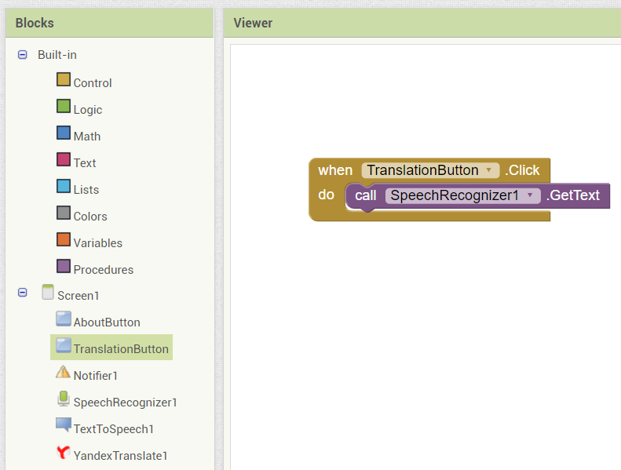
Step 3 Enable Speech Recognizer
TranslationButton: When TranslationButton.Click Do (Brown)
SpeechRecognizer: call SpeechRecognizer.get text (Purple)
Notes:
Now going back to the steps that we identified in designing our prototype , the first behavior to give to our app is to activate the speech recognizer when the translate button is pressed.
Therefore, the first behavior should be given to the translate button. If we press the TranslateButton component there are different “puzzle pieces” that appear on the side. The command that we should use is: « When TranslationButton.Click Do », meaning that when the Translation button is clicked the app needs to do some action. See how the puzzle piece is incomplete? Because we need to tell the app what to do. We want it to activate the speech recognizer.
Clicking the Speech Recognizer component different options of what this component can do will appear from on the side. We select the « call SpeechRecognizer.get text » command (purple) and add it to the puzzle, meaning that the Speech Recognizer will recognize your spoken words and will transform them into text.

Slide 14
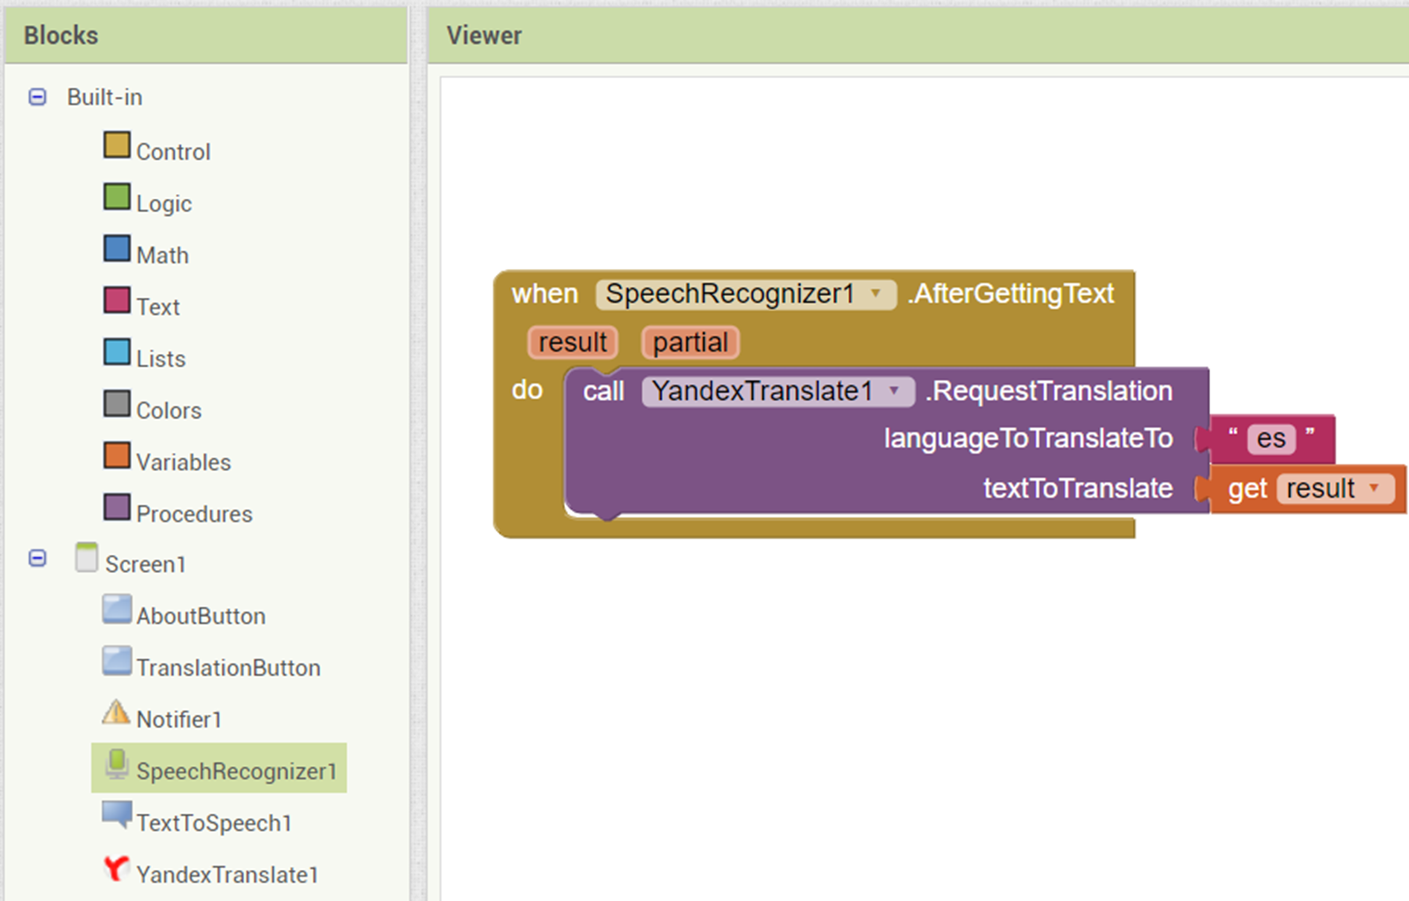
Step 4 Use Yandex Translate
SpeechRecognizer: When SpeechRecognizer.AfterGettingText (yellow)
YandexTranslate: callYandexTranslate.RequestTranslation (purple)
languageToTranslateTo: Text (pink) : es (Spanish)
textToTranslate: Variable (orange): get result
Notes:
Next, we need to add another line of code to tell our app what to do once it has the text to translate.
We click the Speech Recognizer component and we select the “When SpeechRecognizer.AfterGettingText” puzzle piece (yellow).
To do translation, we need to call the Yandex Translate component. We click on the Yandex Translate component and select “callYandexTranslate.RequestTranslation languageToTranslateTo: textToTranslate” (purple). As you see, this command require further indications to the app.
First the language to translate to: from the “Text” built-in blocks, we select a simple text puzzle piece (pink) and inside the text “box” we write “es” to translate in Spanish – small letters, two letters code.
Second, we need to ask the app to store the translation once it get it; for this we select from the Variable built-in block (orange): “get result”.

Slide 15
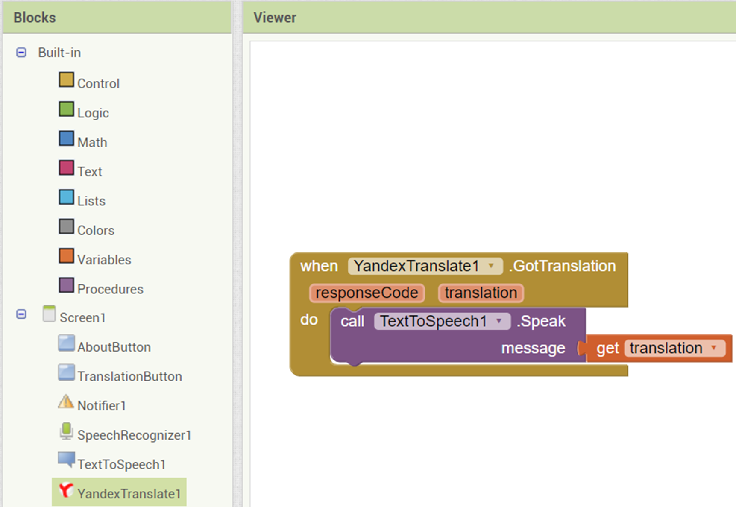
Step 5 Use TextToSpeech
YandexTranslate: when YandexTranslate1.GotTranslation
TextToSpeech: call TextToSpeech1.SpeakMessage (purple)
Variable: get translation (orange)
Notes:
Next, we need to add another line of code to tell our app what to do once it has the translated text.
We click the Yandex Translate component and we select the “when YandexTranslate1.GotTranslation” puzzle piece (yellow).
To ask our app to speak the translation, we need to call the Text to Speech component. We click on Text to Speech component and select “call TextToSpeech1.SpeakMessage” (purple). As you see, this command require further indications to the app, namely what text it needs to speak.
For this we select from the Variable built-in block (orange): “get translation”. This indicates to our app that it needs to speak out loud the translation it made earlier.

Slide 16
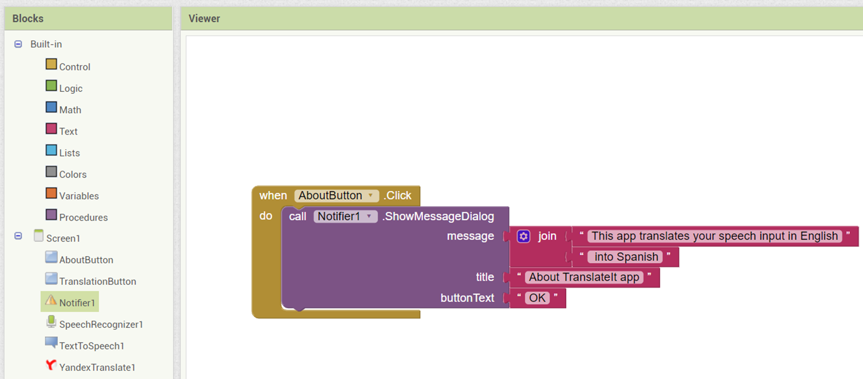
Step 6 Add About Button (optional)
About Button: when AboutButton.click do (yellow)
Notifier: call Notifier.ShowMessageDialog (purple)
Message: Text Join (2 sentences): “nul" & “nul”:
First line: This app translates your speech input in English
Second line: into Spanish
Title: Text - “nul”: About TranslateIt App
ButtonText: Text - “nul”: OK
Notes:
Finally, we will add behavior to our About button, which should inform the user what the app is about.
From the list of components, we click the AboutButton, and we select the puzzle piece/code “when AboutButton.click do” (yellow), that tell our app that an action should follow once the About button is clicked.
Next, we activate the Notifier component, which will display a dialog box on the screen with the message that we will select to explain what the app is about: “call Notifier.ShowMessageDialog” (purple)
You notice the puzzle piece is incomplete, meaning that further action is needed.
First, to add the message to be displayed in the dialog box, we select from the Text block a two-line text “join” and then we select two single line text boxes. On the first line we add the message “This app translates your speech input in English”, and in the second “into Spanish”.
Second, to add the title that will be displayed in the message bow, we select another simple text box, and we add the title “About TranslateIt App”
Third, the buttonText displays the message that the user will press to close the dialog box. We select another simple text box, and we add the text “OK”

Slide 17
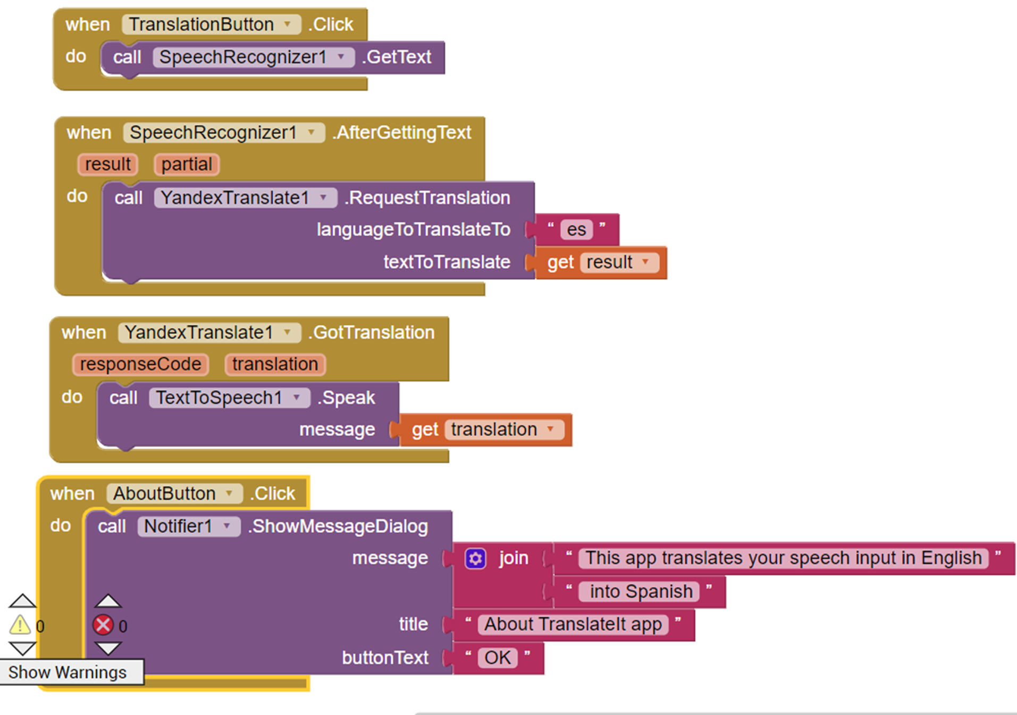
Step 7 You did it! Now test!
Notes:
Test your new app on your phone, using the MIT Inventor Companion App!

Slide 18
THANK YOU !
Find more resources on
http://we4change.eu/
Notes:
merci

