Slide 1

Sustainable Business Model Canvas Workshop

Slide 2

What is the
Business Model Canvas?
The Business Model Canvas is a strategic management tool that lets you visualize and assess your business idea or concept. It’s a one-page document containing nine boxes that represent different fundamental elements of a business.
The Business Model Canvas beats the traditional business plan that spans across several pages, by offering a much easier way to understand the different core elements of a business.

Slide 3
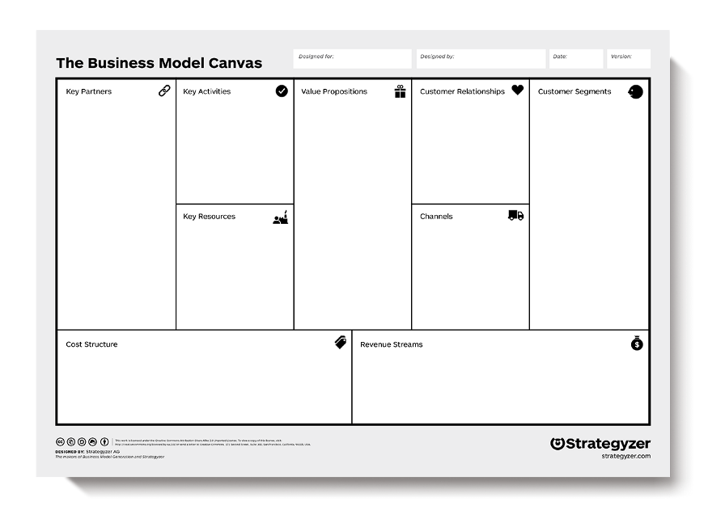
What is the
Business Model Canvas?
Notes:
The right side of the BMC focuses on the customer (external), while, the left side of the canvas focuses on the business (internal).
Both external and internal factors meet around the value proposition, which is the exchange of value between your business and your customer/clients.
Why do we use it?
To quickly draw a picture of what the idea entails.
It allows us to get an understanding of your business and to go through the process of making connections between what your idea is and how to make it into a business.
It looks at what kinds of customer decisions influence the use of your systems.
It allows everyone to get a clear idea of what the business will likely be.

Slide 4

What is the
Sustainable Business Model Canvas?
The Sustainable Business Model enriches the original Business Model Canvas with 3 additional sections: 1) a list of sustainable goals, 2) negative externalities and 3) positive externalities.

Slide 5
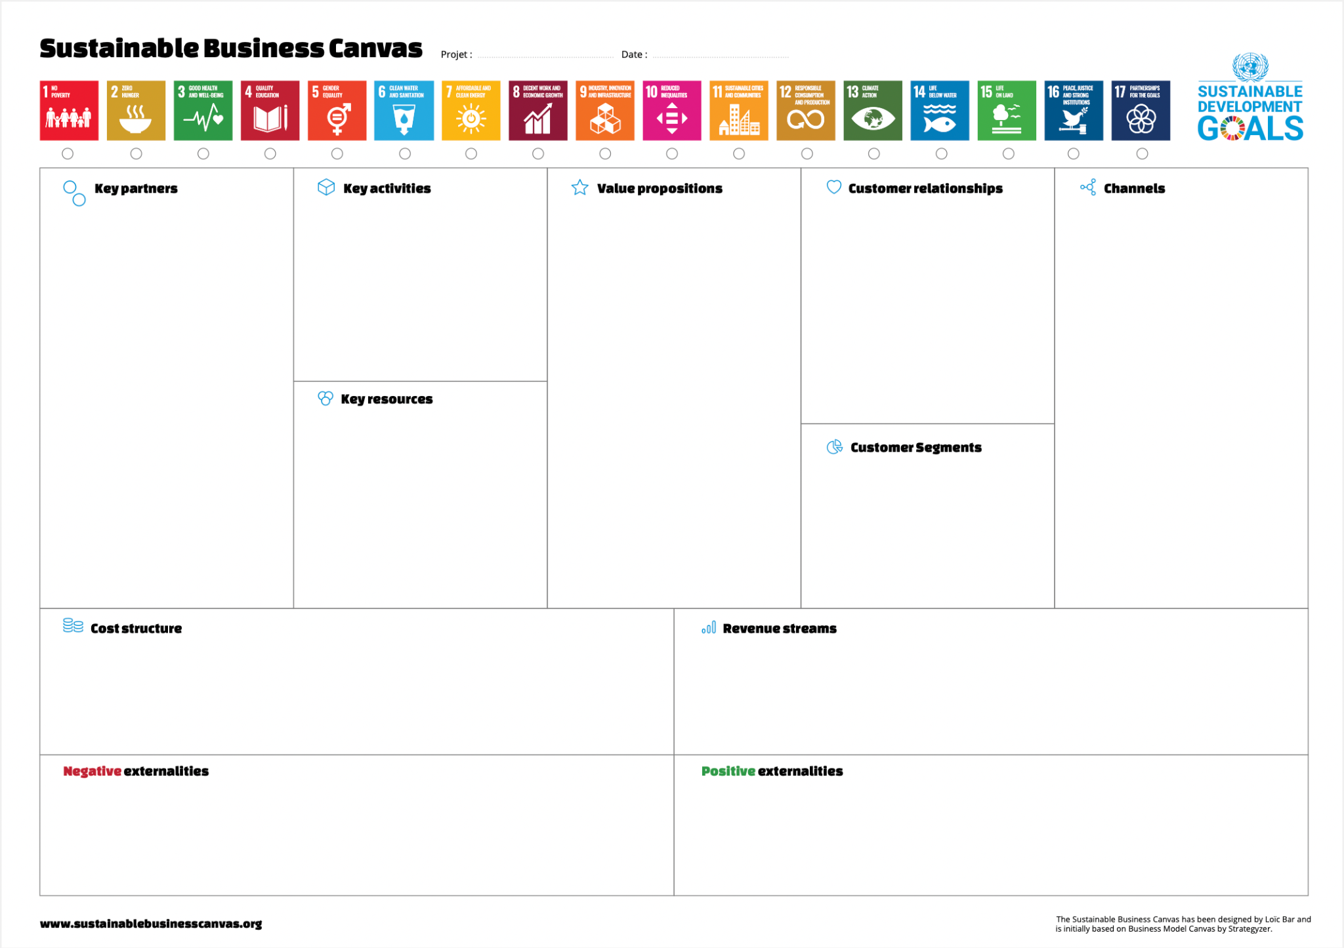

Slide 6
Why you need it
The SBMC provides a quick overview of the business model and is devoid of the unnecessary details compared to the traditional business plan.
The visual nature of the business model canvas makes it easier to refer to and understand by anyone.
It’s easier to edit and it can be easily shared with employees and stakeholders.
The sustainable business model canvas can be used by large corporations as well as startups with just a few employees.
It clarifies how different aspects of the business are related to each other.
You can use a SBMC template to guide a brainstorming session on defining your business model effectively.

Slide 7
How to make your own
There are eleven building blocks in the sustainable business model canvas and they are customer value proposition, customer segments, channels, customer relationships, revenue streams, key resources, key partners, key activities, cost structure, negative externalities and positive externalities.
When filling out a sustainable business model canvas, you will brainstorm and conduct research on each of these elements. The data you collect can be placed in each relevant section of the canvas.
START
YOU HAVE 2 HOURS TO BRAINSTORM AND REASEARCH TOGETHER WITH YOUR TEAM THE DIFFERENT ELEMENTS OF THE BUSINESS CANVA

Slide 8

Structure of the canvas

Slide 9
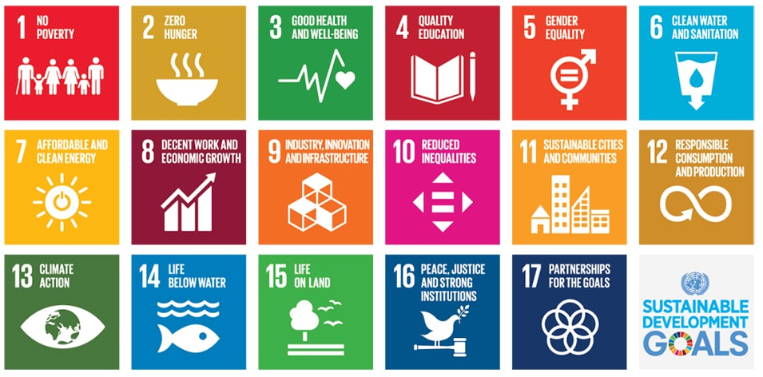
Sustainable development goals
They are the blueprint to achieve a better and more sustainable future for all. They address the global challenges we face, including those related to poverty, inequality, climate change, environmental degradation, peace and justice. This section let the business owner check the goals his/her business addresses.

Slide 10

Key partners
Key partners are the external companies or suppliers that will help you carry out your key activities. They are crucial for successful business model. They can help you to get faster on market or complement your value proposition. Key Partners can also help you compensate your negative externalities.

Slide 11
Key partners
Who are our Key partners?
Who are our key suppliers?
Who can help in negative externalities?
Which key resources are we acquiring from partners?
Which key activities do partners perform?

Slide 12
Key activities
What are the activities/ tasks that need to be completed to fulfill your
business purpose? In this section, you should list down all the key activities you need to do to make your business model work. These key activities should focus on fulfilling its value proposition, reaching customer segments and maintaining customer relationships, and generating revenue.
There are 3 categories of key activities;
Production: designing, manufacturing and delivering a product in significant quantities and/ or of superior quality.
Problem-solving: finding new solutions to individual problems faced by customers.
Platform/network: Creating and maintaining platforms. For example, Microsoft provides a reliable operating system to support third-party software products.

Slide 13

Key resources
This is where you list down which key resources or the main inputs you need to carry out your key activities in order to create your value proposition. You might take into account sustainability in the resources you need.
There are several types of key resources and
they are
Human (employees)
Financial (cash, lines of credit, etc.)
Intellectual (brand, patents, IP, copyright)
Physical (equipment, inventory, buildings)

Slide 14
Value propositions
This is the building block that is at the heart of the business model canvas. And it represents your unique solution (product or service) for a problem faced by a customer segment, or that creates value for the customer segment.
A value proposition should be unique or should be different from that of your competitors. If you are offering a new product, it should be innovative and disruptive. And if you are offering a product that already exists in the market, it should stand out with new features and attributes. Value propositions can be either quantitative (price and speed of service) or
qualitative (customer experience or design). Sustainability can be one of most important aspect of your business model.

Slide 15
Customer relationship
In this section, you need to establish the type of relationship you will have with each of your customer segments or how you will interact with them throughout their journey with your company. Do you want to build tailor made services or self-service approach?
There are several types of customer relationships
Personal assistance: you interact with the customer in person or by email, through phone call or other means.
Dedicated personal assistance: you assign a dedicated customer representative to an individual customer.

Slide 16
Customer relationship
Self-service: here you maintain no relationship with the customer, but provides what the customer needs to help themselves.
Automated services: this includes automated processes or machinery that helps customers perform services themselves.
Communities: these include online communities where customers can help each other solve their own problems with regard to the product or service.
Co-creation: here the company allows the customer to get involved in the designing or development of the product. For example, YouTube has given its users the opportunity to create content for its audience.

Slide 17

Customer Segments
These are the groups of people or companies that you are trying to target and sell your product or service to. Segmenting your customers based on similarities such as geographical area, gender, age, behaviors, interests, etc. gives you the opportunity to better serve their needs, specifically by customizing the solution you are providing them. If your business addresses sustainable goals, you might refine better your customer segments to see how they can be bound to your value.
There are different customer segments a business model can target and they are:
Mass market: A business model that focuses on mass markets doesn’t group its customers into segments. Instead, it focuses on the general population or a large group of people with similar needs. For example, a product like a phone.

Slide 18
Customer Segments
Niche market: Here the focus is centered on a specific group of people with unique needs and traits. Here the value propositions, distribution channels, and customer relationships should be customized to meet their specific requirements. An example would be buyers of sports shoes.
Segmented: Based on slightly different needs, there could be different groups within the main customer segment. Accordingly, you can create different value
propositions, distribution channels, etc. to meet the different needs of these
segments.
Diversified: A diversified market segment includes customers with very different needs.
Multi-sided markets: this includes interdependent customer segments. For example, a credit card company caters to both their credit card holders as well as merchants who accept those cards.

Slide 19
Channels
This block is to describe how your company will communicate with and reach out to your customers. Channels are the touchpoints that let your customers connect with your company. Channels play a role in raising awareness of your product or service among customers and delivering your value propositions to them. Channels can also be used to allow customers the avenue to buy products or services and offer post-purchase support.
There are two types of channels
Owned channels: company website, social media sites, in-house sales, etc.
Partner channels: partner-owned websites, wholesale distribution, retail, etc.

Slide 20
Channels phases
Awareness: how do we raise awareness about our company’s products / services?
Evaluation: how do we help customers evaluate our organization’s value proposition?
Purchase: how do we allow customers to purchase specific products & services?
Delivery: how do we deliver a value proposition to customers?
After sales: how do we provide post-purchase customer supports?
Bonus:
How do you evaluate the sustainability in each of the phase?

Slide 21
Cost Structure
In this block, you identify all the costs associated with operating your business model. You’ll need to focus on evaluating the cost of creating and delivering your value propositions, creating revenue streams, and maintaining customer relationships. And this will be easier to do so once you have defined your key resources, activities, and partners.
Sustainability can represent also a cost for example to create carbon footprint reports. Keep in my mind negative externalities will have an impact on your cost structure.
Businesses can either be cost-driven (focuses on minimizing costs whenever possible) and value-driven (focuses on providing maximum value to the customer).

Slide 22

Revenue Streams
Revenues streams are the sources from which a company generates money by selling their product or service to the customers. In this block, you should describe how you will earn revenue from your value propositions. Don’t forget, revenue streams need to generate more than the cost you will have.
A revenue stream can belong to one of the following revenue models,
Transaction-based revenue: made from customers who make a one-time payment
Recurring revenue: made from ongoing payments for continuing services or post-sale services

Slide 23
Revenue Streams
There are several ways you can generate revenue from:
Asset sales: by selling the rights of ownership for a product to a buyer
Usage fee: by charging the customer for the use of its product or service
Subscription fee: by charging the customer for using its product regularly and consistently
Lending/ leasing/ renting: the customer pays to get exclusive rights to use an asset for a fixed period of time
Licensing: customer pays to get permission to use the company’s intellectual property
Brokerage fees: revenue generated by acting as an intermediary between two or more parties
Advertising: by charging the customer to advertise a product, service or brand using company platforms

Slide 24
Negative externalities
Occur when delivering your value proposition (product or service) causes a harmful effect to a third party. Many businesses have negative externalities. Listing them offers a unique opportunity to better position your business and unleash new business opportunities.
How does your Value Proposition impact negatively your environment?
Your Partners?
Your Ressources?
Your Channel?
An extra question is asked to see how business can compensate this. Negative
externalities can be seen as hidden opportunities that could generate new revenue.

Slide 25

Positive externalities
In this block there are all the positive aspects of your business. Which third parties will benefit from your business.
How your Value Propositions will positively impact your environment?
In what manner your Value Proposition target one or multiple UN sustainable goals?
Positive externalities also create adhesion from customers, employees and shareholders.
In a world where people are the most valuable assets, positive externalities can have a huge impact on keeping this asset onboard.

Slide 26
References
https://creately.com/blog/diagrams/business-model-canvas-explained/
https://corporatefinanceinstitute.com/resources/management/business-model-canvas-template/
https://www.sustainablebusinesscanvas.org

Slide 27
THANK YOU !
Find more resources on
http://we4change.eu/
Notes:
merci

