Slide 1
Your project's visual identity with Canva

Slide 2
What is visual design?
Visual design is the process of creating visual elements that communicate a message or idea to an audience. It encompasses a variety of design elements such as color, typography, images, and layout. Visual design is an essential component of any design project, as it has the power to grab the attention of viewers and convey information effectively.
Notes:
Understanding Visual Design:
Visual design is about creating visual elements that are aesthetically pleasing and effective in communicating a message. It involves the use of design elements to create a visual hierarchy that guides the viewer's eye and directs their attention to key elements.
Elements of Visual Design:
The elements of visual design are the building blocks used to create a design. These include:
Line: Lines are used to create shapes and forms and can be used to guide the viewer's eye.
Shape: Shapes are created by connecting lines and can be used to convey different meanings or emotions.
Color: Color is used to evoke emotions and create a mood or atmosphere.
Texture: Texture adds depth and dimension to a design.
Space: Space refers to the area around and between design elements and is used to create balance and contrast.
Form: Form refers to the three-dimensional quality of a design and can be used to create depth and perspective.
Principles of Visual Design:
The principles of visual design are the guidelines that govern the arrangement of design elements to create a cohesive and effective design. These include:
Balance: Balance refers to the distribution of visual weight within a design and can be achieved through symmetry, asymmetry, or radial balance.
Contrast: Contrast refers to the differences in size, shape, color, or texture between design elements and can be used to create visual interest.
Proportion: Proportion refers to the relative size and scale of design elements and is used to create a sense of harmony and balance.
Repetition: Repetition refers to the use of a design element multiple times within a design and can be used to create rhythm and consistency.
Movement: Movement refers to the way the viewer's eye moves through a design and can be used to create a sense of flow or direction.

Slide 3
Design Tips Some basic tips to keep in mind

Slide 4
Fonts
Some tips
Keep it in the family
Matching fonts are often paired in “Font Families”
Don’t use too many
Two or three at most
Use ALL CAPS sparingly
Notes:
Fonts play a critical role in visual design, as they help communicate the tone and personality of the design. Here are some tips to keep in mind when using fonts:
Choose the Right Font: The font you choose should reflect the message or tone you are trying to convey. For example, a playful font may be appropriate for a children's book, while a more formal font may be appropriate for a business presentation.
Limit the Number of Fonts: Using too many fonts can create a cluttered and confusing design. Limit yourself to two or three fonts to maintain a clean and cohesive design.
Consider Legibility: The font you choose should be legible, even at smaller sizes. Avoid overly decorative fonts that may be difficult to read.
Use Hierarchy: Using different fonts for headings, subheadings, and body text can help create a visual hierarchy and guide the viewer's eye through the design.
Pair Fonts Thoughtfully: When pairing fonts, choose fonts that complement each other and have contrasting characteristics. For example, pairing a serif font with a sans-serif font can create a nice contrast.
Use Font Styles: Using different font styles, such as bold or italic, can add emphasis and visual interest to the design.
Mind Your Spacing: Proper spacing between letters and lines can make a big difference in the legibility and overall look of the design. Adjust the spacing as needed to achieve the desired effect.
Don't Overdo Effects: Avoid using too many special effects, such as drop shadows or embossing, on fonts. These effects can be distracting and take away from the legibility of the font.
By keeping these tips in mind, you can use fonts effectively to create visually appealing and effective designs. Remember, the font you choose can have a significant impact on the overall look and feel of the design, so choose wisely.

Slide 5
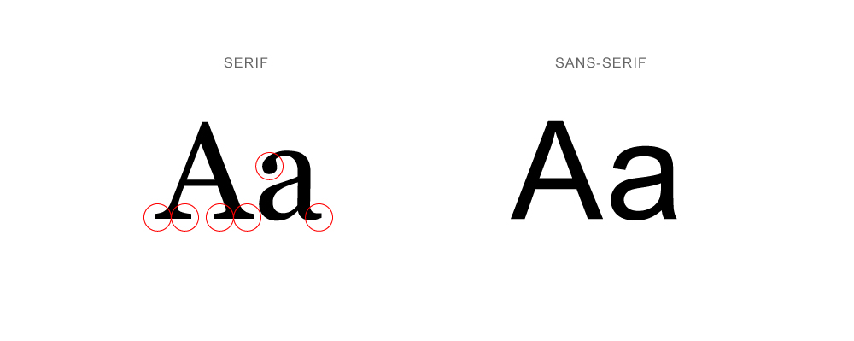
Fonts
Serif vs Sans-Serif
Serif
Traditional
Trustworthy
Classy
Sans-Serif
Modern
Clean
Approachable

Slide 6
Spacing
Space and negative space
Work in grids
Leave space from the worksheet edge
Negative space = Breathing room

Slide 7
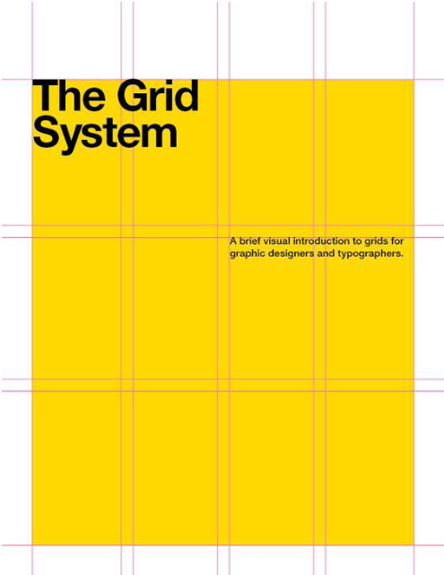
Spacing
Examples

Slide 8
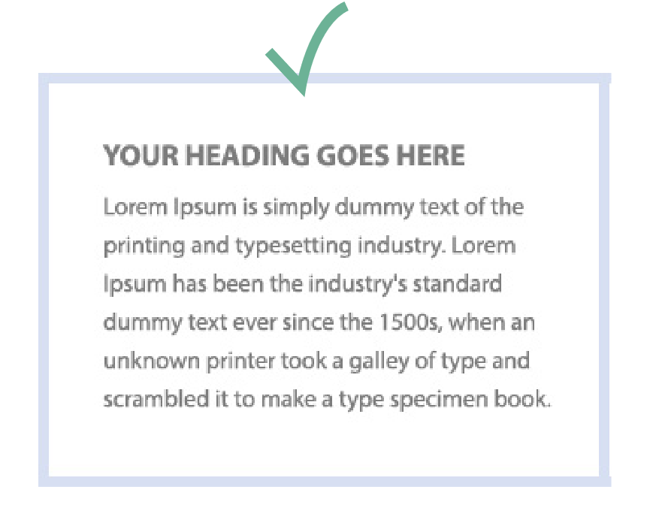
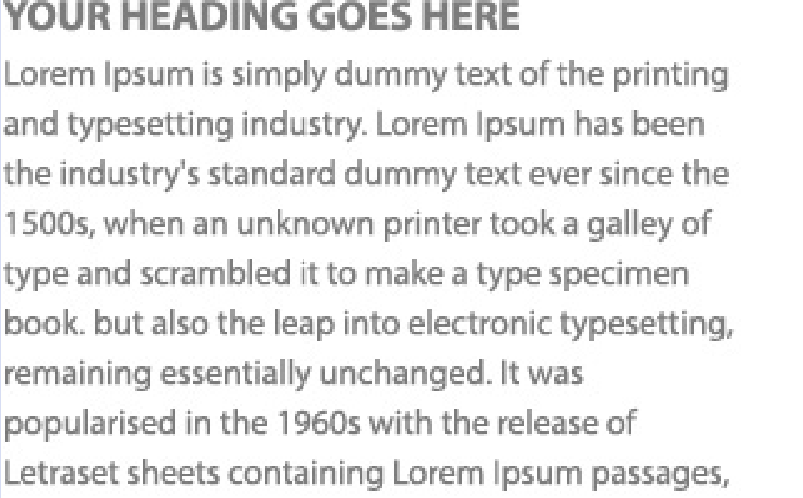
Spacing
Examples

Slide 9
Colors
Color groups and meaning
Choose colors that identify with your brand or design
Different colors have different psychological meaning
Choose colors that are complementary
Not all colors mix
Online tools help you find matches

Slide 10
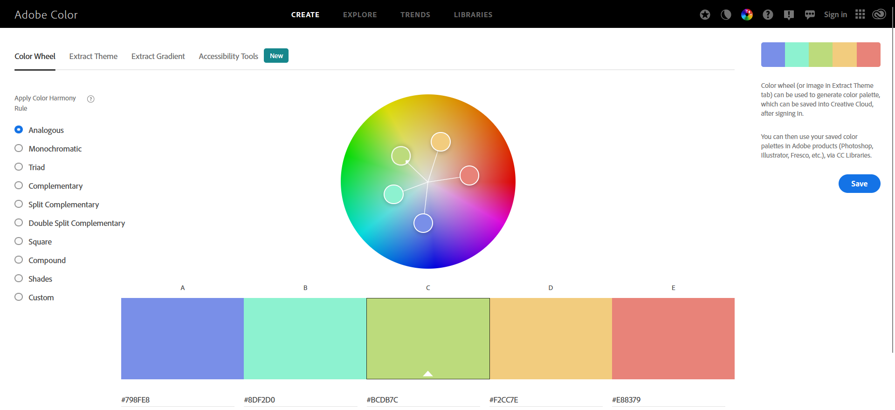
Colors
Examples
https://color.adobe.com/create/color-wheel

Slide 11
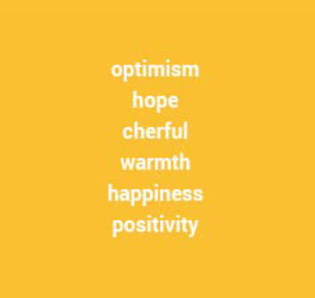
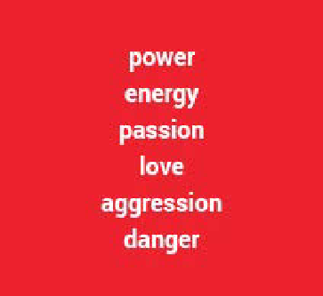
Colors
Examples

Slide 12
Visual design with Canva

Slide 13
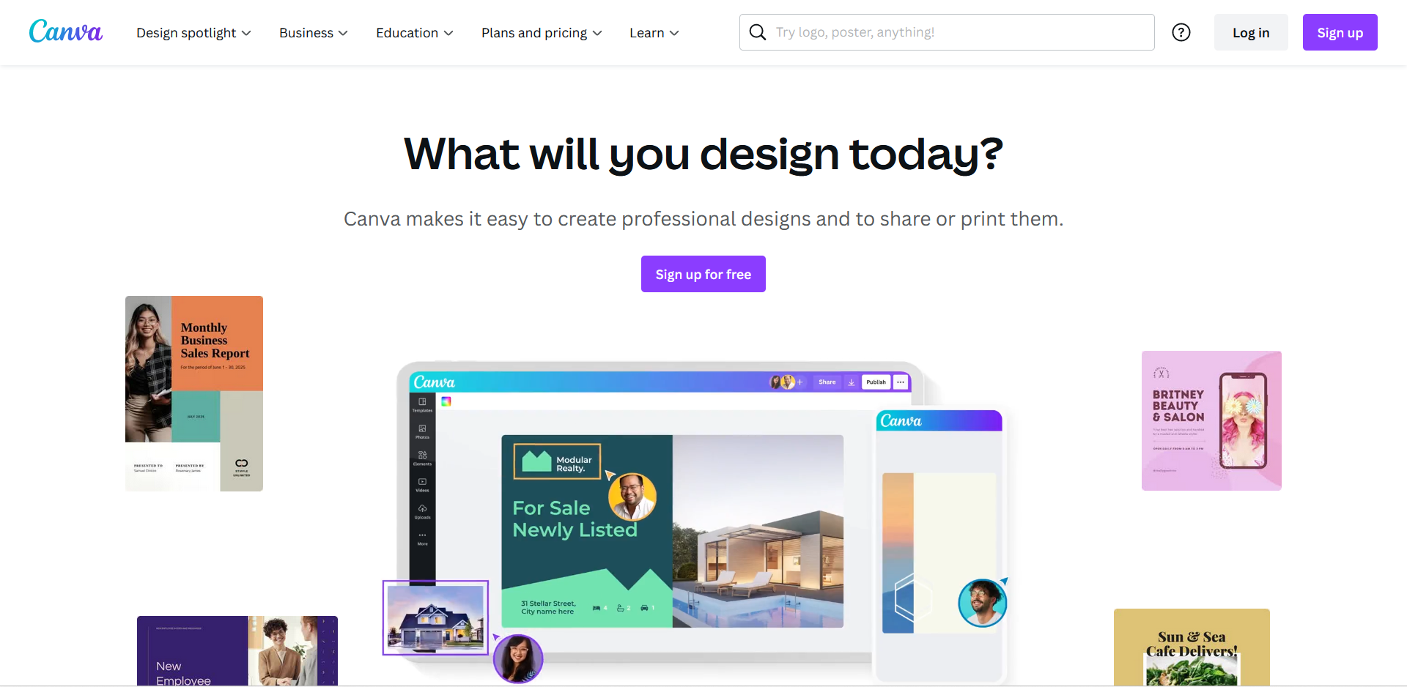
What is Canva?
Canva is an online design website with many tools to help you make things from logos to infographics, videos and more!
Notes:
Canva(opens in new tab) is a graphic design tool that works to simplify the process of digital design. As such, an account can easily be created and everything works either via a web browser or on the iOS or Android apps.
Canva allows for image editing and project-based learning using a simple drag-and-drop interface that works well even for younger students. From brainstorming as a group working collaboratively to individual project creation, it has lots of potential uses in the classroom.

Slide 14
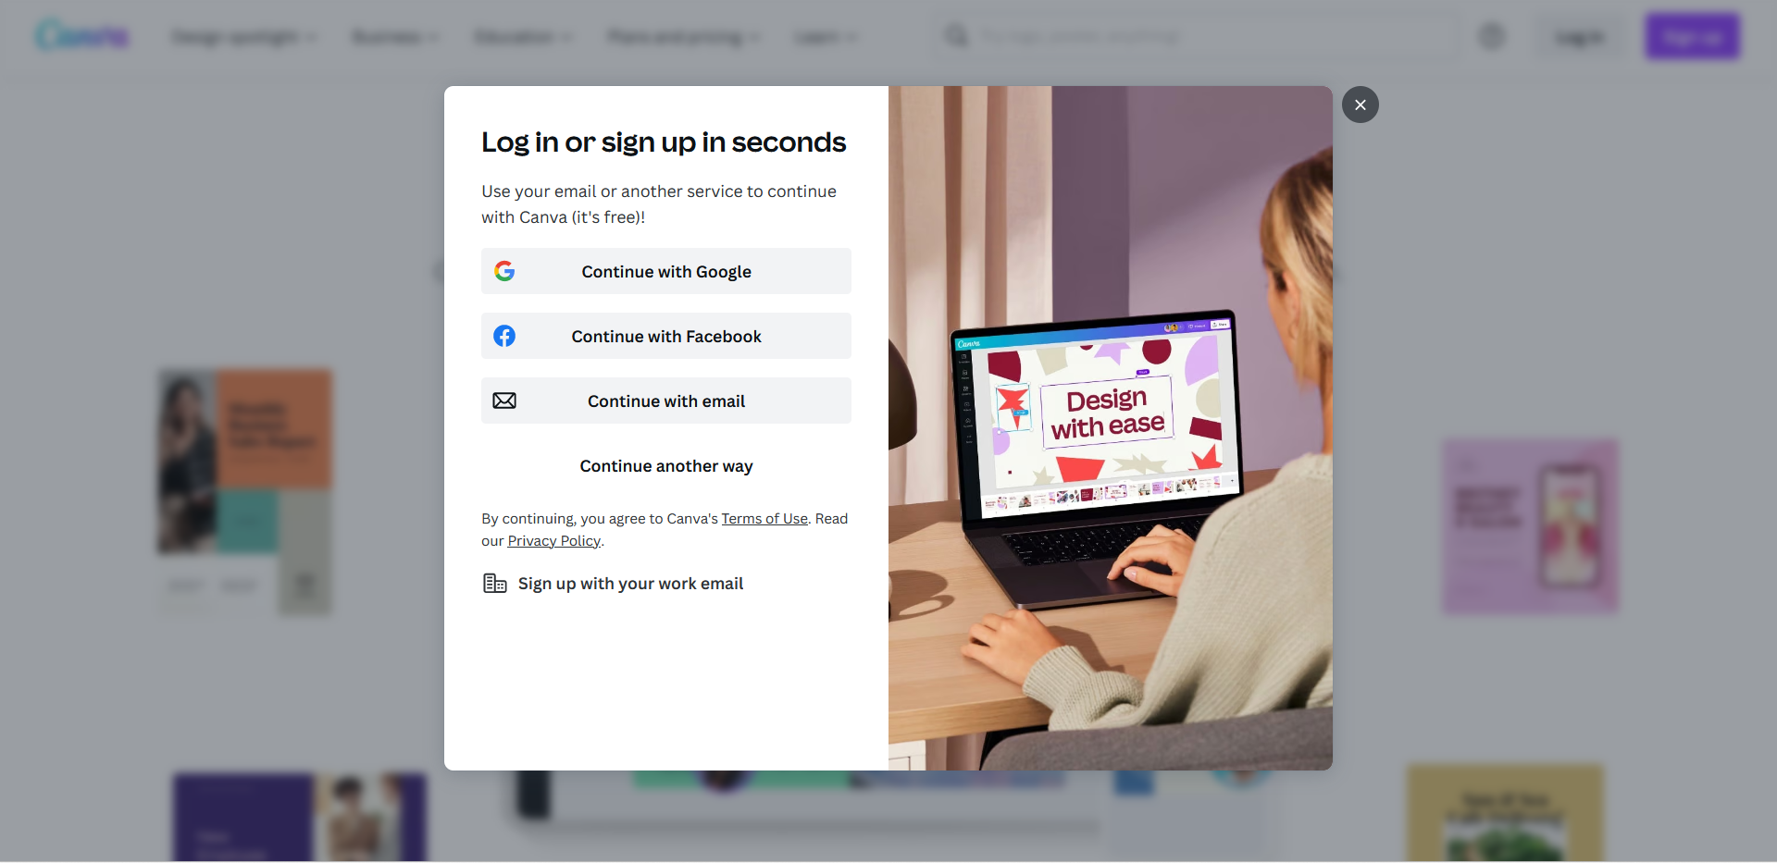
How to get started?
Make an account (it’s free!)

Slide 15
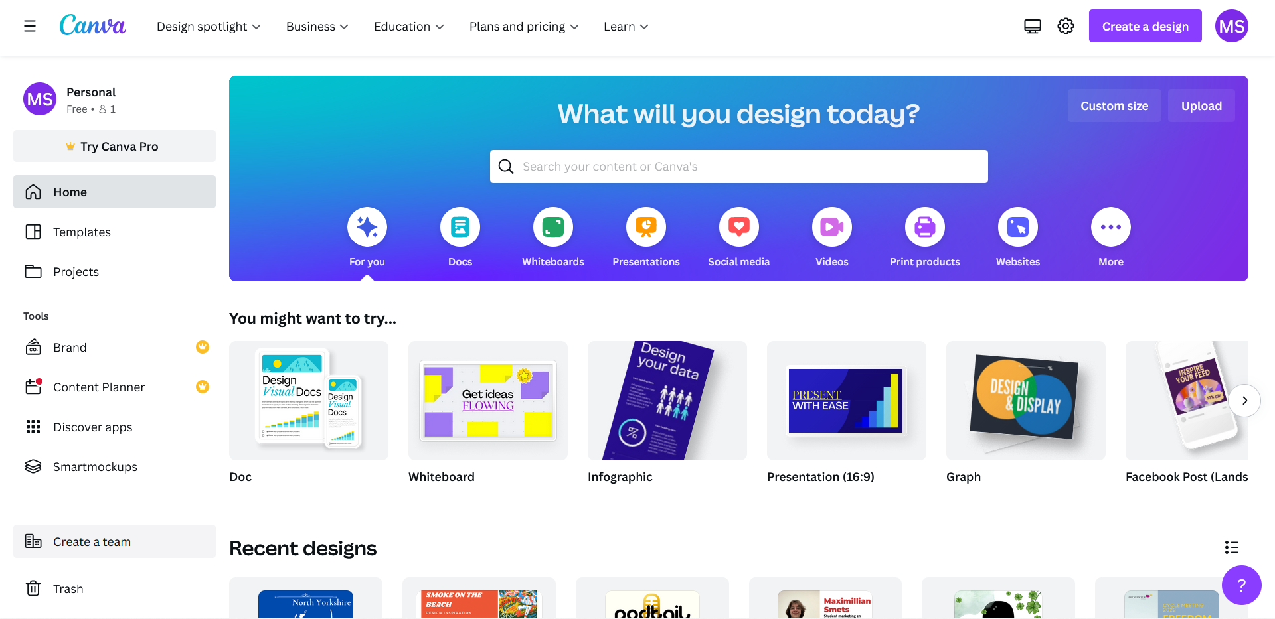
Tools
There are many free templates and mockups to get started

Slide 16
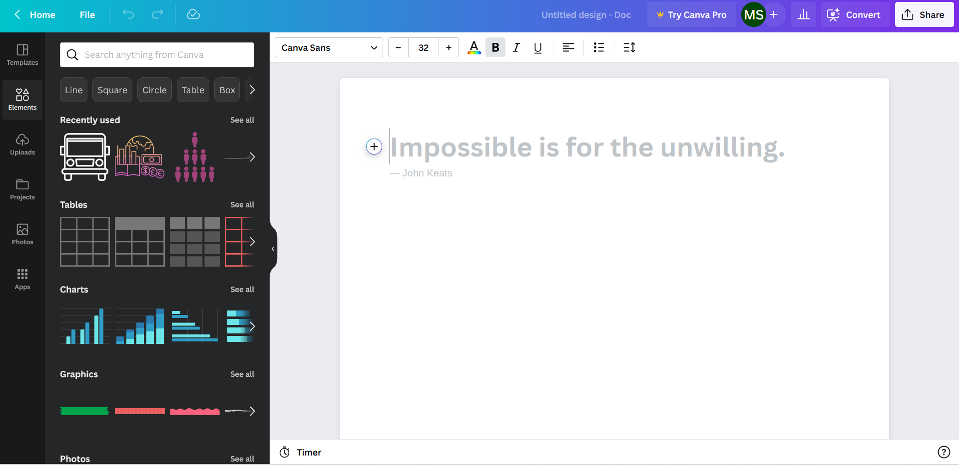
Tools
There are also many free icons, pictures, shapes …

Slide 17
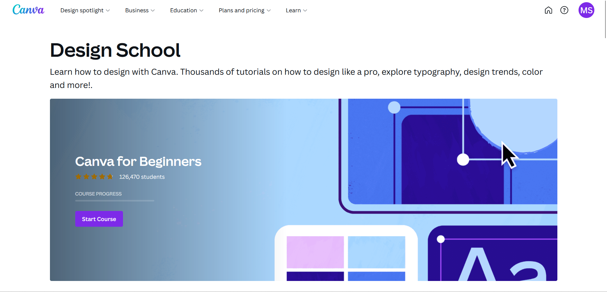
Want to learn more?
Canva offers courses and tips for even more design knowledge

Slide 18
Elements for Brand Design for your project

Slide 19
Building a logo
Exercise
Design a logo for your project
What elements of the logo tell the story of your project?
You have 20 minutes

Slide 20
Building a logo
Don’t go overbroad
Your logo represents your brand/company
Implement related elements
Make it timeless
Will it still look good years from now?
Simple shapes are easy on the eye
and memorable
Make sure it scales well

Slide 21
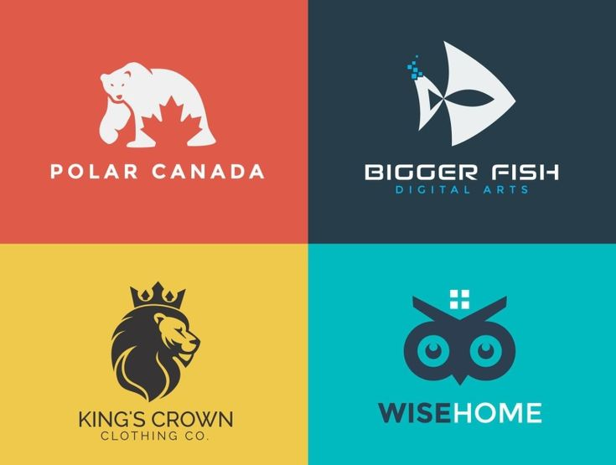
Building a logo
Examples

Slide 22
Building a presentation
Exercise
Make a short presentation about your project
Keep the tips in mind. Also, the presentation is only the support for transmitting the message, not the focus
You have 25 minutes

Slide 23
Building a presentation
The speaker matters the most
The slides are support
YOU are the focus
Don’t overly animate
Animations take distracts the attention of the speaker
No more than 6 text points per slide
Keep it concise

Slide 24
Building a leaflet
Exercise
Design the leaflet of your project
Think up a slogan and call to action
Look for eye catching images
You have 20 minutes

Slide 25
Building a leaflet
Simple but memorable
Choose a concise message
Include a call to action (Ex. Visit now/Check us out…)
Identify your target audience
Make it eye-catching (with text, images…)
Make sure your logo is present

Slide 26
Building a leaflet
Example

Slide 27
Building a social media template
Exercise
Create a social media visual post for your new project
Think of a tagline and hashtags that relate to your brand
Include your logo
You have 15 mins

Slide 28
Building a social media template
Stay consistent
Match your style with your brand/company
Make empty frames to put pictures in
Include your logos when possible

Slide 29
THANK YOU !
Find more resources on
http://we4change.eu/
Notes:
merci

