Slide 1
Girls & Women for
Mobility

Slide 2
Why does it matter to look at climate change through a gender perspective?
Source: https://unsplash.com/pt-br/fotografias/5sh24a7m0BU
Notes:
Climate change is not gender neutral, and througout this document we will contextualize why this is the case

Slide 3
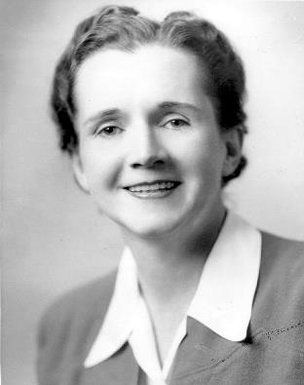
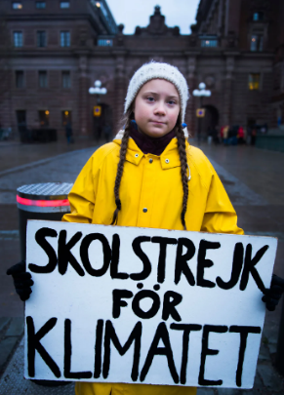
Rachel Carson
Greta Thunberg
Author of the Landmark publication « Silent Spring » in 1962, denouncing the environmental impact of the use of pesticides, denouncing the malpractices of the chemical industry. It is credited for starting the environmental movement in the 60’s
Young activist who started the movement Fridays for Future following her pledge to strike shcool on fridays to make the Sweedish government to act on Climate Change. On March 15th 2019 more than one million students around the world mobilize for the School Strike for Climate and marched in cities all over the world.
Sources:
https://upload.wikimedia.org/wikipedia/commons/f/f4/Rachel-Carson.jpg
https://www.health.harvard.edu/blog/silent-spring-at-50-connecting-human-environmental-health-201206114870
Source:
https://www.britannica.com/biography/Greta-Thunberg
Notes:
If we think about the environment and climate movement, it may be likely that female figures come to mind. From Rachel Carson who in the 1950’s published “Silent Spring” her landmark work that is credited to have kickstarted the environmental movement and paved the way for female representation in male dominated scientific environmental fields, to Greta Thunberg, the most prominent climate activist of today who made herself known for striking school on Friday and kickstarting the international movement Fridays for Future.
Women have clearly been in the forefront of mobilization towards environmental and climate issues. But the reality is that women are considered today one of the most vulnerable groups to the impacts of Climate Change.

Slide 4
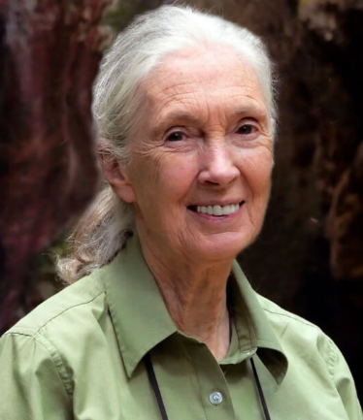
Jane Goodall
Sylvia Earle
Marine Biologist and Oceanographer, one of the most well regarded and landmark names in ocean conservation. An Explorer for National Geographic Society. She has championed the field and launched several initiatives to help protect marine areas.
In the field of chimpanzee research, Jane Goodall is considered a trailblazer. Since commencing her groundbreaking studies in 1960 in Africa, where she established novel conservation and development initiatives, the Jane Goodall Institute has become widely respected.
Source: https://www.miamibookfair.com/event/dr-jane-goodall-in-conversation-with-peter-wohlleben/
Source: https://edition.cnn.com/2022/11/02/world/sylvia-earle-c2e-spc-intl-scn/index.html
Notes:
Last century the environment movement was marked by remarkable women either in conservation on land, with the work of world renowned Jane Goodall, and on the blue side, by Sylvia Earle one of the most recognized names in ocean conservation.

Slide 5
Vanessa Nakate
Artemisa Xakriabá
Climate Justice activist from Uganda. She kickstarted a climate movement inspired by Greta Thunberg, after becoming aware of the consequences of rising temperatures in her country. She is one of the most proeminent voices in the African continent fighting for climate justice
Young indigenous Brazilian activisit. She has been vocal about defend her community from the devastation by the mining industry in Minas Gerais, and oposing the human rights violations.
Source:
https://www.dazeddigital.com/life-culture/article/46209/1/who-isindigenous-climate-change-activist-artemisa-xakriaba
Source:
https://en.wikipedia.org/wiki/Vanessa_Nakate
Notes:
Not only in the global North, women in the global south have also been very much vocal and important voices in mobilizing towards action. Vanessa Nakate is currently one of the most prominent voices in fighting for climate justice in the African continent. In Brazil, Artemisa is active in fighting for indigenous communities' rights against the mining and logging industry. These examples and many others from the Global South are especially inspiring given the social and political context of these regions, in places in which being a vocal activist may put these people in dangerous situations and it carries a big amount of risks.

Slide 6
WOMEN & CLIMATE CHANGE
Why does it matter to look at climate change through a gender perspective?
Climate Change worsens inequalities: the most vulnerable segments of the population will experience the most severe environmental and economic impacts, especially in the Global South;
The experience of women in the Global South is different from the Global North. In the Global South women are perceived as local communities leader and resource stewards;
Women are still very much unrepresented in decision making positions, in particular in science and climate action – research shows that climate action bennefits from more women in these positions.
Women are a part of the most vulnerable segments of population;
Climate change may perpetuate gender violence, especially in communities where women are resource stewards;
Notes:
Women have clearly been in the forefront of mobilization towards environmental and climate issues. But the reality is that women are considered today one of the most vulnerable groups to the impacts of Climate Change.
According to the United Nations Convention for Climate Change (UNFCC) climate impacts, especially extreme weather events, are affecting the roles of women and men around the world, particularly in rural areas. It also recognized that women are agents of change. It has been shown that inclusive governance, promoted by international bodies and national governments, can result in long-lasting and effective climate-resilient policies that lead to improved social equity in general, and gender equality specifically, through integration of more women and marginalized groups into decision-making.
It is also necessary to recognise the difference of experiences between the Global North and Global South. There is a quite difference of experience amongst women in these realities. Whilst women of the south have a more prevalent role resource management and community leadership, and therefore will suffer more from the impacts of extreme weather events worsened by climate change, in the global north there is a lack of representation in the bodies that govern and decide on climate issues, as well in scientific roles. This is not by all means mean that women of the global south do not suffer from this, there is a prevalent lack of representation from the realities of the global south. However, recognizing these different experiences is essential to cultivate solidarity amongst these two parts of the globe, and coordinate an holistic action and support across these interconnected issues.
Sources:
https://www.un.org/womenwatch/feature/climate_change/downloads/Women_and_Climate_Change_Factsheet.pdf
https://unfccc.int/sites/default/files/resource/sbi2022_07.pdf

Slide 7
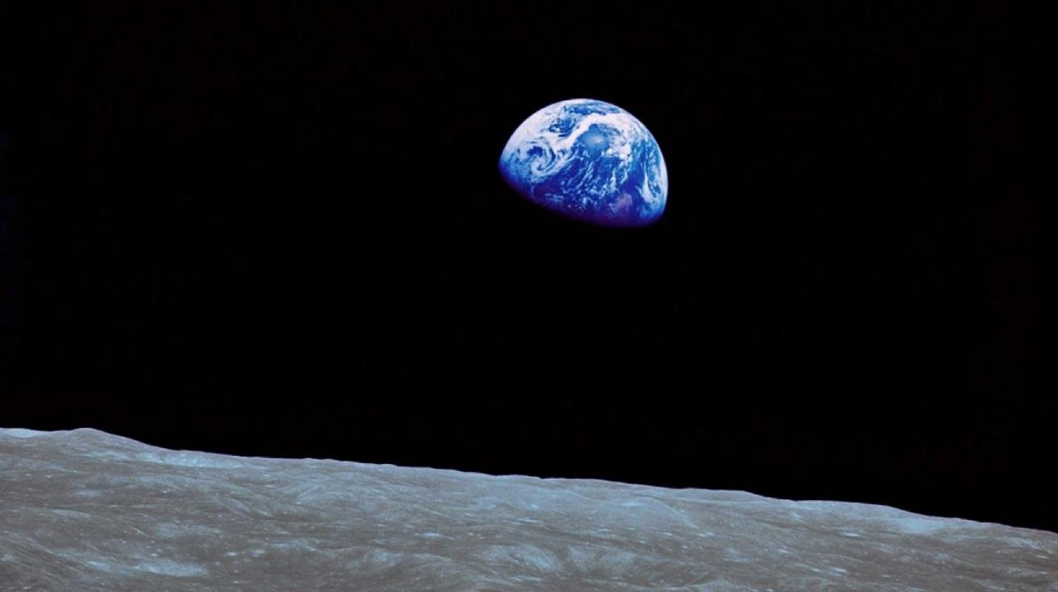
AN INTRODUCTION TO CLIMATE CHANGE
Source: https://www.voanews.com/a/could-a-sprinkle-of-moon-dust-keep-earth-cool/6954388.html

Slide 8
Source: https://www.voanews.com/a/could-a-sprinkle-of-moon-dust-keep-earth-cool/6954388.html
Notes:
This picture was taken by the apollo mission’s astronauts, orbiting the earth. It is a quite symbolic picture because it gave a sense of how unique earth, the blue planet, is.

Slide 9
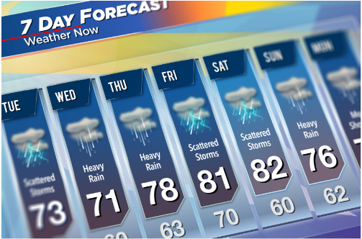
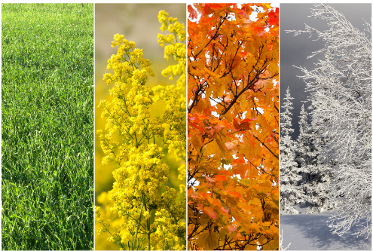
Weather vs Climate
Day-to-day state of the atmosphere and its short-term variation that ranges from minutes to weeks
Average weather over a long period (usually of a period of no less than 30 years), in a specific region and time of the year
Notes:
First and foremost, we need to understand what is changing exactly when we speak of climate change. No better way to do it than to first know what exactly is the climate. A good way to exemplify it is to differentiate weather and climate. Weather is the day-to-day state of the atmosphere and its short-term variation that ranges from minutes to weeks. Simply put, it is the information that the weather people provide us every morning - humidity, wind, temperature and so on... The climate, however, is a long-term account of the weather patterns, usually on a longer period of a minimum of 30 years. In other words, it is the information on weather patterns that allow you to know what to expect from seasonal weather throughout the year, and know which type of clothes to keep in your closet to face the weather in each season.
Now, to focus our attention on where all of this takes place: the atmosphere. The atmosphere is a complex and layered space that revolves around planet earth, composed of several gases that are fundamental to guarantee a liveable planet and where, amongst other, meteorological phenomenon takes place.

Slide 10
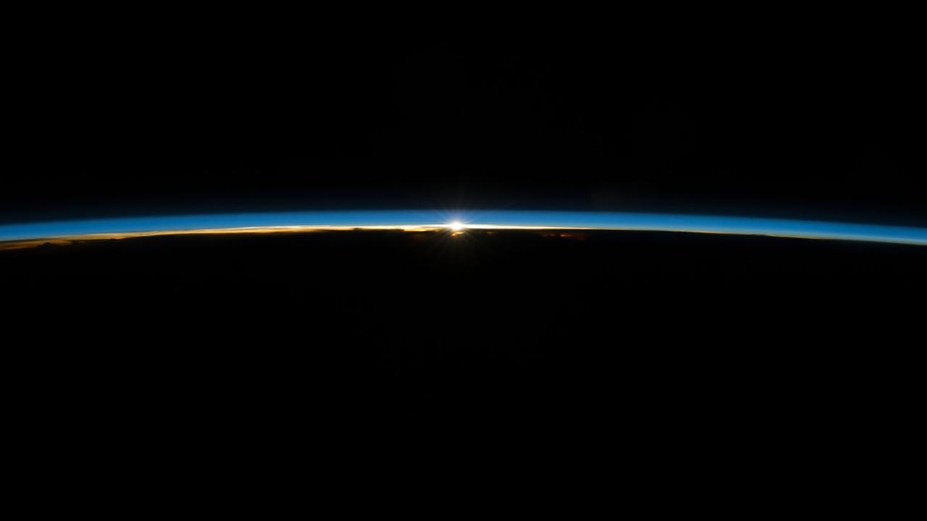
Source: https://www.esa.int/ESA_Multimedia/Images/2022/01/The_beauty_of_the_Sun_seen_from_space
Notes:
Now, to focus our attention on where all of this takes place: the atmosphere. The atmosphere is a complex and layered space that revolves around planet earth, composed of several gases that are fundamental to guarantee a liveable planet and where, amongst other, meteorological phenomenon takes place.

Slide 11
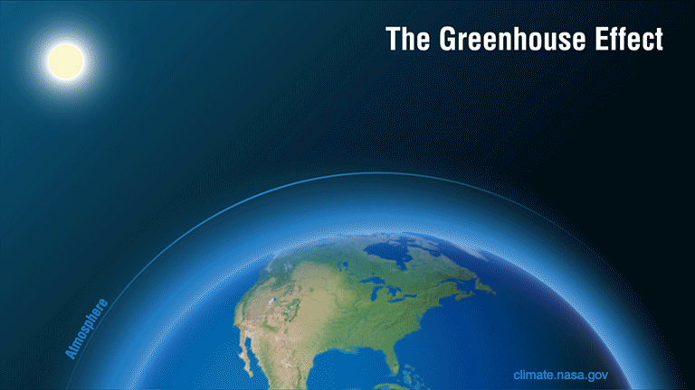
Source: https://climate.nasa.gov/climate_resources/188/graphic-the-greenhouse-effect/
Notes:
A lot happens in the atmosphere, and the most important regarding climate change is the greenhouse effect. The greenhouse effect is a natural process that prevents us from freezing here on the planet. Without it the temperature on the surface of the earth would be -18Cº.
This effect is like the workings of a greenhouse, hence the name. Solar radiation passes through the atmosphere and is absorbed by the earth's surface, which re-emits the radiation at a lower wavelength in the form of infrared (IR) radiation. This IR radiation is thermal radiation, that is, it causes an increase in temperature. This radiation is emitted by the Earth's surface into space but is captured by certain gases present in the atmosphere, which have the ability to absorb and re-emit it in all directions, including back to Earth. Thus, a layer with constant thermal radiation is formed, which does not immediately escape from the Earth, heating its atmosphere. This is exactly what happens in a greenhouse, where light passes through the glass, hits the ground, which heats up and radiates back from the IR radiation, which is retained by the glass, heating the interior of the greenhouse.

Slide 12
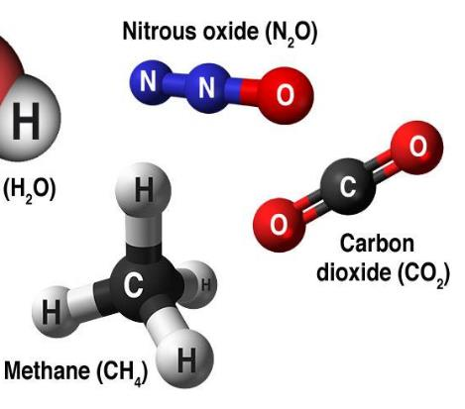
Greenhouse gases (GHG)
CO₂ - carbon dioxide
CH₄ - methane
N₂O - nitrous oxide
HFCs - hydrofluorocarbons
PFCs - perfluorocarbons
SF₆ - Sulfur hexafluoride
Natural
Synthetic
(Fluorinated Gases)
Source: https://climateyou.org/causes/
Notes:
Greenhouse gases (GHG) are responsible for heating of the atmosphere and the surface of the earth. Carbon Dioxide (CO2) is probably the most familiar, since it is the more well known, however it is not the only GHG. The Kyoto Protocol groups the following gases in the category of the GHG:
Natural - and by natural we mean that they exist naturally in the atmosphere and come from natural/anthropogenic environments: Carbon Dioxide (CO2), Methane (CH4), Nitrous Oxide (NH2); Synthetic - created by us: HFCS - Hydrofluorocarbons, PFCS - Perfluorocarbons, SF6 - Sulfur Hexafluoride.

Slide 13
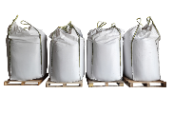
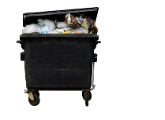
Greenhouse Gases (GHG)
Global Greenhouse Gas Emissions by Gas
Fluorinated
Gases 2%
Nitrous
Oxide
6%
Methane
16%
Carbon Dioxide
(Forestry and other land uses)
11%
Carbon Dioxide
(Fossil fuels and industrial processes)
65%
Source: Intergovernmental Panel on Climate Change, Fifth Assessment Report (2014)
Notes:
GHG come from a wide array of sources. Carbon Dioxide is the most prevalent in the atmosphere, and comes mostly from the burning of fossil fuels in transportation and industrial processes, as well as from forests and other land uses (such as agriculture, for example). Methane is generated by waste but mostly from agriculture and livestock activities, as it is the case of nitrous oxide which mostly comes from the use of fertilizers. Fluorinated gases are mostly generated in industry processes and refrigeration, our air conditioners and fridges as examples.

Slide 14
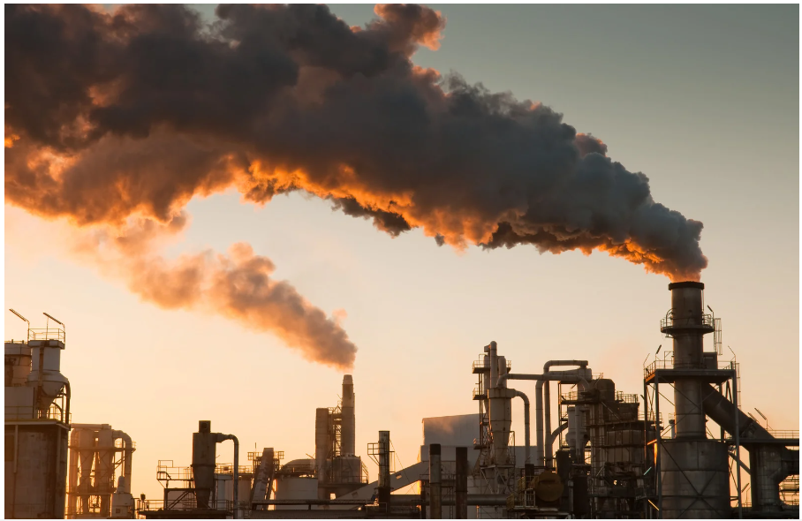
Notes:
Now we’ve learned how the temperature of the earth is maintained at a global average of 18ºC that prevents us from freezing. And how does it relate to climate change? There can be too much of a good thing. And that is true for the concentration of GHG in the atmosphere.

Slide 15
CO₂ is being released into the atmosphere faster than ever before, at least for the last 66 million years.
Fonte: RE Zeebe, et al., Nature Geoscience, March 2016

Slide 16
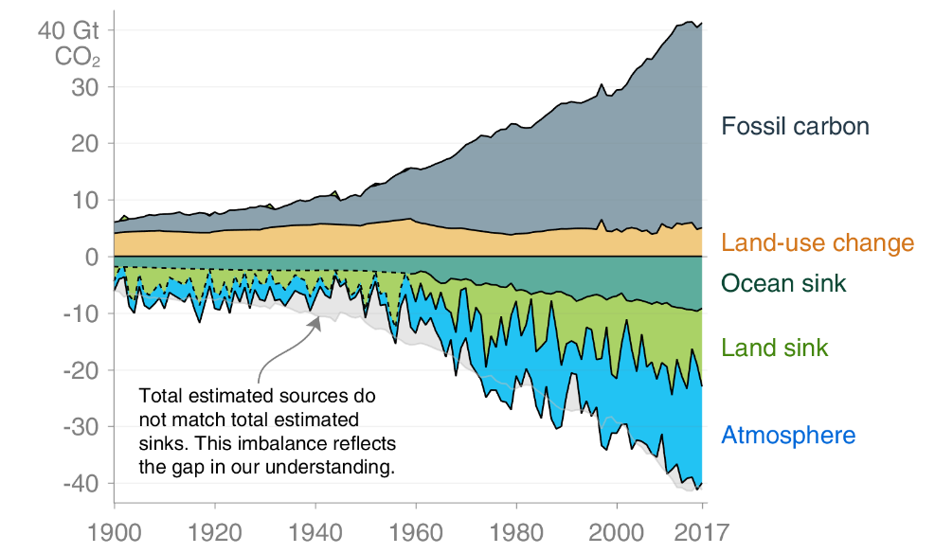
Carbon Global balance
22%
29%
Source: Global Carbon Project
Notes:
The carbon dioxide emitted to the atmosphere does not stay in full there. There is a balance of absorption and emission of carbon dioxide… This balance is maintained by what it is called “Natural sinks”. The natural sinks in earth are the forest and the oceans, that abosrv the CO2 in the atmosphere via photosynthesis. However, we have surpassed the absorption capacity of these sinks, so a lot of the CO2 emitted is being accumulated in the atmosphere, which exacerbates the greenhouse effect.

Slide 17
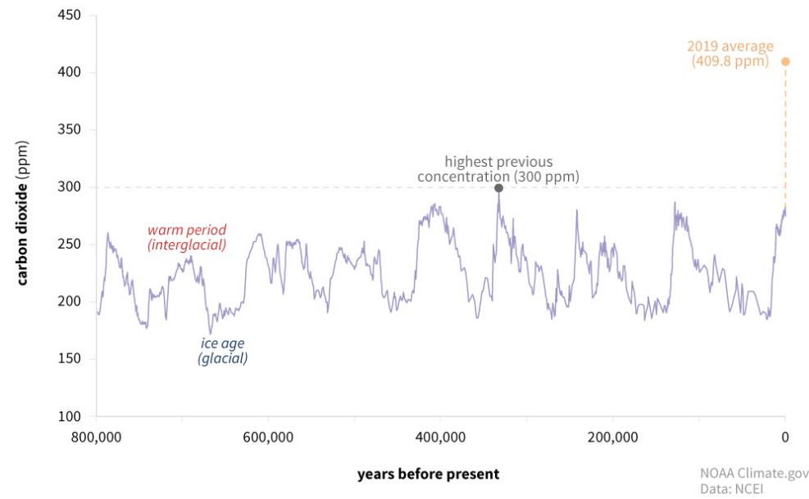
CO₂ concentration
CURRENT CONCENTRATION
417.47 ppm
(last measurement
Jun 2021)
Source: National Oceanic and Atmospheric Administration (NOAA)
Notes:
Variations on the concentration of CO2 in the atmosphere is a cyclical occurrence and are expected, as it has happened throughout the millennia. These variations coincide with the earth’s glacial periods and warmer periods. But what we registered today is an unprecedented record-breaking concentration of CO2 in the atmosphere.

Slide 18
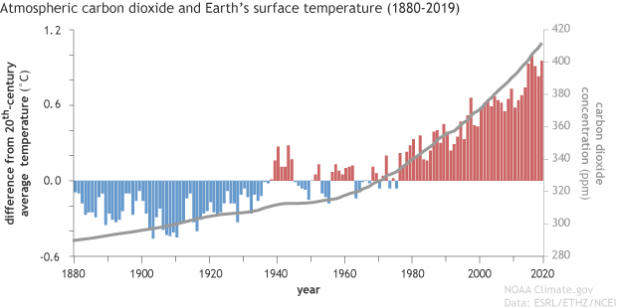
CO2 concentration and temperature increase
Annual differences in temperature at the Earth’s surface relative to the 20th century average and CO2 concentration
Source: National Oceanic and Atmospheric Administration (NOAA)
Notes:
417 parts per million may not look like a lot, but if we bring average temperature differences from the previous century, we can see a correlation between it and the increase in CO2 in the atmosphere.

Slide 19
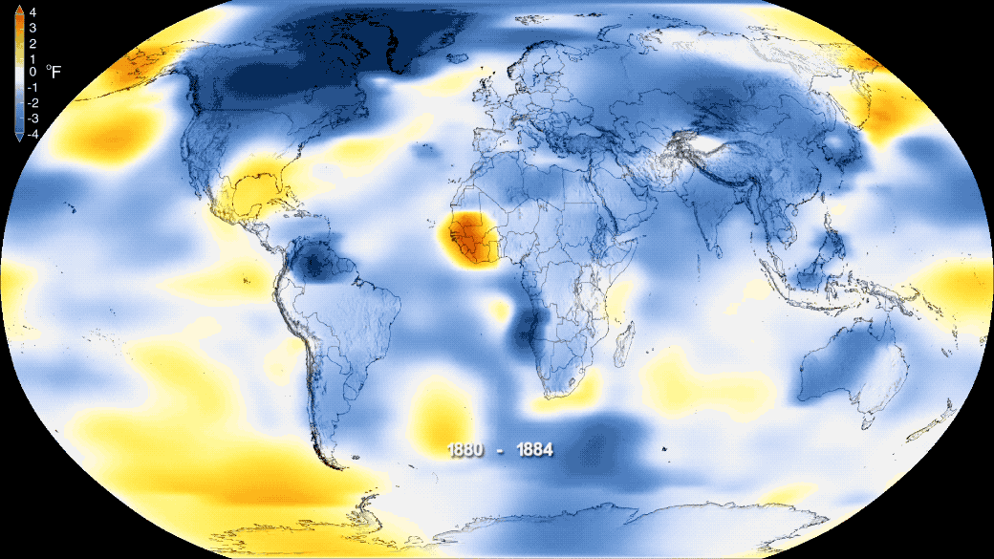
Source: NASA
Notes:
If we take the whole globe into account, as some NASA graphics illustrated in the presentation, we can clearly see a tendency of the temperature to increase since the 19th century.

Slide 20
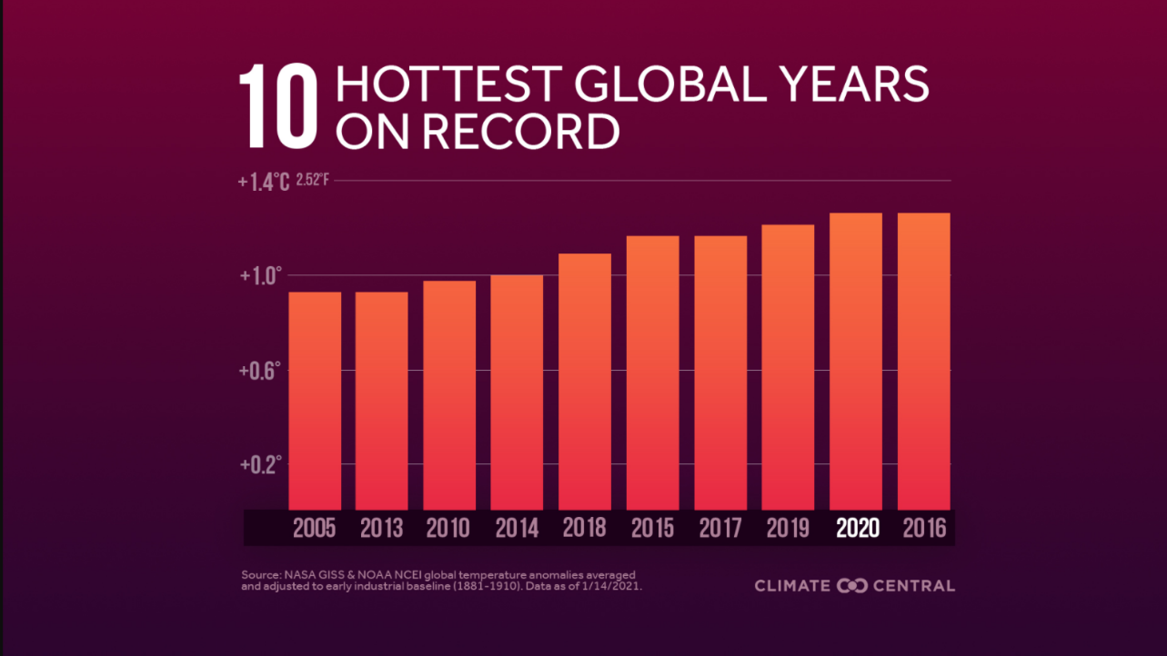
Temperature increase
Fonte: NASA GISS & NOAA
Notes:
Today, in the 21st century we are reaching record-shattering temperatures, with these records all concentrating in this century alone, which supports this temperature increase tendency.

Slide 21
TOP CLIMATE EXPERTS IN THE WORLD!
Source: https://unric.org/en/guterres-the-ipcc-report-is-a-code-red-for-humanity/
Notes:
When the matter of climate change started emerging, some doubts were cast. First over the certainty of this since, as we’ve seen before it is common to have cycles of warmer and colder periods. And the second, over the human influence on said warming of the globe. This has been cast mainly by large economic groups that are vested in keeping things as they are, also known as a business-as-usual approach. But there is unanimous consensus amongst scientists on these two questions raised before. The IPCC – The Intergovernmental Panel on Climate change is comprised of top experts on climate science that release every 4-5 years reports that are considered the most important documents on the matter, and they are unanimous on the human influence on climate change, and the necessity to act on the climate crisis. António Guterres, the United Nations Secretary-General classified the latest IPCC report as a “code red for humanity”.

Slide 22
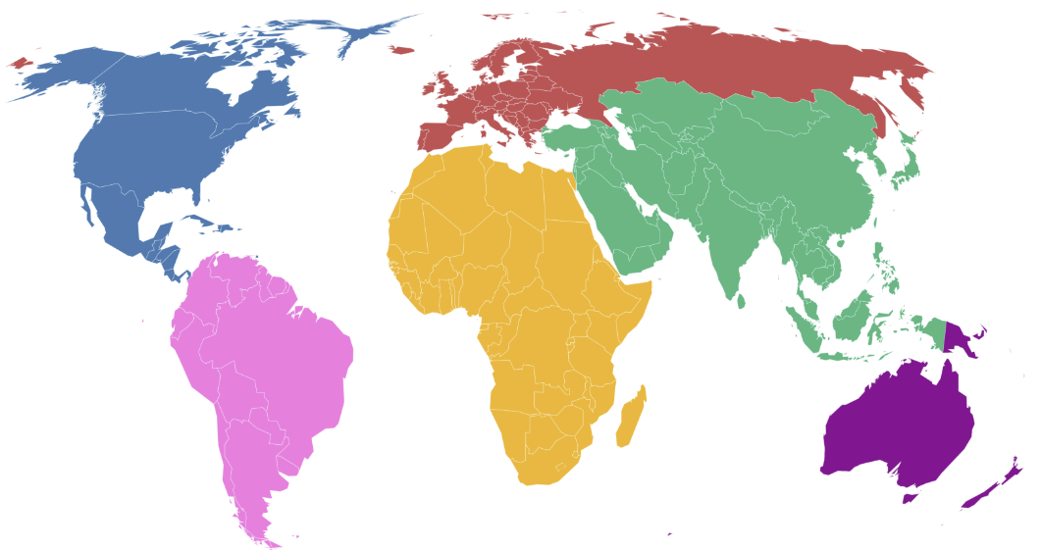
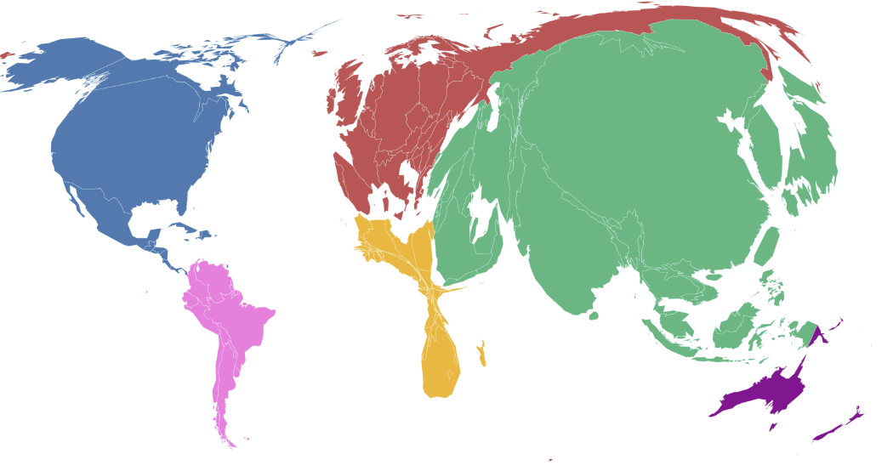
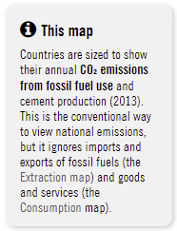
Emissions per country
Source: carbonmap.org
Notes:
Not all emissions are evenly distributed through the countries. In fact, nowadays more than 60% of global emissions come from only 10 countries. The economic disparities between countries are reflected on countries' individual emissions since emissions are intrinsically connected with economic development. The current emissions panorama encompasses the richest countries and countries with emerging economies, such as China and India, as the top contributors to global carbon emissions.
[ This graphic exacerbates the imbalance of global emissions, between countries]

Slide 23
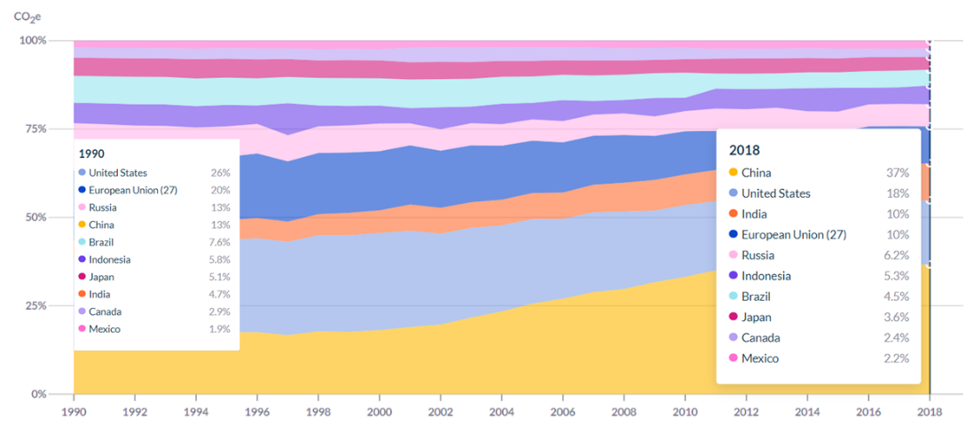
Historical emissions per country
Source: Climate Watch
Notes:
However, on the debate of emission reduction the question arises on how to distribute the reduction in an equitable and fair manner – since developed countries had the chance to grow their economies, shouldn’t developing countries have the same opportunity? This is the case because if we look at the historical panorama on cumulative emissions, the ranking of the top emitters shifts.

Slide 24
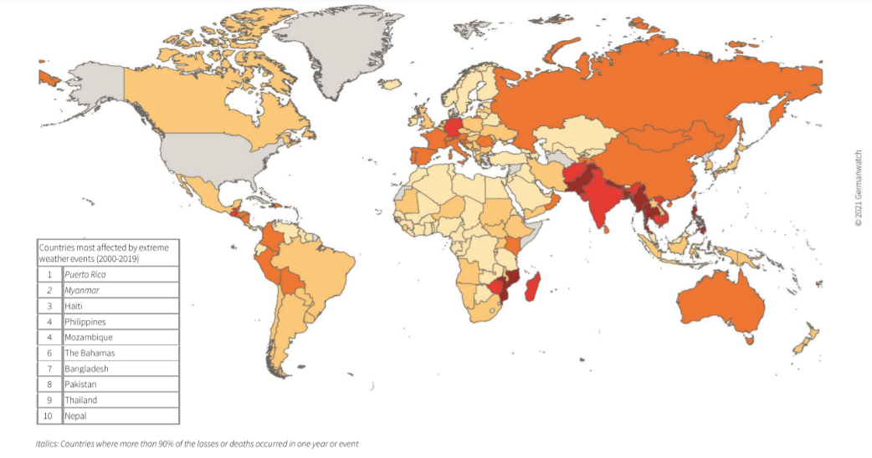
Most vulnerable countries to climate change
Source: Germanwatch
Notes:
Although the biggest part of global GHG emissions belongs to only 10 countries, the vulnerability to and risk to climate change is not proportionally distributed between the biggest contributors to emissions. We can look at the case of Mozambique or the countries in Central America, that has a residual contribution to carbon emissions but are some of the most vulnerable to climate change. Brings light to disparities and inequality between the biggest drivers of the climate crisis, and the ones that have contributed the least but nonetheless suffer the consequences and often have the less economic capacity to react to the extreme weather events.

Slide 25
Reflection
What are the major sources of GHG emissions and in what order of importance?
Notes:
Let’s narrow the scope and look at the emissions by source.
[You can ask the audience to reflect on the main sources, and create a word map using www.mentiminter.com]

Slide 26
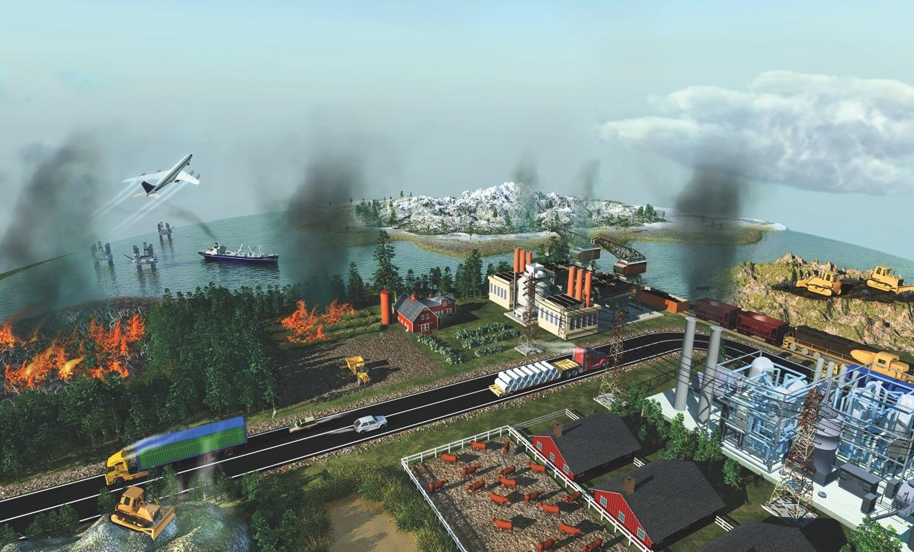
The Biggest Sources of Greenhouse Gases
MELTING PERMAFROST
AIR TRANSPORT
COAL MINING
COAL-FIRED POWER STATIONS
OIL PRODUCTION
INDUSTRIAL PROCESSES
CROP BURNING
FERTILIZERS
FOREST BURNING
INDUSTRIAL AGRICULTURE
ROAD TRANSPORT
LANDFILLS
Melcher
Source: https://www.linkedin.com/pulse/al-gore-case-optimism-climate-change-arjun-suria/
Notes:
ID #3622.B - Can be used in noncommercial online and TV broadcasts of your presentation, but not modified.
DESCRIPTION: Graphic representation of major sources of greenhouse gas emissions
ADDITIONAL TALKING POINTS: Most of the global warming we’re seeing today is caused by carbon pollution from fossil fuels.* Other important contributors include deforestation, transportation, agriculture (crops and livestock), and industrial processes.**
REFERENCES:
* Union of Concerned Scientists, “Why does CO2 get most of the attention when there are so many other heat-trapping gases (greenhouse gases)?," last accessed February, 2017. http://www.ucsusa.org/global_warming/science_and_impacts/science/CO2-and-global-warming-faq.html
** United States Environmental Protection Agency, “Global Greenhouse Gas Emissions Data," last updated August 9, 2016. http://www.epa.gov/climatechange/ghgemissions/global.html
Generally speaking, emissions come from a variety of sources, that are illustrated here in this picture.

Slide 27
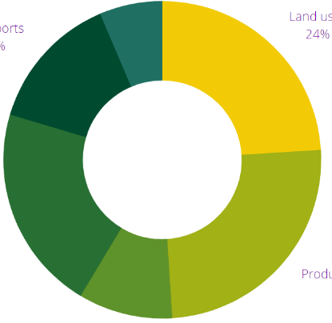
Global sources of emissions
Land uses
24%
Land uses
24%
6,4%
Buildings
Production of electricity and heat
Production of electricity and heat
25%
25%
Transports
14%
Transports
14%
21%
Industry
Energy (other)
9,6%
Source: Intergovernmental Panel on Climate Change, Fifth Assessment Report (2014)
Notes:
One thing to be aware of is that the source data may vary. Some analyses focus on different categorizations of the sources – for instance in the case of energy, which can be considered a broader category that includes electricity production, buildings, and transportation. The characterization of emission sources in the chart was devised by the Fifth assessment report produced by the IPCC in 2014. It may be subject to change when the 5th report is released during this year and throughout 2022.

Slide 28
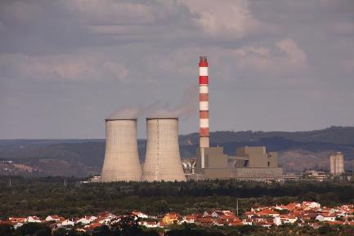
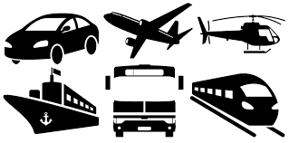
Global sources of emissions
ELECTRICITY AND FUEL PRODUCTION
TRANSPORTS
Hydrocarbons + Oxygen (O₂) -> Carbon dioxide (CO₂) + Water (H₂0)
Notes:
Energy powers not only our houses and buildingins, but it also is fundamental the transportation system, which is heavily dependent on fossil fuels, or to use the scientific term, hydrocarbons. Hydrocarbons are essentially the responsible for the carbon emissions for these two activities.

Slide 29
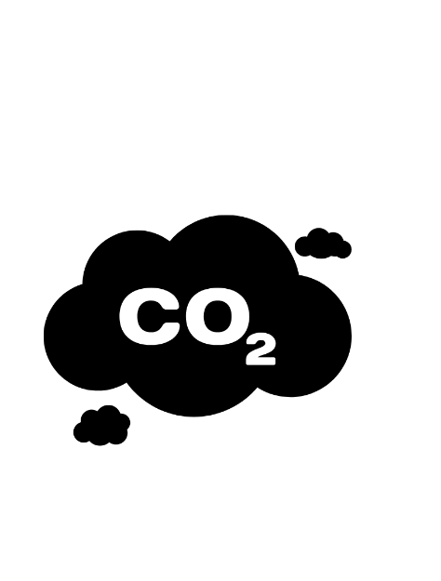
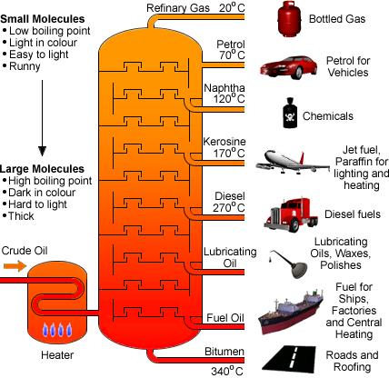
Global sources of emissions - Transports
Notes:
Oil is the fossil fuel most used in the energy and transportation. It goes through a refining process to produce several fuel sources that power cars, planes, and ships. It is the backbone of the mobility system

Slide 30
CONSEQUENCES
Notes:
Now that we understand a bit better what climate change is, and what it is driving it, you should be wondering what are the practical effects of all of this in our daily lives. Let us focus on the consequences of climate change.

Slide 31
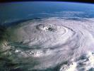
Extreme weather events
More heat waves
Precipitation changes
More droughts, fires
More intense tornados and hurricanes
Sources:
https://www.sfltimes.com/health-and-fitness/death-toll-in-egypts-punishing-heat-wave-rises-to-76
https://www.abc.net.au/news/2010-08-14/un-confirms-cholera-case-in-pakistan/944444
https://nsf.gov/news/mmg/mmg_disp.jsp?med_id=74566&from=
https://www.esa.int/Applications/Observing_the_Earth/ESA_s_orbiting_hurricane_hunter_back_in_action
Notes:
As the global climate patterns are disrupted it contributes to the increase of extreme weather events such as heatwaves, changes in precipitation, floods, droughts, wildfires, and more intense storms and hurricanes.

Slide 32
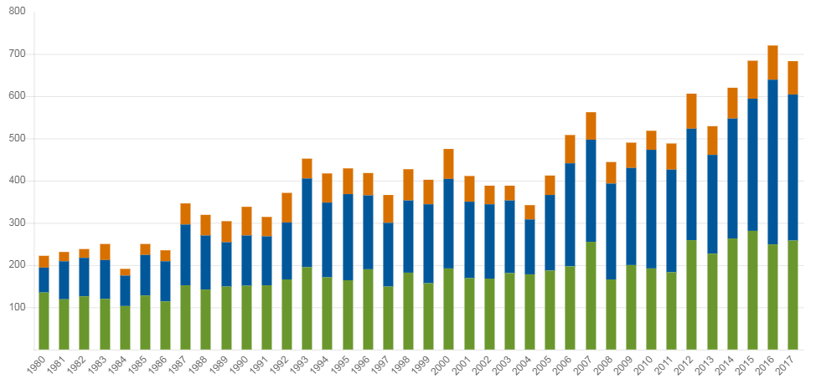
Extreme events
Climate events on a global scale 1980-2017
Number of events
Storms
Floods, landslides
Extreme temperatures, drought, fires
Source:: Munich Re, Geo Risks Research, NatCatSERVICE, Fev 2019.
Notes:
As the global climate patterns are disrupted it contributes to the increase of extreme weather events such as heatwaves, changes in precipitation, floods, droughts, wildfires, and more intense storms and hurricanes. There is a tendency for an increasing number of extreme events, which will worsen in number and intensity in the future.

Slide 33
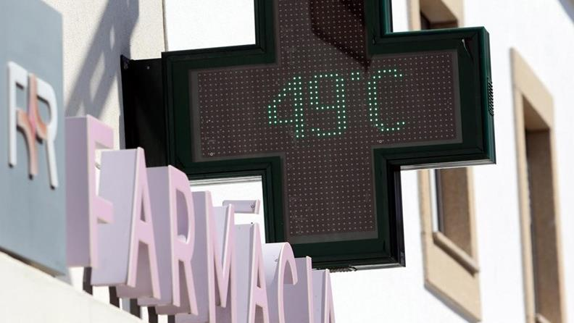
Castelo Branco, Portugal
4 August, 2018
In Portugal, of the 96 IPMA stations, 16 exceeded the 45ºC maximum temperature. The city of Lisbon recorded a new maximum, 44 º C.
Source: https://cnnportugal.iol.pt/aviso-vermelho/distritos/estes-sao-os-distritos-em-aviso-vermelho-a-partir-desta-terca-feira/20220711/62cc60460cf26256cd2cecde

Slide 34
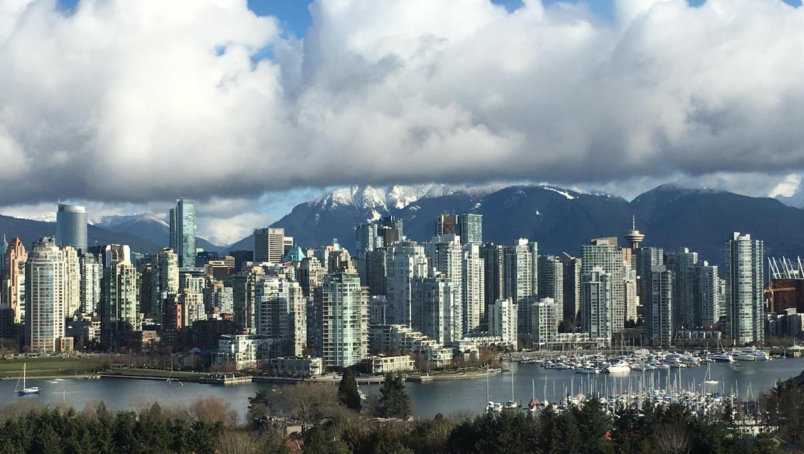
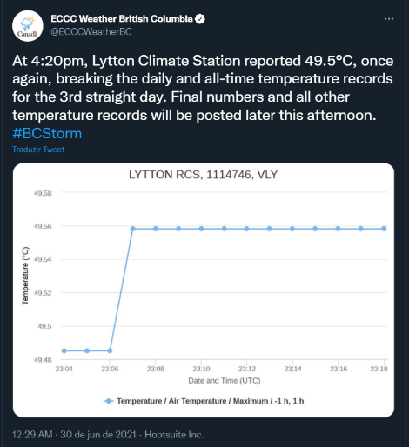
British Columbia, Canada
June, 2021
More than 600 people died in the deadliest heatwave in Canada history.
Source: https://www.westernenergyboard.org/2023-winter-wildfire-meeting/

Slide 35
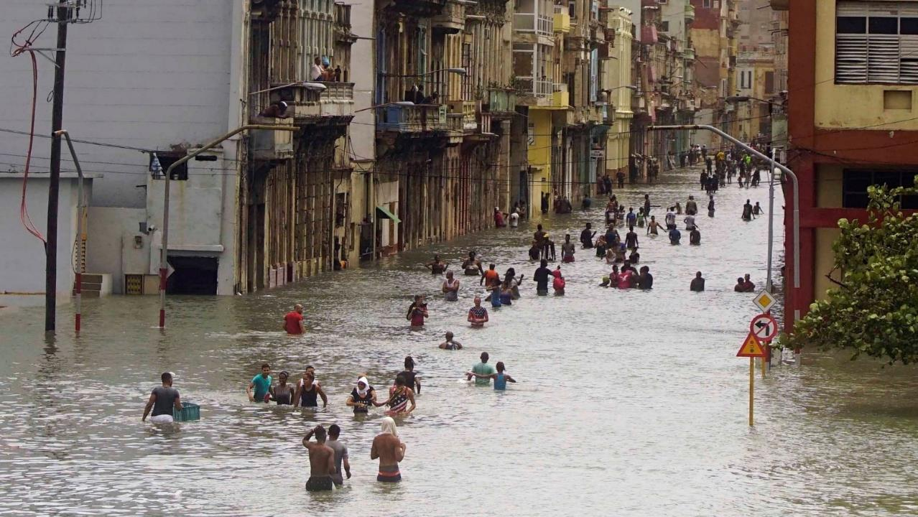
Havana, Cuba
September 10, 2017
Hurricane Irma passes through Cuba. In addition to devastating winds reaching 300 km/h, the storm also caused heavy rain and flooding.
Source: https://www.accuweather.com/en/weather-news/photos-devastation-shows-irmas-immense-power-in-cuba-turks-and-caicos/357268

Slide 36
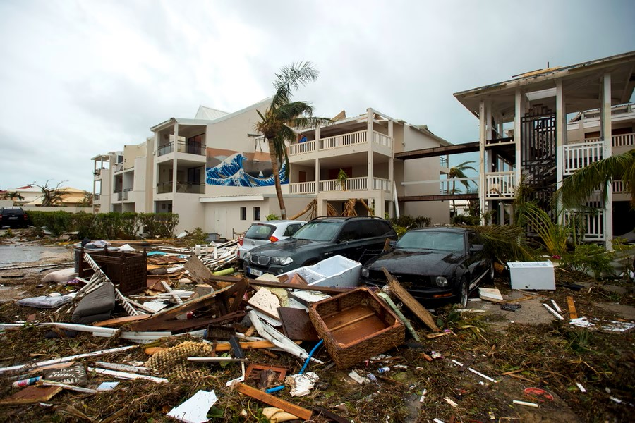
St. Martin, Caribbean
September 13, 2017
Consequences of the passage of hurricane Irma.
95% of the island was destroyed.
Source: https://www.theatlantic.com/photo/2017/09/photos-from-saint-martin-after-hurricane-irma/539103/

Slide 37
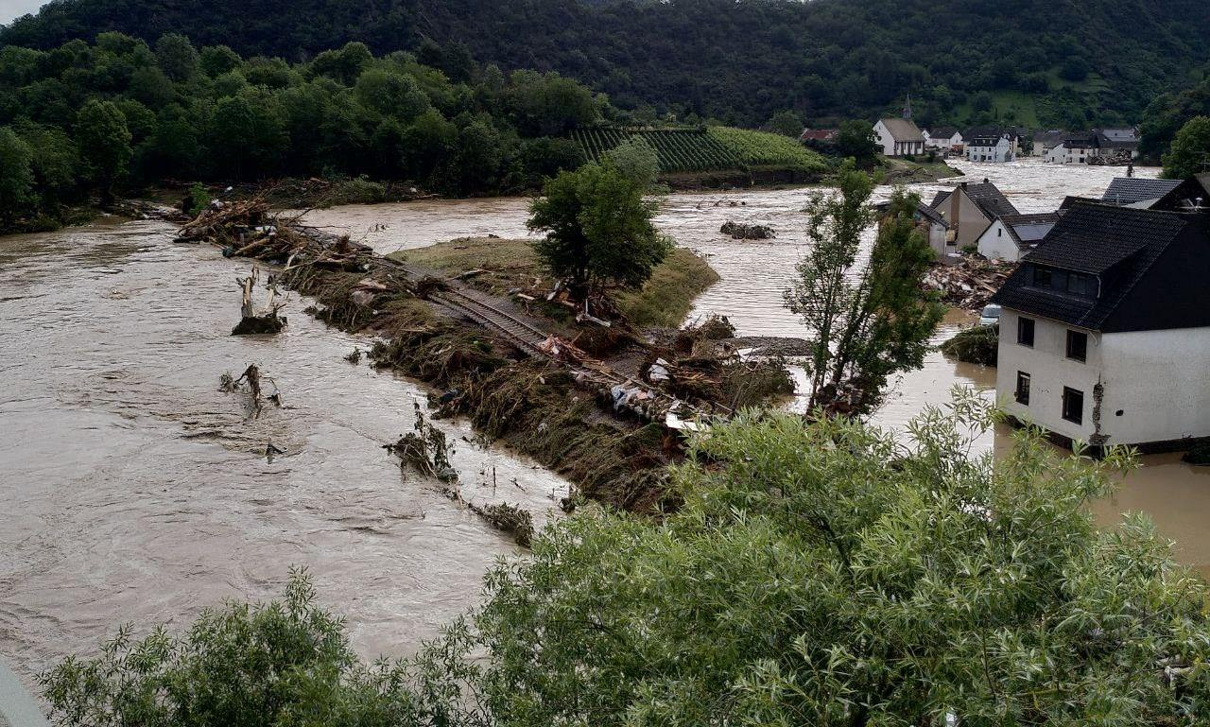
European floods
July 2021
Severe floods affected Europe, in countries such as the UK, Austria, Belgium, Czech Republic, Italy , France, Germany, Luxembourg, The Netherlands, Romania and Switzerland. It killed 296 people and caused > 10 Billion euros in property damages
Source: https://ecfr.eu/article/flash-in-the-pan-flooding-in-germany-and-the-politics-of-climate/

Slide 38
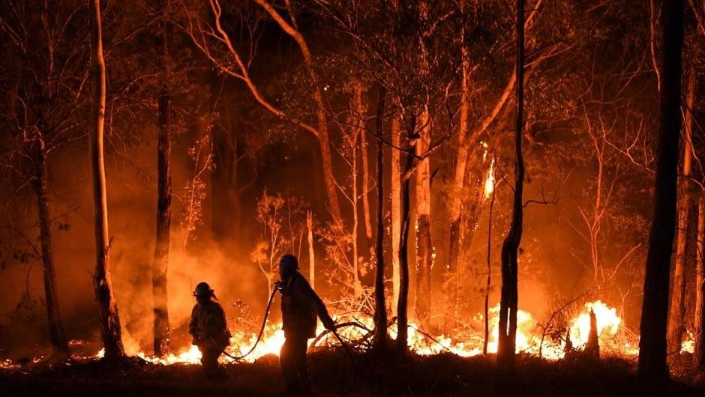
Australian Wildfires
July 2020
Up to 19 million hectares were burnt, and nearly 33 million animals were impacted. 33 people lost their lives, and more than 3000 homes were destroyed
Source: https://www.bbc.co.uk/newsround/52410744
Notes:
Source: https://www.wwf.org.au/what-we-do/bushfires#gs.d3dmvh

Slide 39
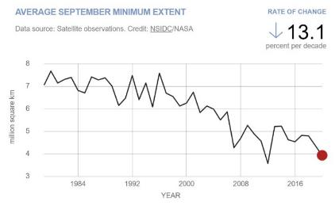
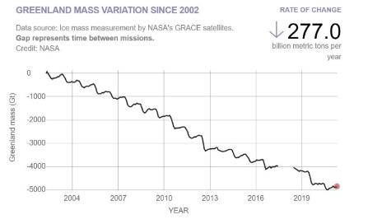
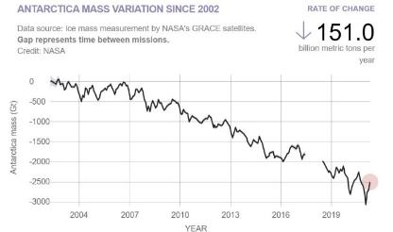
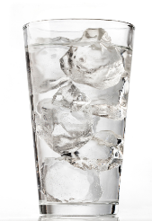
Defrost
Arctic (Iceberg)
Greenland and Antarctica (Glaciers)
The melting of icebergs and glaciers do not have the same consequences on rising sea levels.
Source: National Aeronautics and Space Administration/Goddard Institute for Space Studies (NASA/GISS)
Notes:
An increase in the temperature causes ice to melt, both glaciers (ice over land) , like Greenland and Antarctica and on the mountains all over the world, and icebergs (ice floating in the sea) such as the big ones in the Arctic Ocean. These graphs show a clear tendency of ice cover decrease in both glaciers and icebergs. Loss of glaciers causes sea level rise and affects coastal populations. Loss of ice on mountain glaciers causes a decrease in water resources for populations living in those areas. Iceberg melt doesn’t cause sea level rise, think of an ice cube on a glass of water, however, it can cause changes on ocean currents, and furthermore, it decreases reflection from sunlight, which in turn increases the temperature.

Slide 40
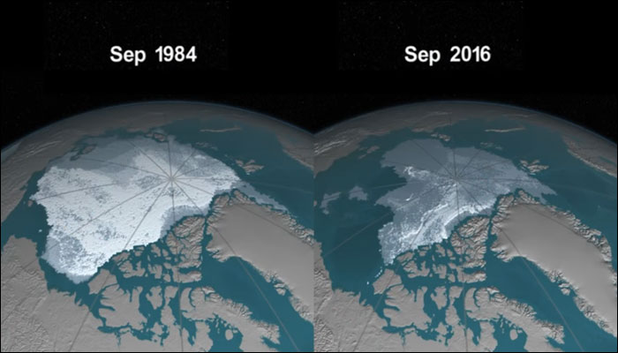
Defrost - Iceberg
Satellite images of the Arctic at the annual minimum ice point (Sept)
Source: National Aeronautics and Space Administration/Goddard Institute for Space Studies (NASA/GISS)
Notes:
Defrost
An increase in the temperature causes ice to melt, both glaciers (ice over land) , like Greenland and Antarctica and on the mountains all over the world, and icebergs (ice floating in the sea) such as the big ones in the Arctic Ocean. There is a clear tendency of ice cover decrease in both glaciers and icebergs. Loss of glaciers causes sea level rise and affects coastal and island populations. Loss of ice on mountain glaciers causes a decrease in water resources for populations living in those areas. Iceberg melt, however, doesn’t cause sea level rise. Think of an ice cube on a glass of water, however, it can cause changes in ocean currents, and furthermore, it decreases reflection from sunlight, which in turn increases the temperature.

Slide 41
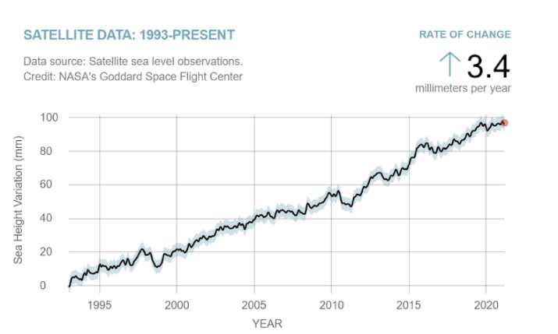
Sea level
2 factors: thermal expansion of the ocean and melting glaciers
Source: National Aeronautics and Space Administration/Goddard Institute for Space Studies (NASA/GISS)
Notes:
There are two main drivers for sea-level rise: the melting of the glaciers and thermal expansion which is caused when seawater expands because of the higher temperature of the water. Since the oceans absorb heat from the atmosphere, when the atmosphere becomes warmer so will the oceans. ... The increased volume will cause the level of the water in the oceans to rise.

Slide 42
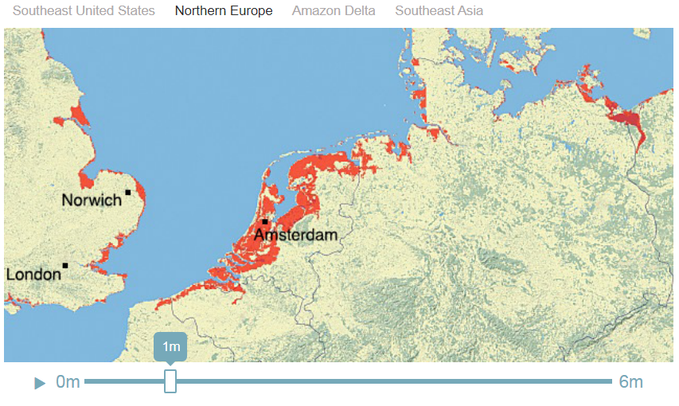
Sea level
NASA coastal zone simulator
Source: National Aeronautics and Space Administration/Goddard Institute for Space Studies (NASA/GISS)
Notes:
Currently, there is a tendency of rising sea level, in 2020 that variation was about 1 cm. Coastal areas are the most vulnerable to sea-level rise, which threatens the coastal communities. Amsterdam is one of the particular areas that are threatened by this since the city is 4 meters below sea level.

Slide 43
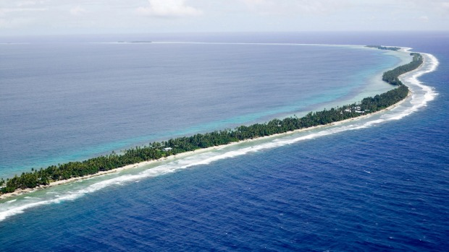
Tuvalu Island faces the risk of completely disappearing due to sea level rise
Source: https://www.traveller.com.au/up-close-and-personal-in-tuvalu-gn445o
Notes:
Tuvalu Island, located in the Pacific Ocean is facing the risk of being submerged if the sea level continues to rise. Island states and coastal areas are the most vulnerable places that face the threat of sea levels rising

Slide 44
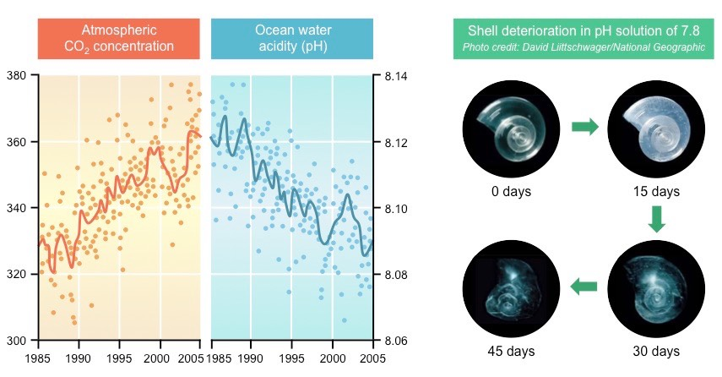
Ocean acidification
Source: https://ib.bioninja.com.au/standard-level/topic-4-ecology/44-climate-change/ocean-acidification.html
Notes:
The oceans are also a natural sink of absorption of CO2. As the CO2 concentration in the atmosphere increases, so does the absorption in the ocean, and the consequential acidification of the water. This has dire consequences on marine life, which are particularly sensitive to these types of variations. As an example, more acidic waters deteriorates the shells of marine organisms that are made of calcium carbonate – caused by chemical reactions between carbon and the chemicals of the shells

Slide 45
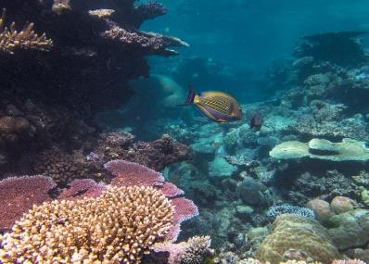
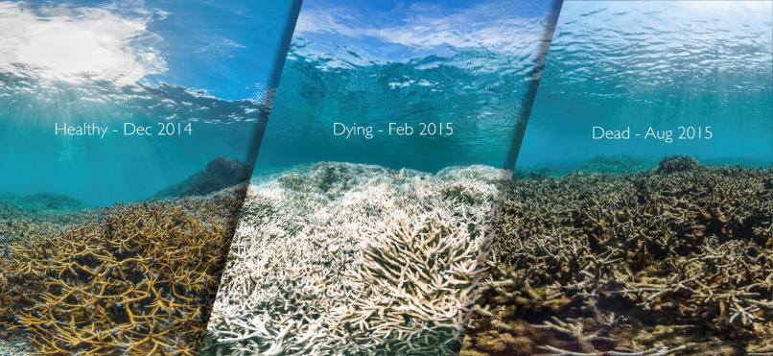
Effects on ecosystems
Coral reefs are home to about 25% of marine life, the terrestrial equivalent of rainforests!
Source: https://www.theguardian.com/environment/gallery/2018/jul/29/can-you-spot-dead-coral-in-pictures
In 2016, during the 4th episode of mass bleaching, 50% of the large barrier coral died.
Source: https://group.bnpparibas/en/news/climate-change-impact-survival-world-s-coral-reefs
Notes:
Rising temperatures have catastrophic consequences on ecosystems. One example is coral reefs, which are fundamental to entire marine ecosystems, and are considered biodiversity hotspots. They are also incredibly sensitive to temperature and pH variations. Temperature increase and acidification of the oceans contribute to the phenomena called coral bleaching that results in the death of the reef – entire organisms perish in these conditions, which means that the marine life that coexists in this ecosystem vanishes completely.

Slide 46
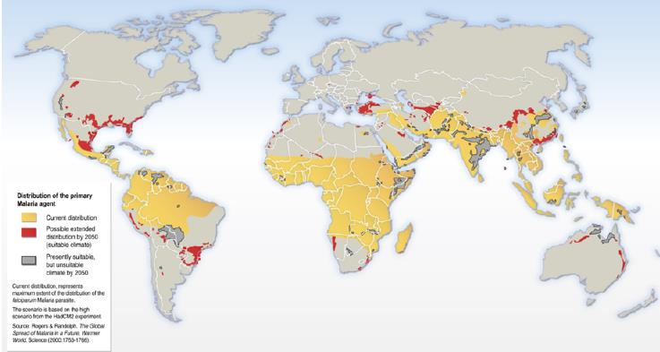
Effects on human health
Distribution of the Malaria pathogen:
Today
Possible in 2050
Climate Change and Malaria
Source: De Souza et. al. (2012), Impact of Climate Change on the Geographic Scope of Diseases
Notes:
Warmer temperatures, and changing climate patterns in countries, creates conditions for pathogens and diseases common to warmer weather to emerge in regions of the world that have never seen them before. This is the case of Malaria, which is transmitted by a mosquito that is common in warmer/tropical climates, but it is predicted to emerge in norther regions of the world.

Slide 47
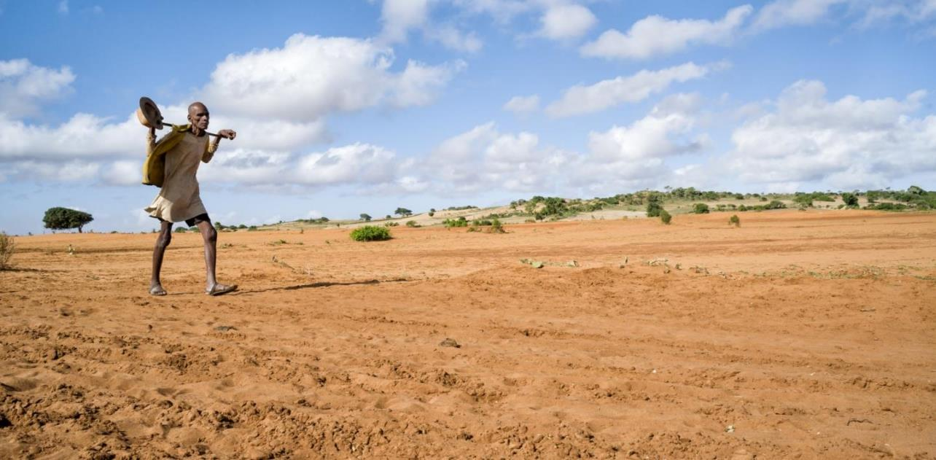
Source: https://www.amnesty.org/en/latest/news/2021/05/madagascar-urgent-humanitarian-intervention-needed-as-millions-face-hunger-due-to-devastating-famine/
Notes:
Madagascar, one of the region’s most vulnerable and at risk of climate change, is already facing the consequences of it, where 1 million people are currently facing famine linked to climate change. Climate change is changing weather patterns in the country, which deeply depends on agriculture, disrupting seasonal weather that allows for this economic and subsistence activity to persist in the area. Again, the countries that least contributed to climate change are the ones that are already facing the consequences.

Slide 48
Climate change "will likely lead to
shortages of food, water, and pandemic diseases,
refugee and resource conflicts, and destruction from natural disasters in many regions of the globe."
US Department of Defense
2014 Climate Change Adaptation Roadmap
October 2014
Source: https://www.lse.ac.uk/granthaminstitute/news/how-can-climate-policy-better-address-climate-driven-population-displacement/
Notes:
More and more populations in the world will face grave consequences caused by climate change in their regions. Today, many people in developing countries are suffering from droughts and windstorms on a scale never seen before, depriving them of daily food and basic needs. It is still fresh in our memories that last November many people from the Central American countries of Honduras, Guatemala, and El Salvador, which were hit by two massive hurricanes, poured across the border into Mexico and headed toward the US border.
The term “climate refugee” was first coined to describe the increasing large-scale migration and cross-border mass movements of people that were partly caused by such weather-related disasters. As the weather events worsen, so dies the need for these populations to migrate to other countries to seek refuge.

Slide 49
Tipping points
Notes:
Think about tipping point as a game of jenga, you remove pieces one by one, and then comes a point where the tower comes down and there is no stopping gravity. This is an analogy for the climate tipping points, which once surpassed will lead to irreversible changes. A specific example, melting of the glaciers and icebergs is a dangerous positive feedback loop on the climate, which means that the effect of temperature increase, ice melt, increases its cause, the temperature itself, keeping a circle of ever increasing temperature which can lead to the disappearance of the glacier.

Slide 50
WHAT CAN BE DONE TO REDUCE EMISSIONS?
Source: https://www.technologynetworks.com/applied-sciences/news/how-can-we-prompt-individuals-to-take-action-on-climate-change-329758
Notes:
Moving on from the doom and gloom of the climate crisis, what can then we do to try and resolve this pressing issue?

Slide 51
On a large scale
Save the trees!
Change our energy system
Source: https://www.umass.edu/stockbridge/academics/summer-programs
Source: https://www.euractiv.com/section/climate-environment/news/exxonmobil-under-investigation-over-claims-it-lied-about-climate-change-risks/
Notes:
On a global large scale level, we need to focus on reducing our global carbon emissions, plain and simple. There are two main ways to seek to balance our emissions and absorption, which is through preserving and restoring our natural sinks and to fundamentally change our energy system

Slide 52
Forests
Global balance between carbon sources and sinks
Source: Global Carbon Project
Notes:
As we have seen previously, natural sinks are essential to maintaining a balance of carbon dioxide in the atmosphere, and we have long surpassed the absorption capacity. Carbon dioxide concentrations have been increasing, for one, because of the ever-increasing emission rate, but also because we are tearing down one of our natural sinks: Forests.

Slide 53
Deforestation in the Amazon Rainforest
Notes:
Brazil has one of the worst rates of deforestation in the world, and it shows no signs of slowing down. The countries in the Indian-pacific also experience a high rate of deforestation, mainly driven by industry exploration. Brazil is an alarming case for example, a country that hosts one of the largest areas of forest cover, including the Amazon Rainforest, commonly named the “lung of earth”.

Slide 54
Preserving vs restoring our forests
Notes:
Does this mean that we can just plant more trees and solve the issue? Not quite. Research shows that preserving our current natural sinks brings more benefits than restoring, in terms of “emissions gains”, because as we mentioned before, cutting down forests not only generates emissions but also reflects in CO2 absorption losses. As trees regrow, the absorption capacity also rises, but it always starts at a smaller level, so it may take up years to actually start to have a meaningful impact on balancing emissions. The time that we currently do not have to address the climate crisis. Research shows that preserving our current natural sinks brings more benefits than restoring, in terms of “emissions gains”, because as we mentioned before, cutting down forests not only generates emissions but also reflects in co2 absorption losses. So in terms of reducing our emissions, preserving the standing forest is preferable to restoration and reforestation practices. But this is not to say that regeneration shouldn’t be an option altogether to the damage already done to our forest areas.

Slide 55
Reshaping our energy system
Source: https://www.timeslive.co.za/news/south-africa/2020-02-05-this-is-how-city-power-kept-the-lights-on-during-load-shedding/
Notes:
Fundamental systemic change on our energy systems

Slide 56
Energy
Greenhouse gas emissions by sector
Notes:
There are several ways we can look at the breakdown of emissions. By sector, by economic activity and so on. If we account energy emissions as a whole, it accounts for a staggering 75% of total global emissions. This means that 75% of total emissions comes from generating energy. Why is this?

Slide 57
Energy production sources
Fossil fuels
Renewable energy
Notes:
There are two main sources from where we produce our energy and electricity. Fossil fuels: Oil, gas and coal. And renewable energy.

Slide 58
Global energy consumption by source
Notes:
Energy production takes up that much of global carbon emissions because it is still mostly reliant on fossil fuels. Almost 85% comes from burning fossil fuels, that are very carbon intensive. Changing the source of energy and transitioning from fossil fuels to renewable energy is fundamental to cutting down emissions.

Slide 59
Renewable energy sources
SOLAR
HYDROELECTRIC
BIOMASS
Solar photovoltaic
Concentrating solar thermal
Reservoirs
Water strands
WIND
OCEANS
GEOTHERMAL
Onshore
Offshore
Waves
Tides
Notes:
Renewable energy sources include:
Solar: Photovoltaic panels, concentrating solar thermal energy through mirrors
Hydroelectric: Water reservoirs, or water strands
Biomass is the burning of wood, agricultural waste, and other organic material, to generate electricity and heat. Although the burning of biomass does release carbon dioxide to the atmosphere, the organic material during its growth phase absorbs a considerable amount of carbon dioxide, so it balances it with emissions.
Wind: located onshore or offshore
Oceans: waves and tides
Geothermal energy uses the heat of the earth to generate electricity

Slide 60
Renewable energy
Percentage of primary energy from renewable sources, 2019
About 11% of global primary energy consumption is from renewable sources.
This is the percentage of renewables in the energy mix. This energy corresponds to the sum of electricity, transport and heating.
About 11% of global primary energy consumption is from renewable sources.
This is the percentage of renewables in the energy mix. This energy corresponds to the sum of electricity, transport and heating.
Source: https://ourworldindata.org/renewable-energy
Notes:
The distribution of renewable energy sources varies between countries that source them – it depends on various economic and environmental factors ( wind, yearly sunlight) and the infrastructure investment of each country. However, globally speaking, the overall renewable energy consumption remains at about 11%. The energy mix is a group of different primary energy sources from which secondary energy for direct use - such as electricity, transports, and heating - is produced.

Slide 61
Renewable energy
Renewable energy
Notes:
But there is hope to have our energy system relying on renewable energies!

Slide 62
Energy consumption
Increase of about 50% in world energy consumption between 2018 and 2050
Primary energy consumption by region
Primary energy consumption by source
10¹⁵ BTU
10¹⁵ BTU
Source: International Energy Outlook (EIA, 2018)
Notes:
Our energy demands increase year after year, and it shows no signs of slowing down. As economies grow and develop, so does the energy demand to accompany this process. It is necessary to invest in energy efficiency and our individual and collective consumption of energy.

Slide 63
The carbon footprint of the internet
Internet users by world region
Source: https://www.istockphoto.com/nl/vector/internet-communicatie-en-sociale-media-gm1164501623-320109553
Notes:
T
An increase in energy use does have a correlation with the growth of the technology sector. Internet users are rapidly increasing around the world, and today we are reliant on the services on the web, for both our work and personal daily lives. From servers powering the internet and technology information, to the actual devices we use. The pandemic actually highlighted the importance of staying connected whilst physically apart.

Slide 64
The carbon footprint of the internet
An email has an estimated carbon footprint of 4 grams of CO2
The average website produces 1,76 grams of CO2 per page view
www.websitecarbon.com
An email with a large attachment can have 50 grams of CO2
Notes:
All the energy consumed for our technology and internet needs does carry a carbon footprint, in other words, sending an email does produce carbon emissions. And websurfing also has its footprint, because of the servers needed to host most web services. You can check a website’s carbon footprint at www.websitecarbon.com! Data centres and web service providerscan opt for renewable energy to source their power needs.

Slide 65
The carbon footprint of the internet
Bitcoin mining consumes more energy than some countries in the world!
Notes:
But the technology sector does rely on energy use, and it is troublesome because as we mentioned, our energy sector is still mostly dependent on fossil fuels. Energy-intensive activities of the technology sector are actually surpassing the energy consumption of whole countries, as is the case of the emerging technology of the blockchain, and more mediatic bitcoin. Bitcoin mining consumes more energy than some countries, and it will continue to rise.

Slide 66
Reduce energy consumption
Source: NASA Earth Observatory
Notes:
All in all, reducing energy consumption is necessary to address global carbon emissions, not only because our energy system is still dependent of fossil fuels, but also as a means to reduce the pressure and strain we put on the energy system to better control demand and supply of energy

Slide 67
Source: https://berlinpolicyjournal.com/climate-children-should-be-seen-not-heard/
Notes:
Shifting away from the larger scale and systemic changes required to cut down emissions, lets now speak of what we can do to act upon our individual consumption of energy, at a smaller scale.

Slide 68
Reduce energy consumption
Renewable Energies
Energy Efficiency
Reduce
Energy consumption
Source: NASA Earth Observatory
Notes:
Final energy consumption in our households is still mostly reliant on fossil fuels, or fossil sources for the production of energy, and it also shows the biggest potential for reducing emissions. Changing the source of our energy and the amount we consume are the two possible approaches in order for us to reduce emissions on the final consumption of energy.

Slide 69
Reflection
What can you do to reduce energy consumption in your house?
Notes:
Let’s narrow the scope, and look at the emissions by source. You can ask the audience to reflect on the main sources, and even ask someone to share their thoughts.

Slide 70
Global CO2 emissions from transportation type
Source: European Environmental Agency
Notes:
[You can interact with the audience and ask which type of transport contributes the most to global CO2 emissions]
Let’s have a look at which transports most of the carbon emissions come from. Which mode of transportation do you think has the greatest carbon footprint overall? Road transportation accounts for more than half of total carbon emissions, and in this category cars take the prize for the biggest source of emissions. Which does make sense considering that on earth there are almost 1.5 billion cars!
Cars are the transport that most contribu

Slide 71
CO2 emissions of travel per km (2018)
Notes:
[You can ask the audience which transport has the biggest emissions per km and per passenger. Essentially the most inefficient if you account the distance traveled per person and the emissions released]
And what about emissions per person and per km traveled in each type of transportation? Essentially which is the least efficient way to travel taking into account the distance traveled against the emissions? In that case, aviation wins. Cars also have a significant inefficiency when it comes to emissions per distance traveled, mainly because, usually, we travel alone in our cars.

Slide 72
Aviation
Source: https://www.onderzoeksraad.nl/en/page/4953/flying-over-conflict-zones---follow-up-recommendations-mh17-crash
Notes:
Aviation is certainly the least efficient, because of the amount of fuel and the power planes consume to travel. And they are increasing ever than ever in the skies, mainly due to the affordability of plane tickets, which were very expensive several decades ago.

Slide 73
Cars

Slide 74
Emissions from cars
Source: European Environmental Agency
Notes:
Carbon dioxide is not the only problematic gas that is emitted from cars. They are one of the greatest contributors to air pollution and respiratory problems caused by these substances. They emit other gases and small particles that are very dangerous for human health. They are also very inefficient in terms of converting energy from fuels to generate power to move, seeing that only 30% of the energy from burning gasoline and diesel is in fact used - this means that we have to use more gasoline to move around if the energy use was 100%.
There are indeed new technologies to substitute petro vehicles. Eletric cars are at the top of the array of alternatives

Slide 75
Electric vehicles
An electric vehicles is powered by an electric battery.
Does not emit GHG, and other gases or particles.
There are also hybrid options that combine a combustion motor and electric motor.
Notes:
There are indeed new technologies to substitute petro vehicles. Electric cars are at the top of the array of alternatives. Electric vehicles exist for some years now, and the technology is evolving evermore. On the electric modality there are some other vehicles that were popularized earlier: hybrid cars, that run on electricity and petrol.Electric vehicles essentially run on large lithium batteries.

Slide 76
Hydrogen vehicles
Power plants generate electricity to separate hydrogen from water
The hydrogen is stored and transported to charging stations
The hydrogen is stored in vehicles. It reacts with oxygen that generates electricity that moves the car. The only “emission” is water!
Notes:
Another alternative, from an emerging technology is hydrogen powered vehicles. Hydrogen is around for some time now, it is the gas that made Zeppelins fly. Electric vehicles are powered by energy from the grid, but the process to get hydrogen to power vehicles has some extra steps to take. It starts from water( h2o), the hydrogen is separated from the oxygen in a process that requires energy. After that the hydrogen is stored, which does require more energy, and transported to fueling stations. The hydrogen is pumped in the car, similar to fueling a petrol vehicle, and takes about just four minutes to fill!. In the car deposit, the hydrogen reacts with the oxygen of the air that comes in the container and the reaction generates electricity that makes the motor run. The result of this reaction is water, it is so pure you can actually drink it!

Slide 77
Cons: Hydrogen vs Electric
Source: https://www.nytimes.com/2017/05/18/automobiles/wheels/first-came-the-hydrogen-cars-now-the-refilling-stations.html
Cons:
Cost;
Hydrogen infrastructure;
Still an inefficient process- the car only has an efficiency of about 15%
Source: https://commons.wikimedia.org/wiki/File:Tartu_railway_station_electric_car_rental.jpg
Cons:
Charging times can take up from 30 min to 12 hours
Range
Environmental impacts of lithium batteries
Notes:
The biggest pro arguments for these vehicles are in fact the zero emissions in transit for these types of cars. But there are some cons particular for each type.
Hydrogen vehicles biggest con is the lack of infrastructure at the moment. This limits the range a car can travel, and you need to take into account where the infrastructure exists, which is still lacking in most parts of the world. The inefficiency of the hydrogen conversion is also a big con, since the process takes up a lot of energy, and only has a conversion of 15%, because the hydrogen is a gas very volatile. And of course, the cost of these vehicles is still very prohibitive for most people, since it is still a novel technology with limited availability, the cost is very high at the moment.
Electric vehicles take a long time to charge. There are supercharging stations, and leaving them to charge overnight is an option. But this limits, for instacance, people that live in apartments with no garages or do not have charging infrastructure nearby. The range, although it is getting better and better, is still limiting for a long range option, and worsen by the charging times, it can make a long drive take even longer. The environmental impacts to construct an electric car, especially the lithium batteries is significant.

Slide 78
Charging stations availability
Hydrogen vehicles
Electric vehicles
Source: https://h2-map.eu/
Source: https://chargemap.com/map
Notes:
Electric vehicle infrastructure is must more developed at this point than Hydrogen vehicles infrastructure, which is noticeable by the number of charging stations available for each, which is considerably less to hydrogen cars.

Slide 79
Renewable energy sources and alternatives to petrol
Notes:
The electric and hydrogen alternatives do not produce emissions in transit. However, they can only be true alternatives if the energy system fundamentally changes, and transitions to renewable energy sources. These vehicles rely on electricity to function, and if the energy system of a country with the best electric vehicle grid still relies mostly in fossil fuels to power it, emissions wise, this is nothing more than a false solution.

Slide 80
CO2 Emissions through the life cycle of vehicles of different fuel types
Source: European Environmental Agency
Notes:
In fact, carbon emissions on the overall life cycle of an electric vehicle that is powered by fossil fuels is greater than a petrol vehicle.

Slide 81
Public transportation
Notes:
Public transportation comes in the form of railroad transport and road transport.

Slide 82
Train, trams and subways
Train
Tram
Subway/ Underground
Notes:
Railway wise, we can count on trains, trams and subways. These locomotives are powered by electricity from the grid. Although there are some trains that move on diesel - following a similar principle as the trains from last century that runned on steam, they are a minority compared to electric trains.

Slide 83
Trains as alternatives to aviation
There is a need to invest in cross-border high speed network to make it a viable alternative to airplane travel.
Source: https://en.wikipedia.org/wiki/High-speed_rail_in_Europe#/media/File:Networks_of_Major_High_Speed_Rail_Operators_in_Europe.gif
Notes:
To make “avoiding aviation” a valid option, trains need to become a viable alternative. But there is still a need to invest in high speed infrastructure and services for cross border train travel to be an efficient alternative.

Slide 84
Buses
Source: European Automobile Manufacturers association
Notes:
Buses are one of the best options to travel between small towns and other localities which do not have railroad connections. And they do have a smaller individual carbon footprint than an individual car. However, they are still mostly reliant on fossil fuels. Not all run on diesel or gasoline, there are some fuel alternatives such as natural gas, Liquified petroleum gas, biofuels and ethanol vehicles, but they too have considerable emissions.

Slide 85
Bicycle and other two-wheel modes of transportation
Riding a bicycle is one of the best ways to move around emissions free
Not all cities and locations can be as flat and bicycle oriented such as the Netherlands, but there is a large variety of electric options that can help with steep ascends
Electric scooters
Notes:
Apart from walking, bicycles are the best option to travel emission free. The benefits reflect economic, health, and environmental gains. Of course not all places have the best infrastructure to accommodate a cycling lifestyle, or have flat surfaces to make it easier to ride a bicycle, such as the Netherlands. But there are some interesting electric options emerging to help fight the steep climbs!

Slide 86
Bicycle and other two-wheel modes of transportation
Sharing services!
Notes:
All throughout cities, two-wheel sharing options are starting to emerge. The equipment can be expensive for an individual to bear the cost of investing, if the travels do not justify that. These grids of scooters and bicycles are a great option to move around the city with low emissions. Usually you pay for the kms you use, and there are stations spread out in the cities that you can leave the equipment for another person to use.

Slide 87
Space taken by 60 people on bicycle, cars and a bus
Source: Brodowicz, Pospiesnzy & Grzymala (2015)
Notes:
The discussion around using cars is not only about emissions, but also for the space they take, and how cities accommodate this vehicle. Options for collective transports or other individual types of transportation free up roads from cities, making way for people to reclaim the space.

Slide 88
Bicycle infrastructure
At www.opencyclemap.org you can check for bike lane routes

Slide 89
Citizen initiatives for cycling
Source: https://www.jf-olivais.pt/comboio-de-bicicletas/
A “bycicle train”, Ciclo expresso is a group of children that gather with monitors to ride their bicycles to school, in Lisbon and Aveiro
CiclAveiro is an association that promotes the use of bicycles for the well being of people and the planet, in Aveiro, Portugal.
Notes:
There are a lot of civic movements and associations that focus on this type of transport. These groups of citizens usually gather to route by bicycle to their works or to leave their kids at school - this is particularly significant in places where bicycle infrastructure is lacking. Traveling in groups significantly increases the security of traveling by bike and makes drivers aware of their presence. These associations also offer repair workshops and other logistic support to make sure you have your gear ready to cycle. These groups can start anywhere, you just need to gather interesting people to make this idea happen.
Two examples of these initiatives in portugal are:
Ciclo espresso - Known as a “Bicycle train”, this initiative is comprised by a groups of children that gather with monitors to ride their bicycles to school in Lisbon and Aveiro. They travel together to ensure safety for all, and parents can join as monitors if they want!
CiclAveiro - is an association that promotes the use of bicycles for the well being of people and the planet, in Aveiro, Portugal. They offer an array of workshops and services for members.

Slide 90
Integrated services
MobiCascais
Source: https://mobi.cascais.pt/
Notes:
Integrated systems are the future for interconnect smart cities. MobiCascais is an example of that, in just one app it gathers together a network of transportation that is free for people who live, study or work in Cascais, a municipality in Lisbon. It also offers reduced prices for everyone else to use any of the services available. For instance, you can buy a day ticket for 1,5 euro and make use of any type of transport in the network for the whole day - bicycles, electric scooters, trains or buses in Cascais. It also shows where to park your car, and where to locate nearby charging stations if you have an electric vehicle.

Slide 91
15 minute cities
Source: https://knowledge-hub.circle-lab.com/article/7642?n=The-15-minute-City-in-Paris
Notes:
Urban planning plays a significant role on how mobility is planed in devised. It is also a major challenge to fundamentally change the fabric of already existing cities, but that does not mean it is not possible. The 15 minute city is a concept which imagines a place where everyone living in a city should have access to essential urban services within a 15 minute walk or bike. This would significantly reduce the need to move around using cars, and would free up the space of cities for communities to better enjoy the space, would significantly reduce air pollution and increase the quality of life in these places.

Slide 92
Μείωση των εκπομπών το 2020 σε σχέση με τα επίπεδα του 2019 λόγω των περιορισμών του Covid-19
Τι μπορεί να σημαίνει αυτό για το μέλλον των πόλεων;
Πηγή: https://www.ccacoalition.org/en/news/green-pandemic-recovery-essential-close-climate-action-gap-%E2%80%93-un-emissions-gap-report-2020
Notes:
Είναι ενδιαφέρον να αναλύσουμε τον αντίκτυπο που είχαν στις εκπομπές οι παγκόσμιες διακοπές που προκλήθηκαν από την πανδημία του 2020. Η σημαντικότερη μείωση αφορούσε ακριβώς τις εκπομπές από τις επίγειες μεταφορές, στις οποίες τη μεγαλύτερη συμβολή έχουν τα μεμονωμένα αυτοκίνητα. Αυτό παρέχει μια επισκόπηση του δυναμικού μείωσης των εκπομπών αν αφήσουμε τα αυτοκίνητά μας στα σπίτια μας και αν υποστηρίξουμε εναλλακτικά μέσα για τη μετακίνηση στις πόλεις. Τι μπορεί να σημαίνει αυτό για το μέλλον; Είναι ένας ενδιαφέρων προβληματισμός, τώρα που οι συζητήσεις γύρω από το μέλλον της εργασίας έναντι της τηλεργασίας βρίσκονται επίσης στο προσκήνιο.

Slide 93
Συνοψίζοντας, τι μπορείτε να κάνετε;
Αποφύγετε τα αεροπορικά ταξίδια
Προτιμήστε τη δημόσια συγκοινωνία
Κυκλοφορήστε με το ποδήλατό σας
Περπατήστε
Μοιραστείτε δρομολόγια
Notes:
Για να συνοψίσουμε όλες αυτές τις πληροφορίες, ποιες μεγάλες μικρές ενέργειες μπορείτε να κάνετε για να μειώσετε το αποτύπωμα των εκπομπών των μεταφορών σας; Για αρχή, αποφύγετε τα αεροπορικά ταξίδια! Προτιμήστε να κάνετε τις διακοπές σας στη χώρα σας, γνωστές και ως staycations - θα στηρίξετε επίσης τις τοπικές οικονομίες αν επιλέξετε να μείνετε στη χώρα σας. Εάν ζείτε μακριά από τον τόπο σπουδών ή εργασίας σας, η επιλογή των δημόσιων συγκοινωνιών, η χρήση του ποδηλάτου ή το περπάτημα είναι οι καλύτερες επιλογές. Αλλά φυσικά, αυτό εξαρτάται από το αν είστε σε θέση να χρησιμοποιήσετε αυτές τις επιλογές. Αν δεν έχετε άλλη επιλογή από το να χρησιμοποιείτε το αυτοκίνητό σας, φροντίστε να μοιράζεστε τις διαδρομές σας!

Slide 94
ΣΑΣ ΕΥΧΑΡΙΣΤΟΥΜΕ
Notes:
merci

